Slide 1
Community based, circular economy social enterprises in mid and north Wales – a case study approach Lyndon Murphy and Nerys Fuller-Love

Slide 2
Introduction
Project funded by Wales Innovation Network and led by Cardiff Met
Undertaken - second half 2022
Three case studies one in north Wales and two in mid Wales

Slide 3
Y Drefwerdd is an environmental community enterprise which was established in 2006
DrefWerdd is also part of Cwmni Bro Ffestiniog which acts as an parasol organisation for a number of social enterprises in Blaenau Ffestiniog
The original aim of the project was to protect and improve the local environment in the Bro Ffestiniog area

Slide 4
The main funding - Lottery Communities Fund - Pawb a’i Le
There are ten people employed
Board of nine directors, all with different areas of expertise

Slide 5
Key activity - food waste collected from the large supermarkets in Bangor and re-distributed to the food banks in Blaenau
Repair café

Slide 7
A not-for-profit social enterprise based in Aberystwyth
Food that is destined to be thrown away is donated to the community
Aber Food Surplus supports the development of a sustainable society
Arguable born as a circular economy project

Slide 8
Origins
Established 2015/16 – University Sustainability Society
2018- Successful funding application – pilot project
2019 - Successful funding application – employ team members

Slide 9
System change focused

Slide 10
Emphasis on establishing collaborative relationships
Create change in people’s awareness of the role they play in their environment
Thinking about surplus food distribution.

Slide 11
Flat organisational structure
Volunteer knowledge and skills
Volunteer induction

Slide 12
Caring today for the World of tomorrow

Slide 13
Craft are an independent, not-for-profit business based in Aberystwyth
Its main aim is to reuse household goods and stop them being sent to landfill.
‘Good for the planet, good for you’.
Arguably born as a circular economy business

Slide 14
Origins
Craft established as a bike and computer repair initiative.
The genesis of the idea emerged as a result of four people chatting in a local Aberystwyth pub in 1998.

Slide 15
Key activities
Reduction of landfill waste by reducing the amount of furniture going to landfill sites.
Furniture donated may need cleaning and repair
Offered to the public as an opportunity to reuse the furniture.

Slide 16
The areas focused on by Craft include furniture repair and retail
Electrical goods repair and retail
Kitchenware repair and retail, household goods and bedding.

Slide 17
Summary
Aber Food Surplus – food system change, community focused, and environmental change .
Craft – reducing furniture items ending in landfill, community focused, working closely with local authorities

Slide 18
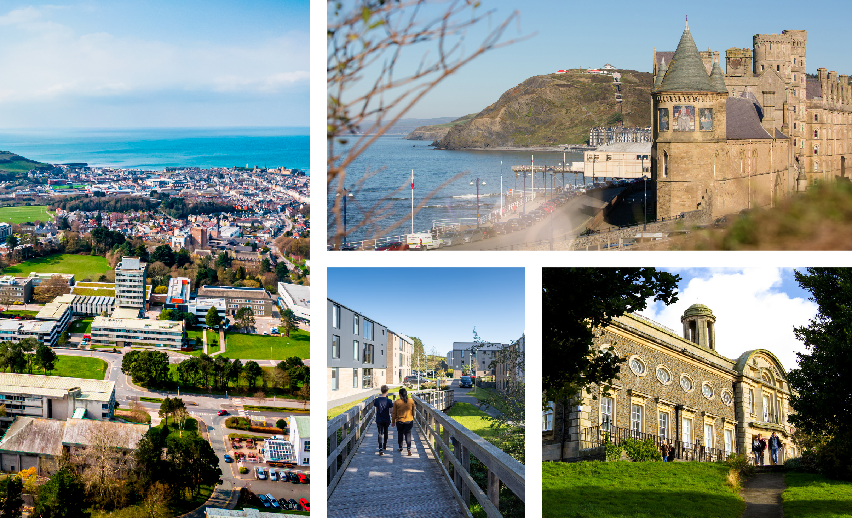
Thank you.
Are there any questions?

