Slide 1
Are You Being Served: The Importance of Service Innovation in Wales
Dr John Barker
Associate Director of Innovation (SimplyDo)
Professor Nick Clifton (Cardiff Met) Professor Gareth Loudon (Royal College of Arts)

Slide 2
Aims
To explore:
How is innovation used in Welsh medium-sized
enterprises?

Slide 3
Big Picture – Innovation
UN Sustainable Goals (United Nations, 2015) – Innovation is a “dynamic and competitive force”

Slide 4
““To sustain the planet and its future population of 8.5 billion by 2030 innovation and creativity will be vital to driving more efficient and better use of resources.”
(Denoncourt, 2020, p. 199)
Notes:
Important for driving GVA per capita and GDP

Slide 5
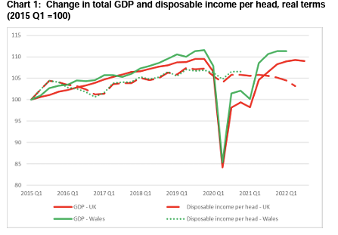
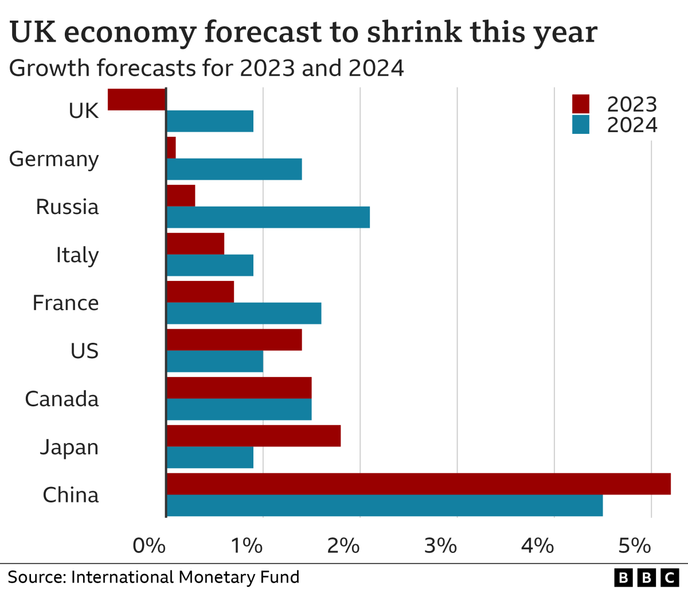
Economic Picture of UK and Wales
Forecasts from IMF show a shrinking economic picture across the UK (IMF, 2022) when compared with the other national economies
‘Scarring Effects’ – Pandemic/Brexit
- Reduction in GDP by 2% or £500 per head each year going forward
Welsh Budget 2022: Chief Economist’s Report - Jonathan Price, Welsh Government
Notes:
Office for Budgetary responsibility had predicted 3% reduction in GDP, but levelled out in real terms at 2%

Slide 6
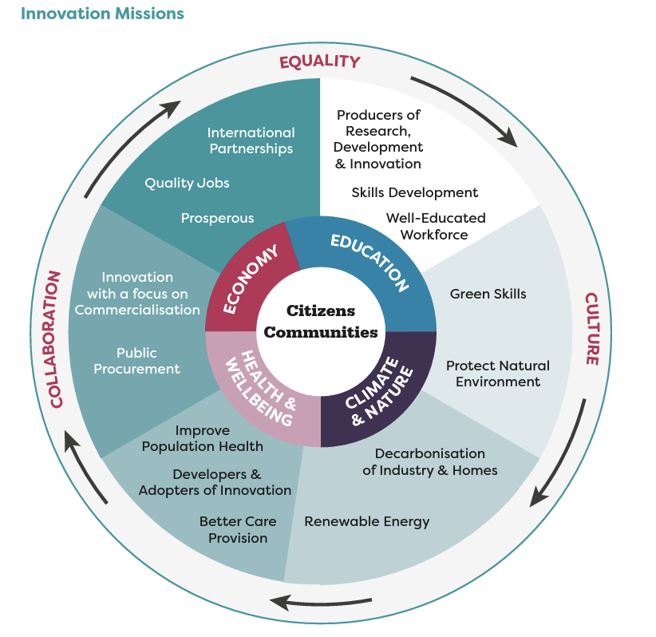
So what’s the potential solution?
“Our economy, education, wellbeing and climate missions are underpinned by our drive for Wales to be a leading, innovation-based nation. To be a society where skills, innovation and collaboration can flourish” (Minister for Economy, Vaughan Gething, 27/02/2023)

Slide 7
Innovation in medium-size enterprises – What and Why?
“We want to increase the number of grounded firms in Wales and establish a firm base of medium sized Welsh firms which are capable of selling outside Wales but have decision making rooted firmly in our communities.”
Lee Walters, AM Deputy Minister for Economy and Transport (2019)
Chartered Business Institute (CBI) – (2011) ‘Future champions Unlocking growth in the UK ’ s medium-sized businesses
Federation of Small Business (FSB) – (2017) ‘WALES ’ MISSING MIDDLE’
Development Bank of Wales – (2019) Medium-sized businesses and Welsh business structure

Slide 8
Why? | Theoretical underpinning
Focus on beneficiaries of open innovation which tend to be large corporates
(see Mortara and Minshall, 2011; Bervanakis and Dešić, 2013; Brunswicker and Chesbrough, 2018)
Focus on engine/provider of the open innovation which tend to be SMEs/academia.
(see Usman and Vanhaverbeke, 2017a; Santoro et al., 2018)
Literature on Welsh medium-sized enterprises is scarce (Rhisiart et al, 2014)

Slide 9
Quantitative Method
Method was adopted to establish a baseline of statistical information for further exploration in the qualitative study `Quantitative Data Capture
SAMPLE: Criteria (FAME Database)
All active companies
Number of employees: >=50, <250 (utilising the EU (2005) definition of Medium-sized enterprise)
Year: 2017 (01/01/2017 – 31/12/2017)
Registered address: Wales
Targeted at Innovation Stakeholders (C&D Suite)
APPROACH: Large scale questionnaire sent to total accessible population.
Population
N = 590 n = 60

Slide 10
Generalisability
Testing for generalizability was performed using comparative analysis between total accessible population and sample population.
Location: Nomenclature of Territorial Units Statistics 2 (NUTS2)
Rurality: Rural Urban Classification 2011
Sector: Standard Industrial Codes (SIC, 2007)
Age: Date of incorporation
Financial Profile: Turnover

Slide 11
Inferential Statistical Analysis
SPSS Process; Tested for normality of distribution
Applied either parametric or non-parametric testing to test for inferential relationships between variables across the study using 2x2 Cross Tabulation.
Focus here on service innovation, but to note other variables showed inferential relations namely;
(1) organizational goals and business model innovation
(2) innovation goals and organisational innovation

Slide 12
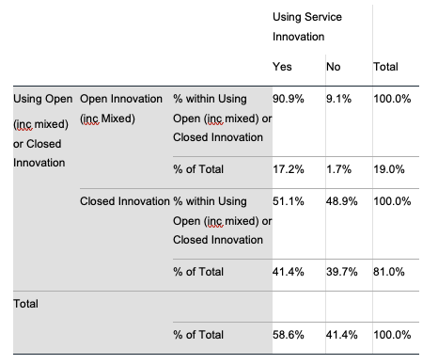
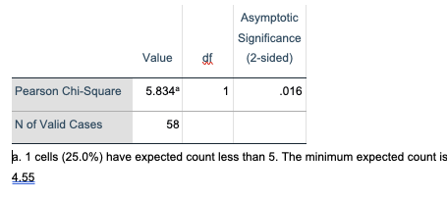
Inferential Results - Open Innovation and Service Innovation
Companies (91%) using open innovation and service innovation,
Companies using closed innovation (51%) in combination with service innovation.
Potential reasoning; Potential broad definition of service innovation - Tether and Tajar (2008)
Less risk and cost than radical innovation makes service innovation more popular (Robertson, Casali and Jacobson, 2012)

Slide 13
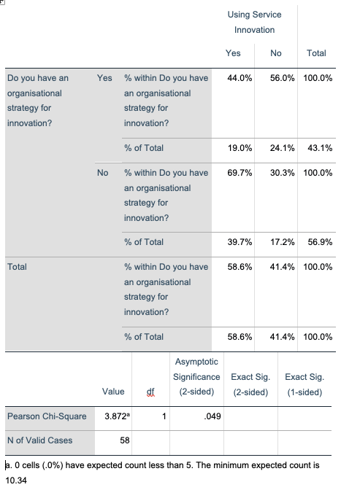
Inferential Results – Organisational Strategy and Service Innovation
Organisations that do not have an innovation strategy are more likely to use service innovation (69.7%).
Basic assumption: Service innovation is not reliant on an operationalised innovation strategy.
Potential reasoning;
Ettlie and Rosenthal (2011, p.294) explain the success of service innovation as being based on the rationale that “services are more likely to convert novelty into success”
Notes:
Smaller percentage of the sample (44%) who indicate the presence of an organisational strategy for innovation are actually using service innovation.

Slide 14
Potential Implications and Conclusions
Importance of service innovation within the Welsh economy – Medium-sized enterprises are engaged actively in this space.
This type of innovation does not require strategic innovation support to operationalize
Broader Macro Observations
Current strands of Welsh Government Innovation funding align with R&D intensive industry and technology rather than service industries.
Should they be funding innovation more broadly?
Wales Innovates Strategy: Is focused on improving public services, but is misses the importance of private sector service innovation.
More diversity in innovation funding/support will allow Wales to be a leading, innovation-based nation.

Slide 15
Thank you
Feedback, Discussion, and Questions

