Slide 1
Online Child Protection and Beyond COVID-19
Authors:
Mr Christantus Tabi
C.Tabi2@cardiffmet.ac.uk
Dr Chaminda Hewage
chewage@cardiffmet.ac.uk
Dr Sheikh Tahir
SBakhsh@cardiffmet.ac.uk
Dr Elochukwu Ukwandu
eaukwandu@cardiffmet.ac.uk

Slide 2
TABLE OF CONTENT
INTRODUCTION
OBJECTIVES
PROBLEM
LITERATURE
FINDINGS/SOLUCTIONS
RESULTS
CONLUSIONS

Slide 3

BENEFITS & ADVERSE EFFECTS
Breaching the gap and reduces physical barriers for all.
Children High Dependency on Technology
Who used the internet during COVID-19?
    Children and families
    Health
    Education
    Law enforcement
    Businesses
    The Government(s)
    Sports Organisations
    The whole world
Increases in Risk for Children while Online.

Slide 4
Child protection & strategies in managing foreseeable risk Online abuse
Child Protection Agencies:
  Children’s Services.
  Police
  Health.
  Education.
  General Public/informants via referrals or disclosures.
Strategies used by Child Protection Agencies:-
  Artificial Intelligence.
  Big Data.
  CCTV.
  Body Camera
  Referral Mechanisms
  Child Protection Investigations.
  Assessment Framework

Slide 5
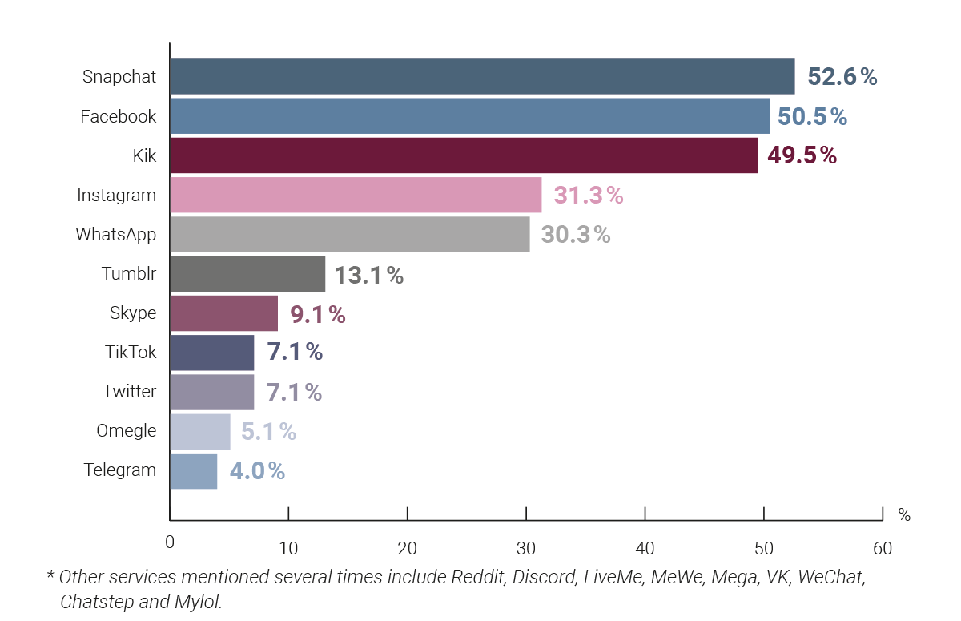
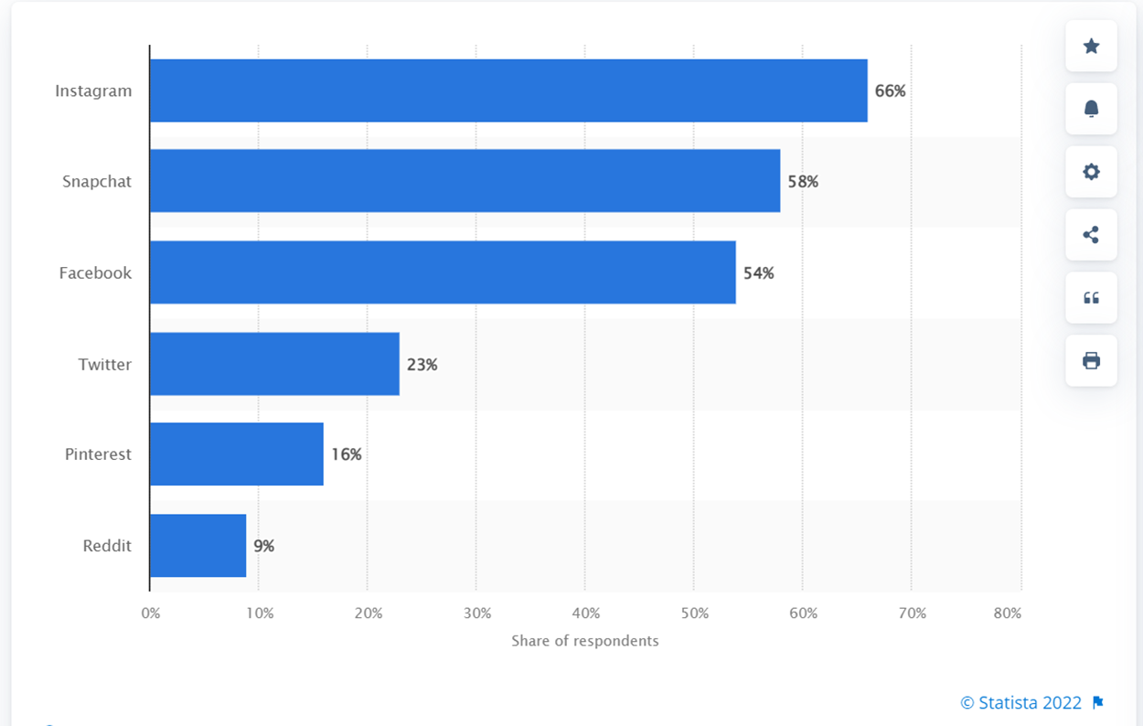
Most Popular social media platforms used by children in UK
Before 2022
In 2022

Slide 6
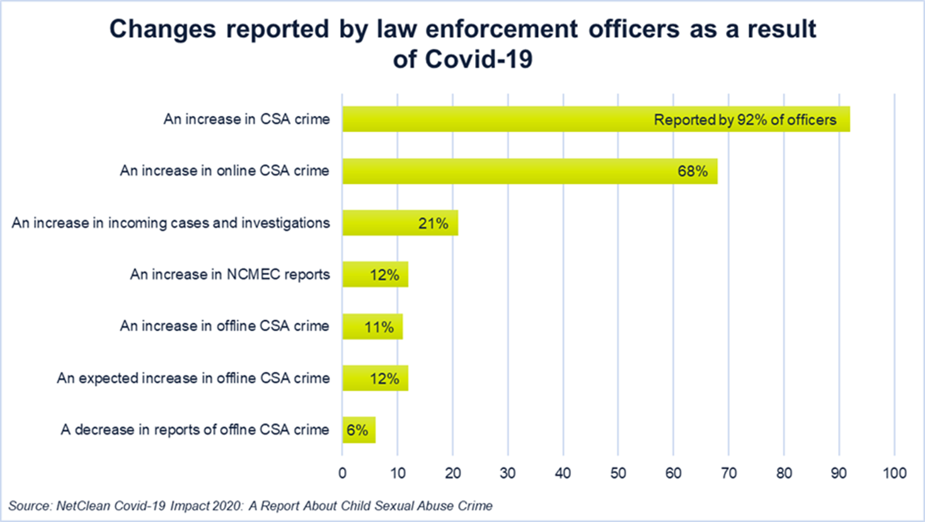
Increases in Risk for Children while Online during covid-19
Less personal interactions with families
Interest in drill music
Online dating vulnerabilities
Crime glamorisation
Bullying
Suicide
Child Sexual Abuses

Slide 7
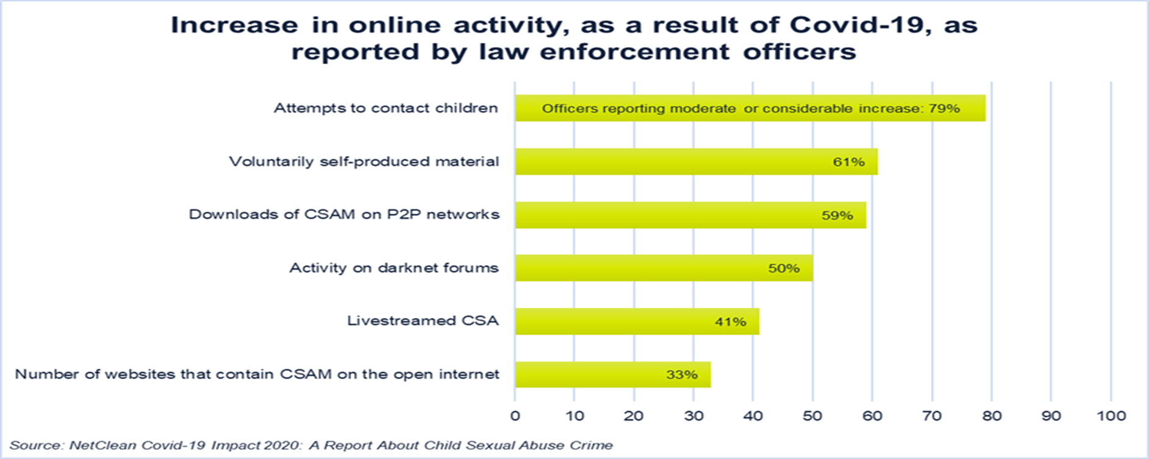
INCREASE IN ONLINE CRIME DUE TO COVID-19
More online contact than face to face.
Easy to share online materials via internet.
Available internet facilities on children’s devices.

Slide 8
Results and investigations.
1 in 6 children communicate with a stranger online.
5% met with someone they had only spoken with online.
Between 2016 and 2021 there was almost 80% online abuse in the UK (NSPCC, 2021).
5% of children in the UK met someone face to face after speaking to them online once during COVID-19 (National Statistics Centre for Crime and Justice, 2022).
1 in 20 has suffered Sexual Abuse in the UK (Statistics on Child Sexual abuse/ NSPCC Learning 2022)

Slide 9
Key message and Limitations
Online child abuses is growing almost the same pace as technology.
The choice between workforce safety and children’s safety at crossraods.
More resources required by police and social services to tackle child online abuses.
Digital globalisation is validation the necessity for collaborative approaches
Use of AI in Child Protection is limited by Human Rights/data protection and the guarantee of private life.
AI as a predictive tool can result to errors in safeguarding children online.
Ineffective reporting and monitoring mechanism on online abuses to law enforcement officers.
Aftermath of COVID-19 might bring unidentified challenges to the Child Protection Agencies.
Top to bottom approach during COVID – 19 (Critical, substantial and moderate child protection cases).

Slide 10
Thank you
Questions & answers

