Slide 1
Accessible Mobile Apps An Exploratory Study
Advancement in Management and Innovations Conference - May 2022
Dr Emmet McLoughlin, Dr Kasha Minor, Dr Vicky Richards, Dr Nic Matthews

Slide 2
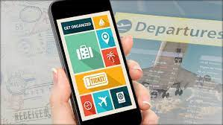
Catalyst for the research
Travel services (e.g. flight, train and bus tickets) was the second highest for inaccessibility after supermarkets despite participants utilising assistive technologies such as screen readers, magnification and dictation software (ClickView Report, 2019)

Slide 3
Context
Relates to the exploratory phase of a wider project aiming to develop accessible travel booking and mobility apps
Travel motivations of people with disabilities mirror those of people without disabilities,
Inaccessible technologies can limit choices for, and enjoyment of, travel. Information and Communication Technologies (ICT) should help disabled tourists navigate through their tourism experience,
Booking sites, information boards, travel apps, etc often come in inaccessible formats or with limited functionality for disabled users
Universal Design principles mean everyone benefits
Reflects a whole of life approach

Slide 4
Wales Council of the Blind Research
Wales Council of the Blind with Cardiff Met designed a small qualitative study to provide an insight into the accessible information needs of vision impaired travellers, their use of assistive technologies with the tourism information communication technologies, pre-travel; travelling to and from the holiday destinations.
9 interviews conducted by WCB with vision impaired people
Inconsistency of design
Not updated
Confusing technology
Universal Design
Designers and tourism providers have a role to play
Requires co-ordinated approaches

Slide 5
Catalyst
Wales Council of the Blind
Qualitative Study of accessibility of tourism-related apps
Phase 1
Exploratory Study – assessing the need for and engagement with accessible mobile apps
Quantitative Survey
Phase2
Travel Apps Qualitative study
Mobility Apps Qualitative study
Collaboration with Wales Council of the Blind
Phase 3
App Development with CTS
Phase 4
Application (visitor attraction opportunity for booking and interpretation) and trials of the app
Collating and analysing data

Slide 6
Purpose of this exploratory study
To assess the need for, and engagement with accessible mobile apps by the general population.
To identify desired features
To consider how the limitations of current technologies will be a factor in future app development
The focus
Booking apps designed to book travel and travel related sources
Mobility apps designed to aid mobility within a destination

Slide 7
Methodology and Research Design
Online quantitative survey – Qualtrics
20 Questions:
designed using the TAM
Mapped demographics
Convenience/snowballing sampling
Accessible format/alternative methods for potential vision impaired respondents
N=195 (of 325)
Analysis – Qualtrics and SPSS

Slide 8
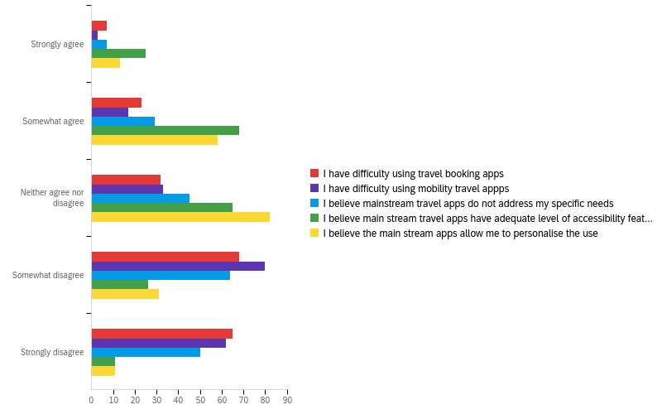
Results 1:
85 % of respondent did not consider themselves to have disability as defined by the Equality Act 2010
Generally, do not experience problems using travel and mobility apps and consider ‘main - stream’ apps to be relatively accessible
49 % believe travel apps should have more accessibility features
45 % were undecided
only 6 % believed that there is no need for more accessible features

Slide 9
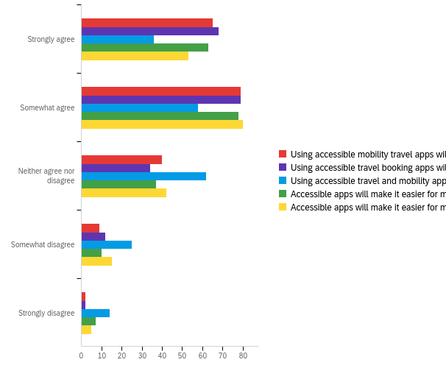
Results 2
Accessible apps will:
Improve tourism experience
33% Strongly, 41% somewhat agree
Improve booking experience
31 % Strongly, 41 % somewhat agree
Will encourage to travel more
18 % Strongly, 30 % somewhat agree

Slide 10
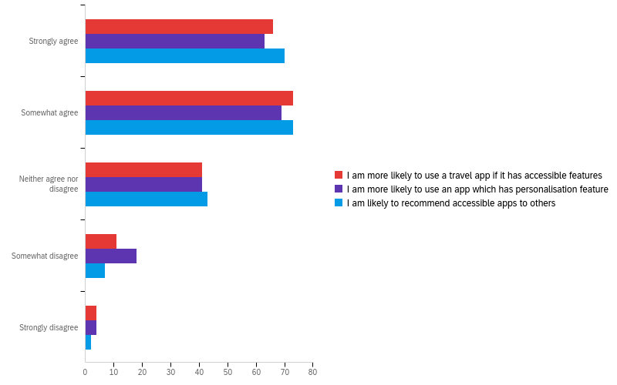
Results 3:
Accessible travel app design would encourage use
Due to accessible features
Due to ability to provide personalised content
This type of app would be recommended to others more often than not

Slide 11
Conclusions
Universal, accessible design will not deter but rather encourage main-stream use of travel apps
Confirming that:
the foundations of any tourism experience is accessibility (Darcy, 2002, 2010; Israeli, 2002)
Including accessibility of format and information
As the world is increasingly moving toward digitalised, mobile-based future, there is an increased need to consider accessibly of apps
those initial decisions and choices about travel need to come in accessible functionality to truly create inclusive environment for all

Slide 12
Thank you Diolch
Questions?

