Slide 2
The feasibility of teaching and assessing a vocational programme using blended learning in Further Education
Is it possible to teach and assess vocational students using blended learning?

Slide 3
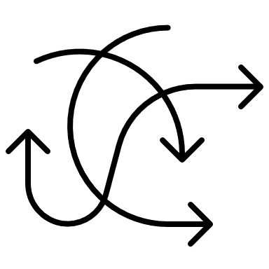
Lost learning
Learning progress
Attainment levels
Assessment outcomes

Slide 4
Practical Hospitalty vocational learning
Develop knowledge
Develop skills
Develop attitude

Slide 5
Harvey (2022) The learning pyramid Adapted from the NTL of Applied Science Learning Pyramid
Online learning =5%
Practical teaching = 90%
Discussion = 10%
Lecture = 10%
Demonstration = 30%
Practice = 80%
Learning sessions
Learner retention from sessions

Slide 6
Harvey (2022) The learning pyramid flipped Adapted from the NTL of Applied Science Learning Pyramid
On line learning =?
Discussion = ?
Lecture = ?
Demonstration = ?
Practice = ?
Practical teaching = ?
Learning sessions
Learner retention from sessions

Slide 7
How to integrate blended learning in vocational subject areas Harvey (2022) flipped classroom for vocational learning model
Be able to supervise food service
Tutor led session explaining the command verbs and assessment criteria (online)
Tutor designed work sheet, case study based on practical assessment conditions (online)
Qualification handbook
Video presentations, workbooks, reflective logs (online)
Assessment
Practical assessment (face to face)
Cognitive test, student self assessment (online)
Reflective log (online)
Peer feedback (online)
Tutor feedback (online)

Slide 8
Harvey (2022) Level three reflective log and diary page
Name: | Assessment Date: | Area of assessment: | Resources needed or used:
Online session What are your assessment objectives?
Online session What do you need to plan before the assessment?
Online session What practical duties did you perform today?
Online session General comments from you about today's session as a supervisor.
Online session What improvements will you make for the next assessment?

Slide 9
Excerpt from the thematic analysis
Student statements from diary pages | Unit
Develop a time plan | 401
Provide support and help those who need support. Provide advice | 401 x2
Ensure health and safety is followed | 404
Source ingredients | 403
Monitor food production | 401
Determine quality of produce and products | 403
Ensure correct uniform is worn | 404
Ensure uniform is clean | 404
Monitor drink production | 403
Provide a hospitable service | 405
Make a time plan | 403
Make sure everyone is in correct uniform ensure uniform is clean | 404
Decide who is where in the restaurant and kitchen | 401 | 402

Slide 10
Results of the pilot study
Number of times assessment criteria has been met

Slide 11
Conclusion
Was it possible to measure successful assessment in vocational subjects using blended learning – yes

Slide 12
References
Cassandra Davis, Harriet Hartman, and Dara Mendez, 'Understanding college persistence for first-generation college students living through Covid-19,'Center for First-Generation Student Success, September 2020. https://firstgen.naspa.org/blog/understanding-college-persistence-for-first-generationcollege-students-living-through-covid-19.
Megan Kuhfeld, Jim Soland, Beth Tarasawa, aet al., 'How is Covid-19 affecting learning?,' Brookings Institute, December 3, 2020. https://www.brookings.edu/blog/brown-center-chalkboard/2020/12/03/how-is-covid-19-affecting-student-learning/.gh-covid-19.
White Paper | The Class of Covid-19: Lessons of Today and Learning for Tomorrow. Harvard Business Review Analytic Services

Slide 13
Thank you all for listening Any questions ?

