Slide 1
An Artificial Neural Network approach for predicting antecedents of m-commerce loyalty
Dr. S. Saibaba
Assistant Professor
Shri Dharmasthala Manjunatheshwara Institute for Management Development
Mysore
India

Slide 2
Mobile Commerce – A Revolution
According to eMarketer (2022a), the retail e-commerce sales are expected to grow from $4,248 billion in 2020 $7,391 billion in 2025.
Interestingly, the growth rate of e-commerce across the world is estimated to decrease to 9.2% in 2025 from 26.4% in 2020, due to the disruption of Covid-19 pandemic crisis and other global economic conditions.
Further, the percentage of retail e-commerce sales worldwide to the total retail sales is expected to increase from 17.9% in 2020 to 23.6% in 2025.

Slide 3
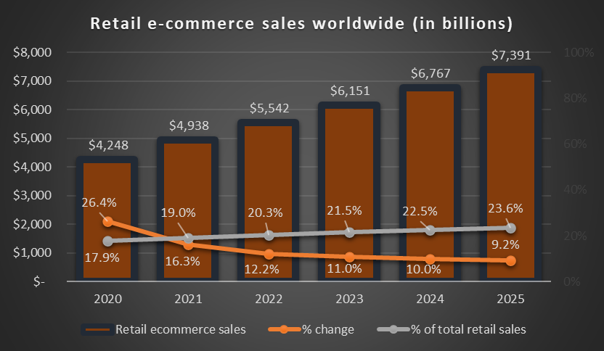

Slide 4
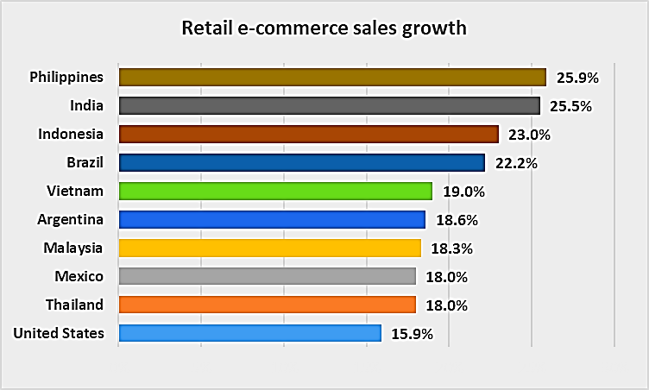

Slide 5
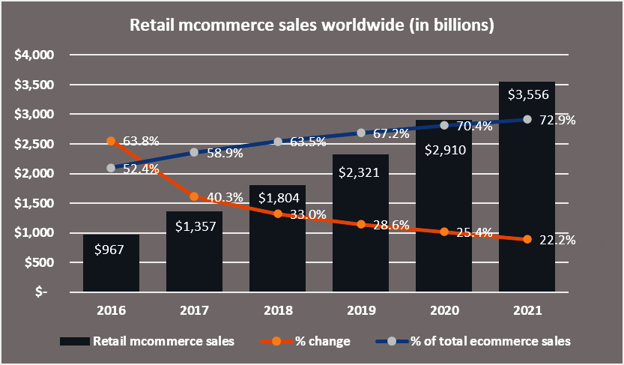

Slide 6
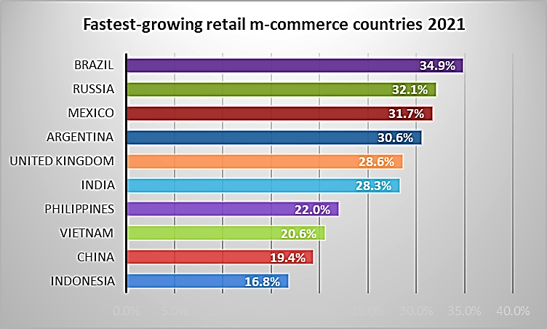

Slide 7
Objectives
The primary objective of this study is to identify the determinants of mobile shopping customers’ loyalty in India.
Further, the study aims at ranking the most significant predictors of customer loyalty in the context of mobile shopping applications.

Slide 8
Review of Literature
The theory of reasoned action (TRA) (Fishbein and Ajzen 1975),
the technology acceptance model (TAM) (Davis 1986),
the theory of planned behaviour (TPB) (Ajzen 1991),
the diffusion of innovation (DOI) theory (Rogers 1995),
the unified theory of acceptance and use of technology (UTAUT) (Venkatesh et al. 2003)
UTAUT2 (Venkatesh et al. 2012)
the expectation confirmation model (ECM) (Bhattacherjee 2001)

Slide 9
Research Model

Slide 10
Research Methodology
The primary data for this study was collected through an online survey using convenience sampling technique.
The questionnaire was designed by including (i) the measurement scales of study’s constructs and (ii) the demographic profile of the respondents.
The scale items of all constructs were derived from the previous literature on mobile shopping literature.
After the data collection for a period of 12 weeks, 535 valid responses were used for validating the proposed research framework of the study.

Slide 11
Results

Slide 12
 | SAT | LOY | HM | TR | PSO | PR | PU
SAT1 | 0.822 | 0.164 | 0.101 | 0.208 | 0.219 | 0.121 | 0.171
SAT2 | 0.781 | 0.297 | 0.122 | 0.224 | 0.251 | 0.149 | 0.178
SAT3 | 0.793 | 0.185 | 0.086 | 0.199 | 0.183 | 0.106 | 0.170
SAT4 | 0.753 | 0.301 | 0.095 | 0.209 | 0.177 | 0.197 | 0.184
LOY1 | 0.181 | 0.744 | 0.059 | 0.198 | 0.157 | 0.166 | 0.205
LOY2 | 0.212 | 0.784 | 0.148 | 0.174 | 0.214 | 0.166 | 0.151
LOY3 | 0.188 | 0.821 | 0.096 | 0.126 | 0.216 | 0.224 | 0.189
LOY4 | 0.272 | 0.747 | 0.128 | 0.120 | 0.135 | 0.188 | 0.111
HM1 | 0.103 | 0.079 | 0.920 | 0.105 | 0.090 | 0.140 | 0.202
HM2 | 0.075 | 0.093 | 0.915 | 0.119 | 0.104 | 0.135 | 0.210
HM3 | 0.120 | 0.166 | 0.906 | 0.120 | 0.130 | 0.149 | 0.155
PT1 | 0.264 | 0.141 | 0.130 | 0.864 | 0.129 | 0.098 | 0.133
PT2 | 0.179 | 0.149 | 0.115 | 0.883 | 0.153 | 0.143 | 0.109
PT3 | 0.235 | 0.242 | 0.123 | 0.874 | 0.146 | 0.133 | 0.114
PSO1 | 0.249 | 0.195 | 0.155 | 0.175 | 0.836 | 0.172 | 0.156
PSO2 | 0.252 | 0.245 | 0.112 | 0.145 | 0.840 | 0.159 | 0.178
PSO3 | 0.231 | 0.232 | 0.112 | 0.150 | 0.871 | 0.136 | 0.170
PR1 | -0.154 | -0.242 | -0.159 | -0.131 | -0.100 | -0.873 | -0.153
PR2 | -0.102 | -0.165 | -0.115 | -0.091 | -0.190 | -0.822 | -0.120
PR3 | -0.172 | -0.203 | -0.163 | -0.138 | -0.111 | -0.840 | -0.100
PU1 | 0.247 | 0.221 | 0.247 | 0.129 | 0.167 | 0.123 | 0.818
PU2 | 0.239 | 0.232 | 0.273 | 0.120 | 0.161 | 0.148 | 0.825
PU3 | 0.154 | 0.172 | 0.185 | 0.143 | 0.180 | 0.157 | 0.856
Eigenvalues | 10.954 | 2.289 | 1.725 | 1.573 | 1.295 | 1.152 | 1.082
Explained variance (%) | 47.624 | 9.952 | 7.498 | 6.841 | 5.631 | 5.009 | 4.705
Total explained variance (%) | 47.624 | 57.576 | 65.074 | 71.916 | 77.546 | 82.556 | 87.260

Slide 13
Variables | HM | PSO | PR | PU | PT | SAT | LOY
HM | 1
PSO | .350** | 1
PR | -.381** | -.434** | 1
PU | .510** | .498** | -.421** | 1
PT | .334** | .444** | -.375** | .406** | 1
SAT | .336** | .591** | -.440** | .542** | .556** | 1
LOY | .351** | .559** | -.523** | .533** | .477** | .604** | 1

Slide 14
Construct | No. of Items | Cronbach's alpha
Hedonic Motivation | 3 | 0.965
Price Saving Orientation | 3 | 0.959
Perceived Risk | 3 | 0.904
Perceived Usefulness | 3 | 0.948
Perceived Trust | 3 | 0.950
Customer Satisfaction | 4 | 0.926
Customer Loyalty | 4 | 0.903

Slide 15
Model | R | R Square | Adjusted R Square | Std. Error of the Estimate | Durbin-Watson
1 | .714ª | 0.509 | 0.504 | 1.97388 | 1.926
Predictors: (Constant), SAT, HM, PR, PT, PSO, PU
Dependent Variable: LOY

Slide 16
Model |  | Sum of Squares | Df | Mean Square | F | Sig.
1 | Regression | 2135.896 | 6 | 355.983 | 91.367 | .000^{b}
 | Residual | 2057.188 | 528 | 3.896
 | Total | 4193.084 | 534
Dependent Variable: LOY
Predictors: (Constant), SAT, HM, PR, PT, PSO, PU

Slide 17
Model |  | Unstandardized Coefficients |  | Standardized Coefficients | t | Sig. | Collinearity Statistics
 |  | B | Std. Error | Beta |  |  | Tolerance | VIF
1 | (Constant) | 8.345 | 0.830 |  | 10.057 | 0.000
 | HM | -0.006 | 0.038 | -0.005 | -0.146 | 0.884 | 0.694 | 1.441
 | PSO | 0.238 | 0.051 | 0.186 | 4.625 | 0.000 | 0.575 | 1.740
 | PR | -0.287 | 0.047 | -0.223 | -6.134 | 0.000 | 0.700 | 1.428
 | PU | 0.175 | 0.041 | 0.174 | 4.234 | 0.000 | 0.553 | 1.807
 | PT | 0.129 | 0.046 | 0.106 | 2.795 | 0.005 | 0.645 | 1.550
 | SAT | 0.257 | 0.046 | 0.244 | 5.605 | 0.000 | 0.489 | 2.045
Dependent Variable: LOY

Slide 18
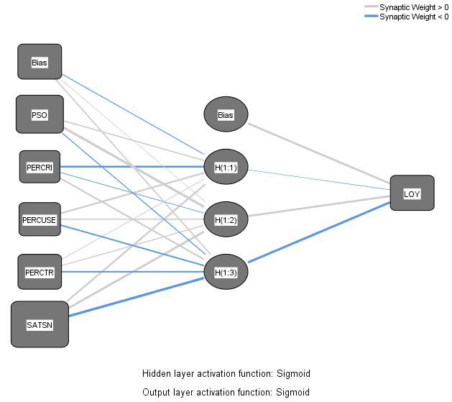

Slide 19
Training |  |  | Testing
N | SSE | RMSE | N | SSE | RMSE
475 | 3.543 | 0.086 | 60 | 0.493 | 0.091
469 | 3.887 | 0.091 | 66 | 0.485 | 0.086
477 | 3.892 | 0.090 | 58 | 0.347 | 0.077
479 | 3.731 | 0.088 | 56 | 0.540 | 0.098
476 | 3.875 | 0.090 | 59 | 0.547 | 0.096
484 | 4.002 | 0.091 | 51 | 0.321 | 0.079
474 | 3.654 | 0.088 | 61 | 0.504 | 0.091
481 | 3.807 | 0.089 | 54 | 0.395 | 0.086
485 | 4.148 | 0.092 | 50 | 0.397 | 0.089
471 | 3.554 | 0.087 | 64 | 0.584 | 0.096
Mean | 3.809 | 0.089 | Mean | 0.461 | 0.088
Standard deviation | 0.183 | 0.002 | Standard deviation | 0.086 | 0.007

Slide 20
PSO | PR | PU | PT | SAT
0.116 | 0.286 | 0.164 | 0.127 | 0.308
0.216 | 0.177 | 0.177 | 0.090 | 0.341
0.266 | 0.216 | 0.134 | 0.063 | 0.321
0.245 | 0.229 | 0.147 | 0.125 | 0.255
0.222 | 0.273 | 0.116 | 0.116 | 0.273
0.162 | 0.215 | 0.139 | 0.202 | 0.282
0.228 | 0.222 | 0.158 | 0.129 | 0.264
0.231 | 0.245 | 0.170 | 0.073 | 0.281
0.191 | 0.131 | 0.105 | 0.239 | 0.333
0.169 | 0.226 | 0.169 | 0.122 | 0.313
0.205 | 0.222 | 0.148 | 0.129 | 0.297
69% | 75% | 50% | 43% | 100%

Slide 21
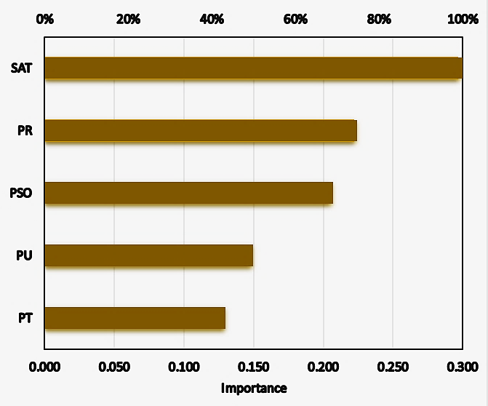

Slide 22
Conclusion
The results of multiple regression analysis have revealed that perceived risk, satisfaction, price saving orientation, perceived usefulness and perceived trust are significantly influencing the customer loyalty, whereas the impact of hedonic motivation was insignificant.
The uniqueness of this study lies in identifying the linear and non-linear relationships between predictors and customer loyalty, through multiple regression analysis and ANN. Another significant contribution is highlighting the relative importance of determinants of customer loyalty through ANN technique.

Slide 23
Key References
Ajzen, I. (1991). The theory of planned behavior. Organizational behavior and human decision processes, 50(2), 179-211.
Bhattacherjee, A. (2001). Understanding information systems continuance: An expectation-confirmation model. MIS quarterly, 351-370.
Chen, Y. M., Hsu, T. H., & Lu, Y. J. (2018). Impact of flow on mobile shopping intention. Journal of Retailing and Consumer Services, 41, 281-287.
Escobar-Rodríguez, T., and Carvajal-Trujillo, E. (2014). Online purchasing tickets for low cost carriers: An application of the unified theory of acceptance and use of technology (UTAUT) model. Tourism Management, 43, 70-88.
Oliver, R. L. (1981). Measurement and evaluation of satisfaction processes in retail settings. Journal of Retailing, 57(3), 25–48.
Thakur, R. (2018). The role of self-efficacy and customer satisfaction in driving loyalty to the mobile shopping application. International Journal of Retail & Distribution Management, 46(3), 283-303.
Venkatesh, V., Thong, J. Y., & Xu, X. (2012). Consumer acceptance and use of information technology: extending the unified theory of acceptance and use of technology. MIS quarterly, 157-178.

