Slide 1
A marketing conundrum: resolving the contradictions and primacy claims between the brand experience or customer experience literature and marketing scholars
Mrs Poorvi Agarwal, Cardiff Metropolitan University
Dr Keith Glanfield, Cardiff Metropolitan University
Dr Ahmed Almoraish, Cardiff Metropolitan University
Dr Nichola Bolton, Cardiff Metropolitan University

Slide 2
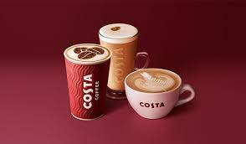
A practical issue:
An experience? What experience?

Slide 3
A proposed research study: resolving the contradictions and primacy claims between the brand experience or customer experience literature and marketing scholars
Their foundations
Brand experience literature
Customer experience literature
The counter claims
The research study

Slide 4
The foundation of both constructs!

Slide 5
Marketing experiences: cognitive psychology rules!
The Oxford Dictionary’s definition of an experience refers to “an event or occurrence that leaves an impression on someone”.
Dewey (1925), knowledge based view of experience by considering experiences to extend past the knowledge held by an individual and contesting that experience also includes perceiving, feeling and doing.
Dube and LeBel (2003), taking experiences in the direction of cognitive psychology i.e. for an individual, experiences are the result of individuals cognising the experience, not just experiencing the experience.
Pinker (1997), individuals are subject to a system of computational cognitive processes that are triggered by events and cues in the environment. Whereby, individuals sense, feel, reason and relate to what occurs in their surrounding environment.

Slide 6
Brand experience?

Slide 7
A refresher, a simple definition of a brand?
As part of their daily lives consumers encounter brands in the form of :
‘a name, term, sign, symbol. Or design, or a combination of them intended to identify the goods and services of one seller or group of sellers and to differentiate them from those of the competitors’ (Aaker, 1991).

Slide 8
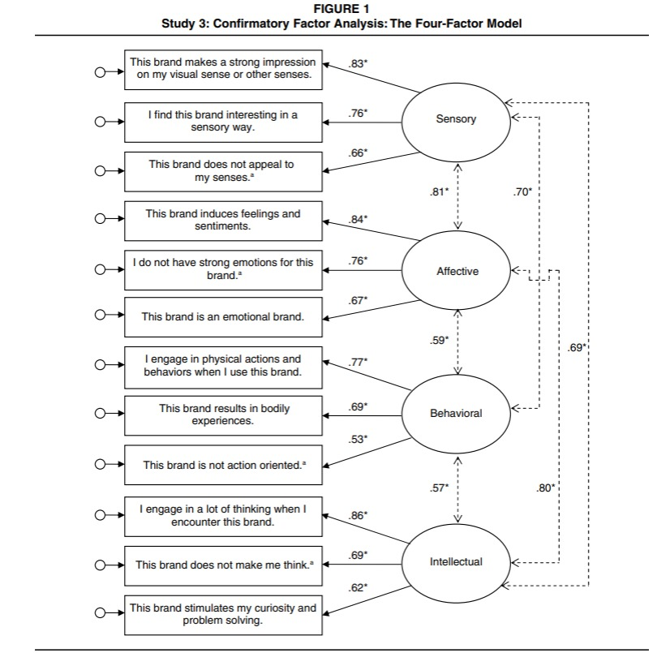
Brand experience 2009 model
J. Jo ˘sko Brakus, Bernd H. Schmitt, & Lia Zarantonello
Sensory- Strong impression on senses like see, smell, touch, taste
Affective- induces feeling and emotions towards a brand
Behavioral- how you act
Intellectual- anything to do with memory or thinking

Slide 9
What does brand experience influence?
Many, many quantitative studies establish strong relationships between brand experience and consumer marketing phenomena, most recently:
Customer loyalty (Ong, Lee & Ramayah, 2018)
Customer inspiration (Kwon & Boger, 2021)
Etc ………………..

Slide 10
Brand experience influence?
Many, many quantitative studies establish strong relationships between brand experience and consumer marketing phenomena, most recently:
Customer loyalty (Ong, Lee & Ramayah, 2018)
Customer inspiration (Kwon & Boger, 2021)
Etc ………………..

Slide 11
Brand Experience revisited: 2020 onwards!
Zha, Melewar, Foroudi, and Jin (2020)

Slide 12
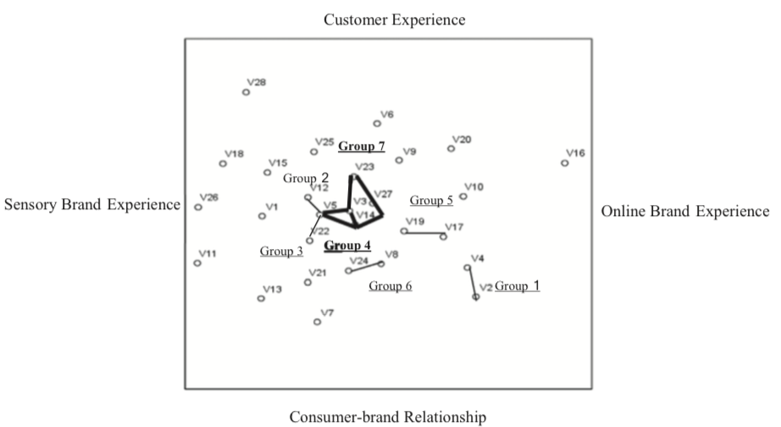
A bibliometric examination of the brand experience literature covering 136 articles published between 2002 and 2018, resulting in a database of 2698 citations.
Zha, Melewar, Foroudi, and Jin (2020)

Slide 13
Customer experience?

Slide 14
A simple definition of customer experience!
Meyer (2007) defines customer experience as :
‘the internal and subjective response customers have to any direct or indirect contact with a company’.

Slide 15
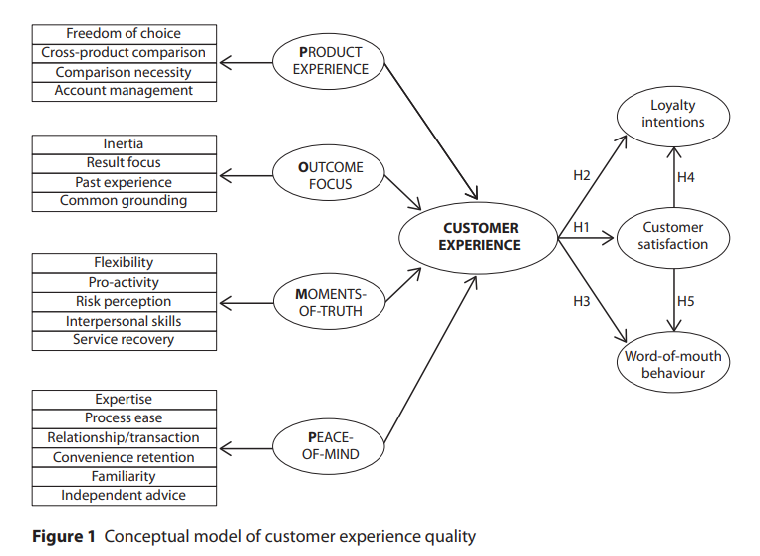
Customer Experience 2012 Model
Philipp ‘Phil’ Klaus used same factors for measuring customer experience like Brand experience.
Product experience- Sensory factor and it has impression on senses.
Outcome focus- Affective factor
Moment of truth- Behavioural factor
Peace of mind- Intellectual factor
(Klaus and Maklan, 2012).

Slide 16
Customer experience occurs as part of a customer journey! (Lemon and Verhoef, 2016).

Slide 17
Customer experience revisited: new measurement in 2021
(Kuppelweiser and Klaus, 2021)

Slide 18
The marketing conundrum?
Let battle commence!

Slide 19
A simple definition of customer experience!
Klaus, P. P. (2020). Customer experience, not brands will be on the iron throne. International Journal of Market Research, 62(1), 6-8.

Slide 20
Customer experience revisited: new measurement in 2021
(Kuppelweiser and Klaus, 2021)

Slide 21
Brand Experience revisited: 2020 onwards!
Zha, Melewar, Foroudi, and Jin (2020)

Slide 22
A bibliometric examination of the brand experience literature covering 136 articles published between 2002 and 2018, resulting in a database of 2698 citations.
Zha, Melewar, Foroudi, and Jin (2020)

Slide 23
A new research study to unpick the conundrum from first principles!

Slide 24
A. Systematically investigate the ‘experience’ literature of adjacent academic disciplines (i.e. sociology, anthropology, social psychology, medicine and so on) to identify differing ways of defining and the framing experiences for potential application in the domain of marketing.
B. Empirically (qualitatively) investigate the marketing experiences of individual consumers, to broadly categorise them and to establish against which objects individuals attribute them.
C. Synthesise the results of the systematic literature review and the qualitative research study to define, delineate and arrive at the key components of brand experience and customer experience.
D. Establish the boundary conditions for customer experience and brand experience, model the potential relationship between the two constructs and establish potential changes to the quantitative measurement of both constructs.

Slide 25
Analysis of qualitative data
Corley & Gioia (2011)

Slide 26
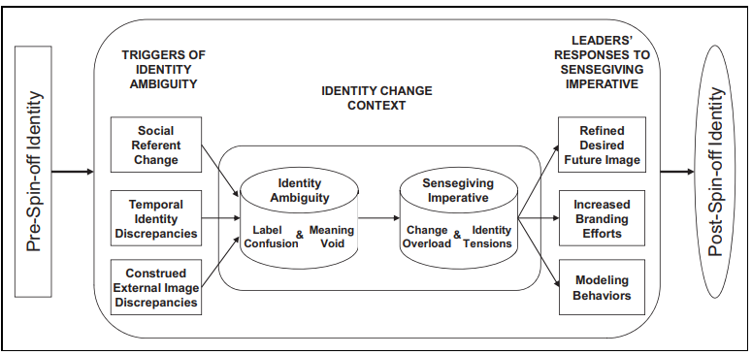
Developing TheoreticalModel
Corley & Gioia (2011)

Slide 27
Thank you!
Any questions?

