Slide 1
An Investigative Study into the Application of Automated Trading Systems in Bulgaria
Diyan Dimov

Slide 2
Contents
Introduction
Research Aim and Objectives
Literature Review and Initial Conceptual Model
Methodology
Research Findings
Analysis and Final Conceptual Model
Conclusion

Slide 3
Introduction
Research journey – discovery of a real-life issue and its subsequent investigation
Automated trading system (ATS) is a software system, sometimes called a trading robot or a bot, programmed to execute financial trading activities based on predetermined market conditions and signals (Lo, 1996; Conlan, 2016; Cespa & Vives, 2017)

Slide 4
Research Aim
The aim of this study is to investigate the potentially disruptive impact that ATS have on early adopters and to determine the best operating conditions for the implementation of such systems within an early adopter environment
This investigation will result in the development of a conceptual model which enables individual and institutional traders to identify the best operating conditions for using ATS within an early adopter environment

Slide 5
Research Objectives
The objectives of the study are:
To conduct a comprehensive literature study which identifies the current research theory behind the implementation of ATS
To formulate a clear research strategy for the implementation of the primary research phase
To undertake a detailed research program that surveys 300 traders to determine the impact of ATS
To develop a novel conceptual model that determines the best application point for the implementation and use of ATS within an early adopter environment

Slide 6
Literature Review
ATS in Bulgaria
Theoretical framework of technology adoption
Theoretical framework of ATS adoption
Technological factors
Hardware
Software
Internet
Market conditions
Cultural and ethical characteristics
Experiential considerations

Slide 7
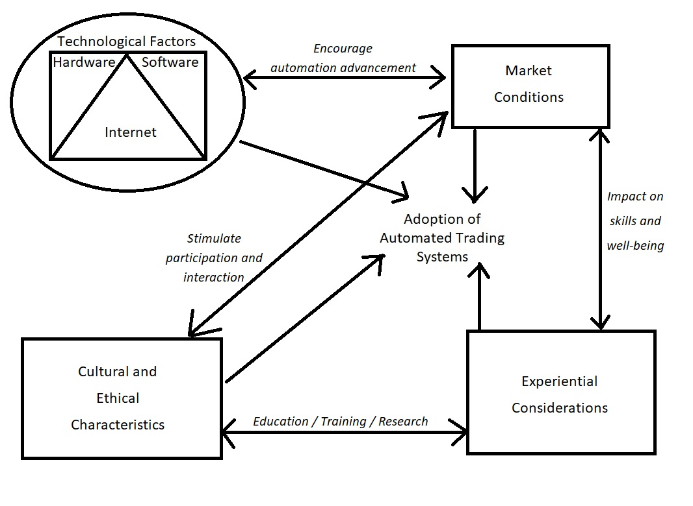
Initial Conceptual Model

Slide 8
Methodology
Research strategy
Data collection method
Time horizon
Survey population
Sampling frame and sample size
Sampling method
Questionnaire design and distribution
Analysis of the results
Validity and reliability of the results
Limitations

Slide 9
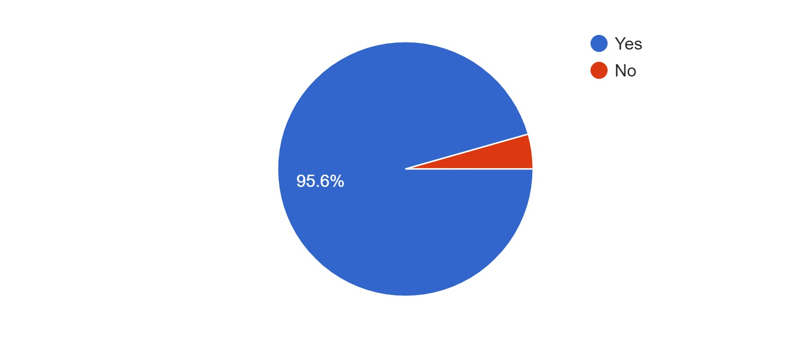
Research Findings
Primary research summary – 317 respondents
Demographics of the respondents
Core findings
Summary of the research findings

Slide 10
Analysis
Research variables
Independent variables
Dependent variables
Statistical analysis of the research findings
Independent variables interrelationships with paired samples t-test
Independent and dependent variables interrelationships with regression analysis
Revision of the conceptual model

Slide 11
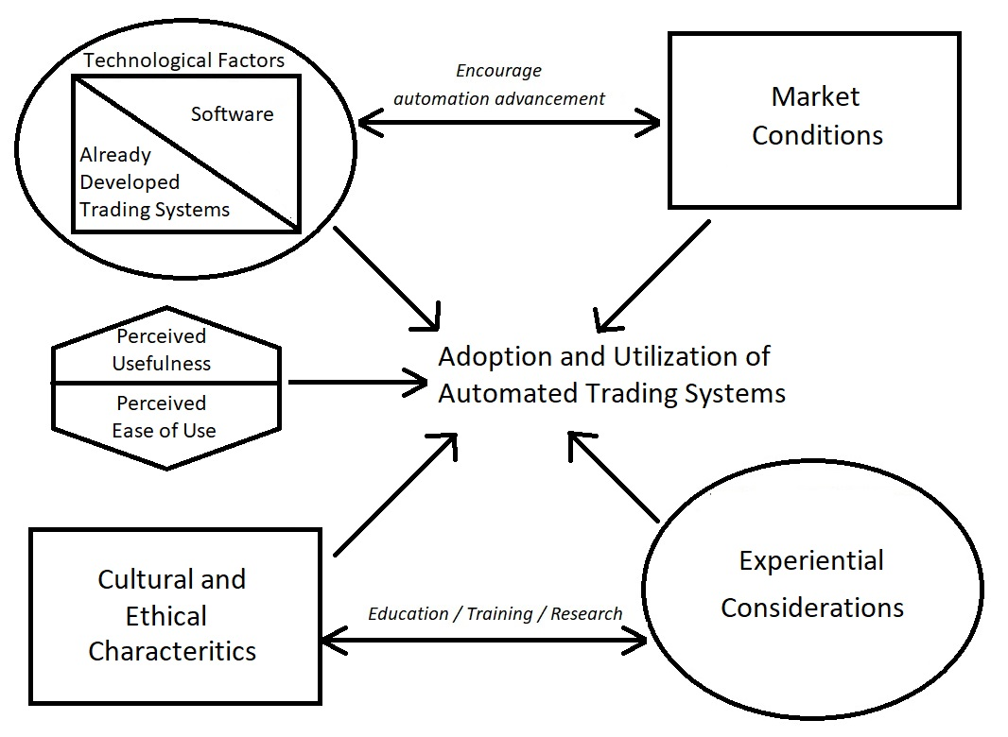
Final Conceptual Model

Slide 12
Conclusion
Review of objectives
Major findings
Study contributions
Recommendations
Limitations
Suggestions for future research

Slide 13
References
Cespa, G., & Vives, X. (2017, February). High Frequency Trading and Fragility. European Central Bank Working Paper 2020. Retrieved on August 19, 2021, from https://www.ecb.europa.eu/pub/pdf/scpwps/ecbwp2020.en.pdf
Conlan, C. (2016). Automated Trading with R: Quantitative Research and Platform Development. Cambridge, MA: Academic Press.
Lo, A. W. (1996). The Industrial Organization and Regulation of the Securities Industry. Chicago, IL: The University of Chicago Press

