Slide 1
Industrialisation, Ecologicalisation and Digitalisation (IED): Building a theoretical framework for sustainable development
Yongjiang Shi, University of Cambridge
Jialun Hu, Queen Mary University of London
David Tianxin Shang, University of Cambridge
Zheng Liu* (corr.), Cardiff Metropolitan University
zliu@cardiffmet.ac.uk
AMI2022 - The 6th Advances in Management and Innovation Conference, Cardiff, 19th-20th May 2022

Slide 2
Research background
Manufacturing has witness significant transformation (Shi and Gregory, 2005). However, there are many challenges due to the increasing scale of industrialisation (Shi et al., 2021).
New sustainable approaches considering the balance of environmental and business ecosystems (Moore, 1993; Hou and Shi, 2021) becomes increasingly important, considering the ecological problems in advance when designing the production system.
Digital transformation provide new opportunities for industrialisation and green innovation (Kiel et al., 2017; Sung, 2018; Lanzolla et al., 2020).
The integration, co-evolution and synergy of IED is required to reach dynamic balance and sustainability.

Slide 3
Research aim and objectives
To explore the current research themes of IED, and develop a theoretical framework to integrate these three aspects;
To propose a research agenda to further enrich and validate the theoretical framework.

Slide 4
Ecologicalised industrialisation: towards the IE3 model
Industrialisation and emerging challenges
- Definition of industrial system (Royal Academy of Engineering, 2012)
Ecologicalisation of industrial system
- Industrial symbiosis/circular economy etc. (MacArthur, 2013; Valenzuela-Venegas et al., 2016)
Resource cascading for more sustainable development
- Cascading process (Campbell-Johston et al., 2020)

Slide 5
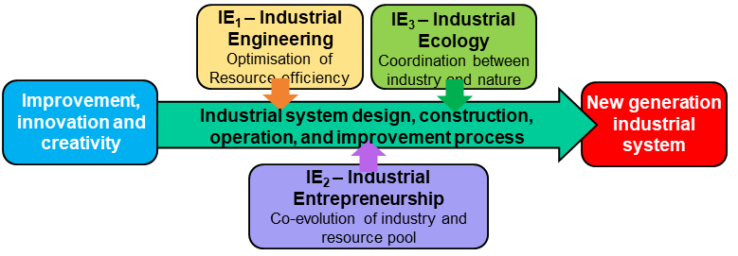
IE³ Integrated Model

Slide 6
Digitalisation: its position in industrialisation and ecologicalisation (D1 + D2)
D1: Digitalisation of industrial system (Pizzi et al., 2021; D’Amico et al., 2021)
Industrial system digitalisation (Overviews – digital technology applications in the industrial systems and operations management processes)
Digital Technology Applications/Deployments in the Industrial Systems: Industry 4.0 …
Digital Technology Applications/Deployments in the Operations Management Processes (design – operations – improvement)

Slide 7
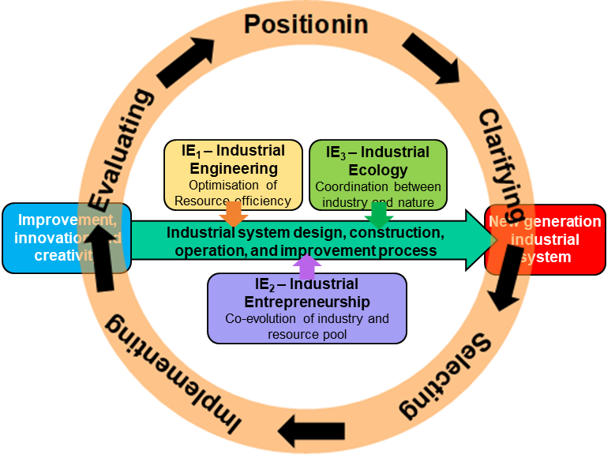
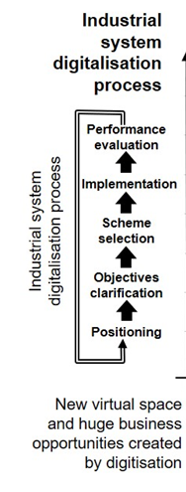
Successful experiences of the applications will encourage wider range of further deployments/ industrialisation of the digital technology

Slide 8
Digitalisation: its position in industrialisation and ecologicalisation
D2: Digitalisation of industrial system (Kiel et al., 2017; Sung, 2018; Lazolla et al., 2020; Yu et al., 2016)
How to build a new industry based on a new technology?
Different Processes of “Industrialisation”:
New product development (existing/established firms’ NPD)
Commercialisation (entrepreneurial process)
Industrialisation – emergence of industry
Some gaps identified in the processes

Slide 9
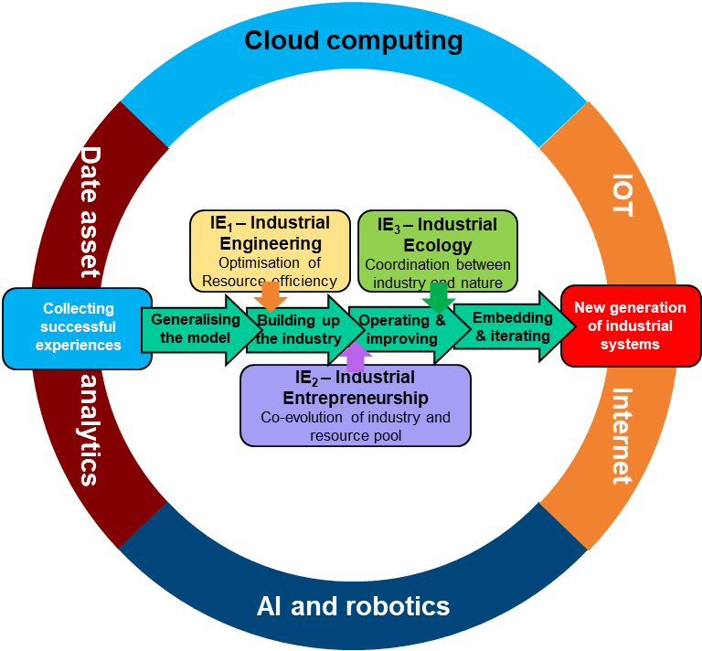

Slide 10
Research question:
How to integrate the three aims - industrialisation, ecologicalisation and digitalisation (IED) for sustainable development?”

Slide 11
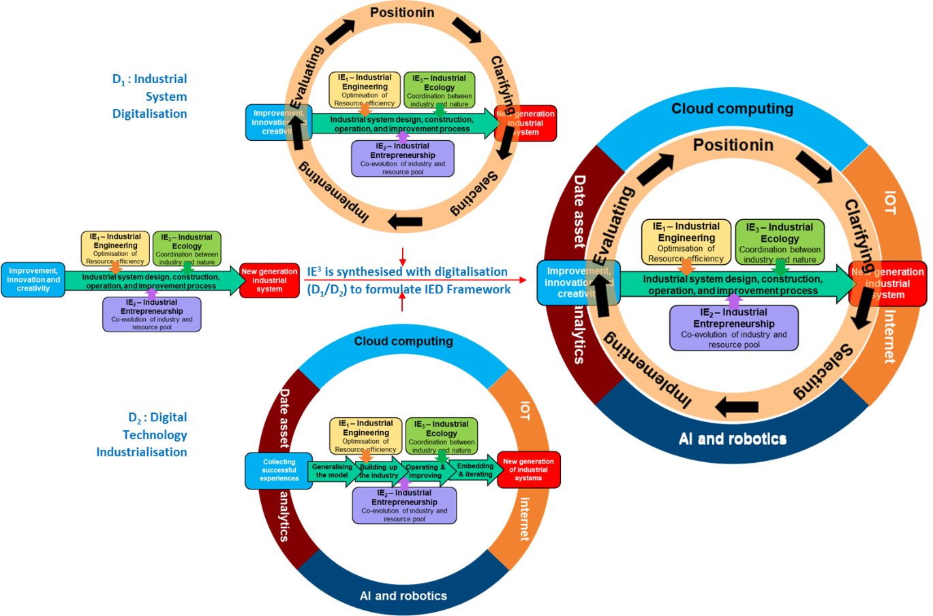
A theoretical framework to integrate IED

Slide 12
Discussion
Why do we need to have this complex framework?
What can an academic research framework offer in a theoretical development?
From a practical perspective, will the framework benefit industrialists and policy makers?

Slide 13
Research design for future exploration
Research Design Research Module |  | Research Module Objectives | Main Research Module Tasks | Key Research Approaches | Main Research Process/Stages
IE₁ Module – Industrial Eng.
IE₂ Module – Innovative Entrepreneurship
IE₃ Module – Industrial Symbiosis for New Value Creation
D₁ Module – Industrial System Digitalisation
D₂ Module – Digital Technology Industrialisation
Synthesising Modules | Resource cascading platform
 | Social resource development platform
 | Waste/by-product symbiosis platform
 | Digital central-end hub
 | Open module for the emerging requirements

Slide 14
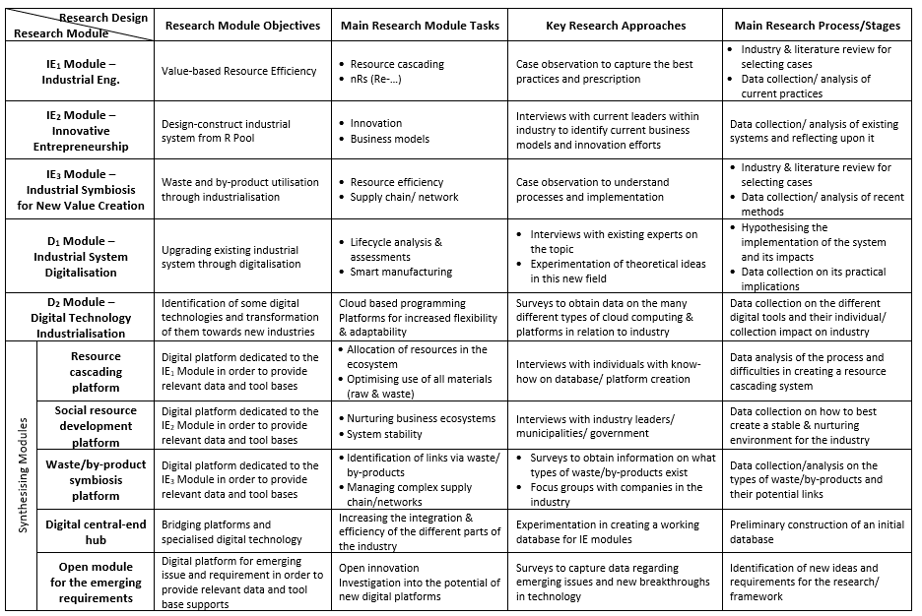

Slide 15
Conclusion
Theoretical contribution and findings
Theoretical framework based on critical literature review to integrate IED
New research methodology: process oriented abductive research method
Implications to the business practice
Future collaboration on IED research

Slide 16
Industrialisation, Ecologicalisation and Digitalisation (IED): Building a theoretical framework for sustainable development
Thank you!
Yongjiang Shi, University of Cambridge
Jialun Hu, Queen Mary University of London
David Tianxin Shang, University of Cambridge
Zheng Liu* (corr.), Cardiff Metropolitan University
zliu@cardiffmet.ac.uk
AMI2022 - The 6th Advances in Management and Innovation Conference, Cardiff, 19th-20th May 2022

