Slide 1
AMI 2021
The 5th Advances in Management and Innovation Conference 2021
Cardiff School of Management
Distributed Computer System to Display the Water Footprint of a Product in Real Time
Authors:
Sofía Isabel Vera Vega and José Manuel Cuenca Lerma
Coatzintla, Veracruz, Mexico. May 2021.

Slide 2
Water Status
2000 millions of people lack access to potable water in the world.
In Mexico, 80.4% of the national territory have presented a drought condition.
Measures to prevent COVID 19 breakout change water consumptions. That increase 12 times their demand in Mexico.
47% of Mexicans does not have regular access to water.
References:
ONU. (2021, March 11th). Agua. Organización de las Naciones Unidas. https://www.un.org/es/sections/issues-depth/water/index.html
Luna, A. (2021, March 3rd). El oscuro panorama por las sequías en México: crisis alimentaria, incendios y muerte. Infobae. https://www.infobae.com/america/mexico/2021/03/03/el-oscuro-panorama-por-las-sequias-en-mexico-crisis-alimentaria-incendios-y-muerte/
Toche, N. (2021, March 15th). La pandemia cambió los hábitos de consumo del agua: el grave problema que viene. El economista. https://www.eleconomista.com.mx/arteseideas/La-pandemia-cambio-los-habitos-de-consumo-de-agua-el-grave-problema-que-viene-20210215-0144.html
Quijano, D. (2021, March 2nd). La necesidad de infraestructura hídrica en México. Inmobiliare. https://inmobiliare.com/la-necesidad-de-infraestructura-hidrica-en-mexico/

Slide 3
State of the Art Work
Measure guidelines of water footprint in farms.
Measurer stations to track water footprint in crops.
Water footprint impact in the industry sector.
Sharing Knowledge with Augmented Reality Technology.
References:
Nagypál, V., Ördög, D., László, Z. y Mikó, E. (2019). Factors affecting water use and water footprint of dairy farms. 2019 7th International Youth Conference on Energy (IYCE), 8138-8143, doi: 10.1109/IYCE45807.2019.8991577.
Koley, S. (2020). Estimation of the Green and Blue Water Footprint of Kharif Rice Using Remote Sensing Techniques: a Case Study of Ranchi. 2020 IEEE India Geoscience and Remote Sensing Symposium (InGARSS), 1-4, doi: 10.1109/InGARSS48198.2020.9358924.
Romeni, G., Appio, F., Martini, A. Mercat, B., Jean-Marie, A. y Joubert, C. (2020). Enhancing Ecoinnovation Performance: Evidence From a Water Footprint Assessment in the Manufacturing Industry. IEEE Transactions on Engineering Management, 67(3), 724-739. doi: 10.1109/TEM.2019.2893968.
Cuenca Lerma, J.M. y Herrera Vera, C. (2021). Distributed Computer System to Display the Atomic Elements in an Object with Augmented Reality. International Journal of Science Academic Research, 2(1), 862 - 866. https://scienceijsar.com/sites/default/files/article-pdf/IJSAR-0392.pdf

Slide 4
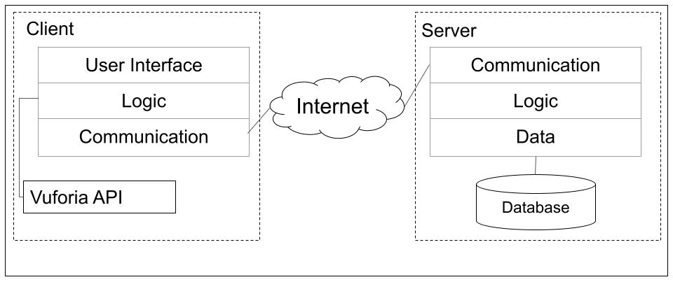
System Design
System Architecture

Slide 5
System Implementation
Technologies Implemented
 | Client | Server
Back-End | C# | Php
Front-End | XML | -
APIs | Vuforia | PhpSlim
Data Storage | - | MySql
Publication Platform | Google Play Store | Hostinger

Slide 6
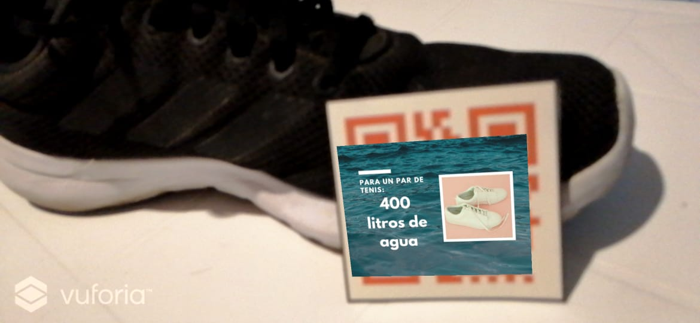
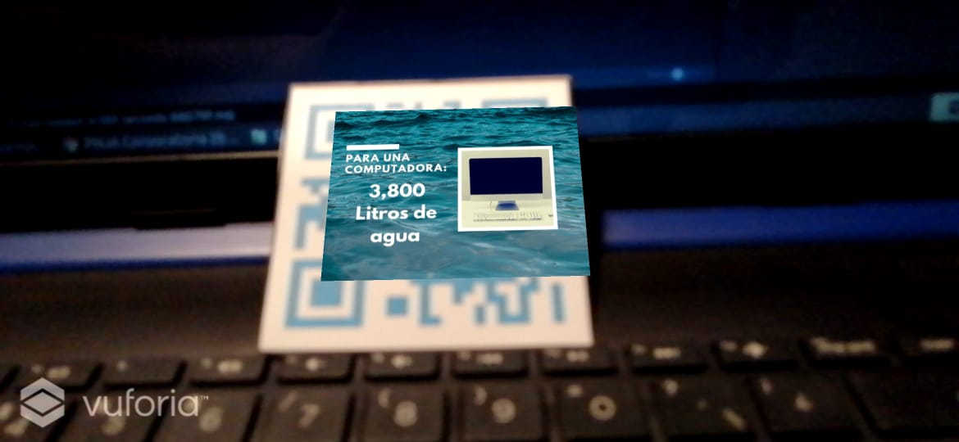
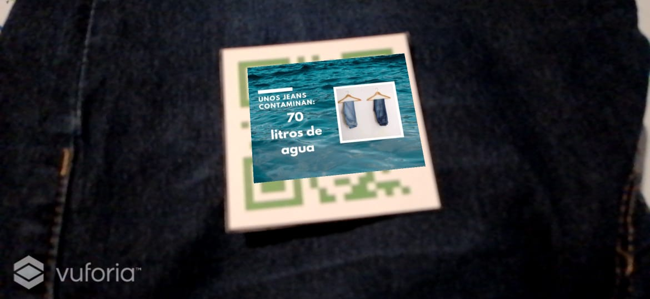
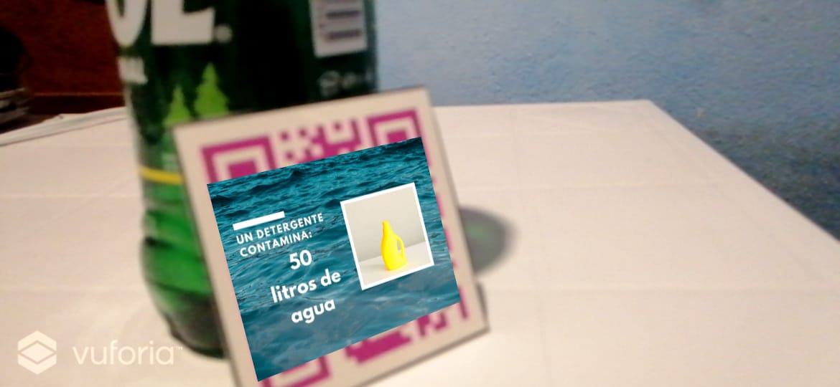
System Implementation
System Usage Scenarios

Slide 7
Conclusions
The system achieve the Quality Software Standards of Google Play.
The system is implemented at Colegio Agustín de Hipona.
The System facilitates the data access about products' water footprint.
It is contributing to achieve the UN Sustainable Development Goals.
AI Modules will be implemented in future works.

Slide 8
AMI 2021
The 5th Advances in Management and Innovation Conference 2021
Cardiff School of Management
Distributed Computer System to Display the Water Footprint of a Product in Real Time
Authors:
Sofía Isabel Vera Vega and José Manuel Cuenca Lerma
Coatzintla, Veracruz, Mexico. May 2021.

