Slide 1
Innovation in Crisis: an examination of the interoperation of Triple Helix actors in response to Covid-19 pandemic
Steffan James, University of South Wales
Zheng Liu* (zliu@cardiffment.ac.uk) , Cardiff Metropolitan University,
Victoria Stephens, University of South Wales
Gareth White, University of South Wales
- A presentation for the Cardiff Metropolitan University Advances in Management and Innovation Conference Paper Development Workshop (20th May 2021)

Slide 2
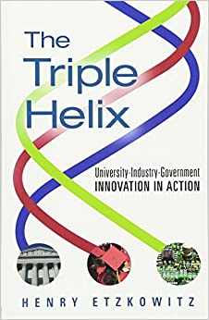
Research background
Covid-19 pandemic has resulted in huge disruption to the healthcare sector. In response to it, there have been collaborative efforts among universities and industry in terms of product and service innovation.
Triple Helix has been – implicitly and explicitly – used as a model for economic development in the South Wales region.
Triple Helix (Etzkowitz and Leydesdorff, 1995) theories shows non-linear interaction among university, industry and government at regional level. The innovation is driven mainly by government centralised support or university project with clear practice purpose.
However, current literature cannot explain sufficiently on how Triple Helix functions during the crisis (Etzkowitz, 2012; Rodrigues and Melo, 2012; Oksanen and Hautamiki, 2014).

Slide 3
Research aim and methodology
This study aims to contribute to our understanding of how the triple helix functions in response to the Covid-19 crisis.
It also contributes to the limited literature that examines the operation of systems of innovation in response to current crisis and does so through study of the on-going events.
Three case studies: three USW medical innovation projects in response to Covid-19 crisis
Data collection: semi-structured interviews (Denscombe, 2010), Oct 2020, each lasting 1 hour
Data analysis: 5 step thematic analysis (Guest et al., 2012; Castano et al., 2019; Locke, 2001; Strauss and Corbin, 1998; Sandelowski, 1993)

Slide 4
Case One – Optical Oximeter
“we were genuinely concerned that people COULD actually lose their lives if we don't get, you know, get this delivered.”
“it was 4:30 in the morning, and they were tired, I said, “come on, guys, I'm older than you. I can stay up, yeah? We've got to finish this off.””
“I wouldn't say it's the university, I think it's probably more likely to be one individual, right, ummm, who has decided that”
– Case One project leader
Starting: March 2020 - required to monitor patients undergoing CPAP treatment. Existing supply chains would be overburdened, and government initiated through asking university what was possible
During the project:
Individuals from the university, industry, and government facilitated the project, going above and beyond what was expected to meet deadlines.
Innovation transitioned from a 'pull' to a 'push'
Ending: Feasible product developed, emergency use permission obtained. Opportunities to develop further as a spin off company or through licensing manufacture

Slide 5
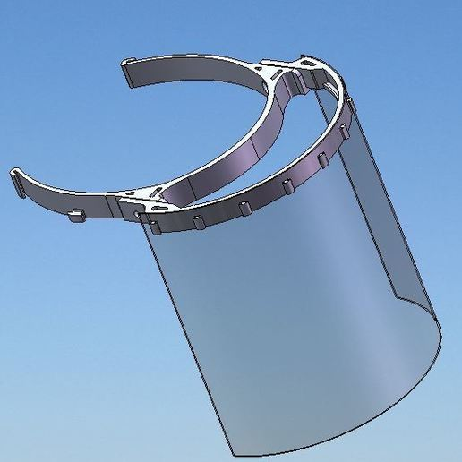
Case Two - 3D printed visors
Starting: March 2020, passion and responsibility, resource (3D printer)
During the project:
Quick prototype design
Production inside the University (160 per day)
Team: E&E engineers, 3D printing experts, aircraft maintenance and mechanical technicians
Department and University support
No external partner, no government support
Ending: May 2020, global PPE supply chain recovered,
2400 visors to 84 institutions (care homes)
“if we had an opportunity and resources and contacts to deliver to every single person between South Wales to produce with the visor, that should have been our end goal.”
– Case Two project leader

Slide 6
Case Three - Rapid Diagnostic Test
“At first I was reluctant because I just thought ‘it's too much of a tangent, we've got so much on’, and then, as the pandemic got worse and worse, I [felt] like it was my civic duty to work on this. I just thought, ‘it's crazy that we've sat here doing nothing when we could be trying to help by developing a test that doesn't exist’ ”
– Case Three project leader
Starting: Need for rapid, point of care testing; motivated by opportunity to adapt existing technology and ‘civic duty’; aim to adapt and re-deploy existing technology.
During the project:
Working with health board to develop, test and validate the device.
Working with industry to manufacture the device
Innovation enabled by collective commitment and University support (access, funding), as well as hampered by ‘business as usual’
Ending: Project ongoing. Clinical testing with a view towards getting product to market in 2021
Notes:
The third case concerns the development of a rapid new test for the underlying SARS-CoV-2 virus
Before the pandemic hit, a multi-disciplinary team with specialisms across micro-biology, molecular genetics and electronic engineering, working on a platform technology that could facilitate the rapid test of UTIs.
Technology adapted to enable rapid testing for the virus underlying Covid-19.
Central to the initiation and progression of the project was the removal of bureaucratic barriers and the mobilisation of financial and human resources across the University to support the innovation project, and expedite the innovation process:

Slide 7
Cross-case Thematic Analysis: Preliminary findings
Supply Chains
Push vs. pull innovation
Medical certification
Patent and prototype
Team/communication/trust
University/ Internal politics

Slide 8
Preliminary finding: Supply chains
Shortage of supply at a global level → need to develop bespoke supply chain structures to support innovation (All cases).
The international travel restrictions → growing need for local supplies (Case One, Case Three) or internal supplies (Case Two).
The need to access and communicate with industry partners more easily, e.g. through the government (Case One) → a ‘local’ and ‘short’ supply chain.
The cases highlighted a short term perspective on the development of the supply chain, without explicit focus on the long term structure and scope of the supply chain. Nonetheless, the long term opportunities emerged.

Slide 9
Cross-case Thematic Analysis
Preliminary finding: Team/communication/trust
Serendipity
"I didn't know him to be honest with you, right, … I hadn’t spoke to him…..I think I might've bumped into him…some place before….errm…. which he remembers, I don’t, you know, but, we had had some interactions but I couldn’t remember" - Case 1
"one of my colleagues, … she actually seen one of the video on that particular website, saying by using this 3D printer, you can print some visors, right? And then she forwarded that link to me saying, ... seems interesting, do you want to look into further?" - Case 2
"he has no sense of time or like personal space or anything, so he just {laughing} phones up whenever he wants and…ummmm… and I hadn't spoken to him for months. And he'd phoned up about something entirely different" - Case 3

Slide 10
Next steps…
Analysis of the other themes…
Theory framework/contribution to the Triple Helix Innovation
- Existing literature posits Triple Helix as a means of economic development - 'continuous innovation'
- Our findings explore the function of Triple Helix and its actors in response to a crisis - 'rapid innovation'

Slide 11
Innovation in Crisis: an examination of the interoperation of Triple Helix actors in response to Covid-19 pandemic
Thanks for listening!
Questions?
Steffan James, University of South Wales
Zheng Liu, Cardiff Metropolitan University,
Victoria Stephens, University of South Wales
Gareth White, University of South Wales

