Slide 1
Collaborative Community-based Self Expanding E-Learning Model (CCSE)
Shalini Anita Chellaraj, University of South Wales, Dr. Fiona Carroll, Cardiff Met University
Special Thanks to Dr. Daniel Cuniffe, University of South Wales

Slide 2
Contents
Introduction
CCSE eLearning model highlights
Uniqueness of this study
Theory behind community-based eLearning system
Screen short of the Application design
Plans for testing
Q&A
Research motive
CCSE eLearning model Architecture
Evaluation, interaction, resources provided by CCSE
Demo

Slide 3
Introduction
CCSE eLearning Model highlights
Learner engagement
Reflection
Motivation
Construction of knowledge
Effective peer support
Assessment & feedback

Slide 4
Research motive
To evaluate the effectiveness of the CCSE model in enhancing community ability to generate new knowledge
To measure community enjoyment in learning, contributing and providing peer support

Slide 5
Uniqueness of this study
Existing e-learning tools and frameworks require teachers as mediators
01
Existing models lack an integrated and scalable learner-driven collaborative framework
02
The CCSE eLearning model do not require teachers as mediators
03
Any learners can be promoted as Leaner Advocate gaining pedagogical responsibilities when they gain enough points
04

Slide 6
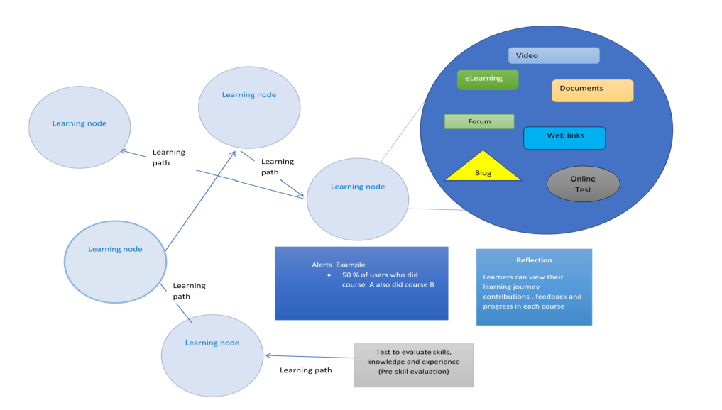
CCSE eLearning model Architecture

Slide 7
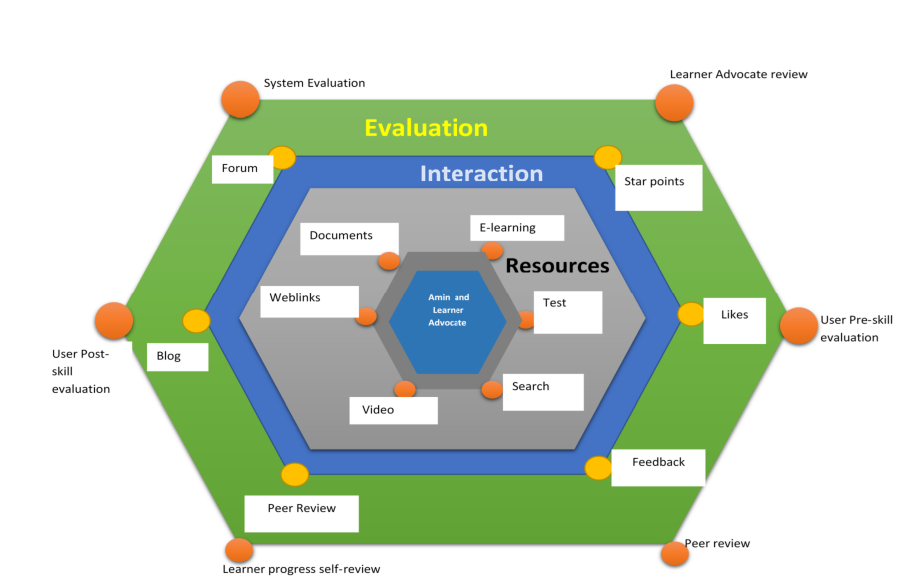
Evaluation, interaction, resources provided by CCSE

Slide 8
Theory behind community-based eLearning system
Blended learning, constructivism, collaboration, distributed leadership, reflection, hedonic and utilitarian IT
CNNE Cooperative Neural-Network Ensembles (CNNEs) algorithm proposed by Islam et al. (2003) is used to add learning nodes

Slide 9
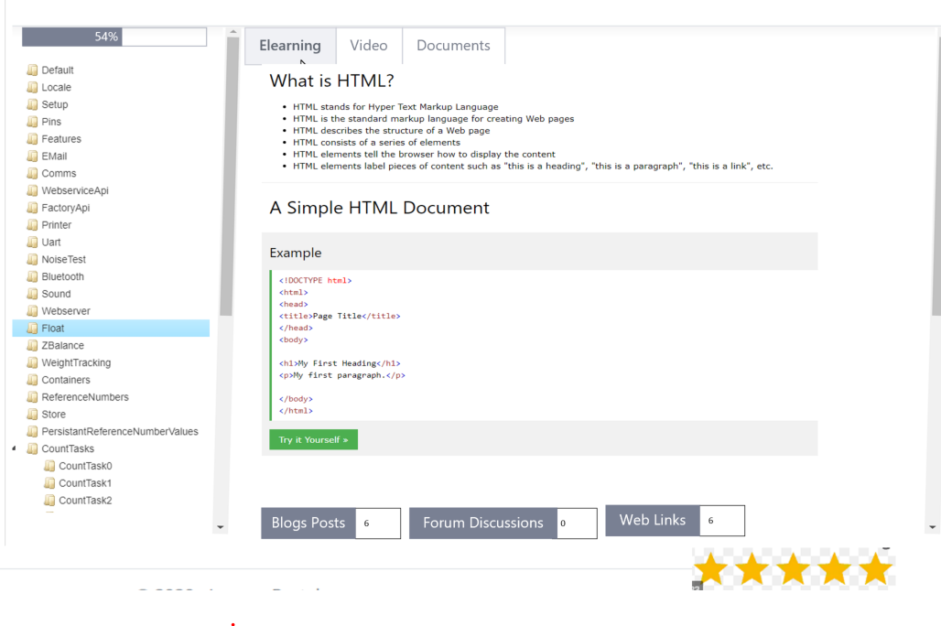
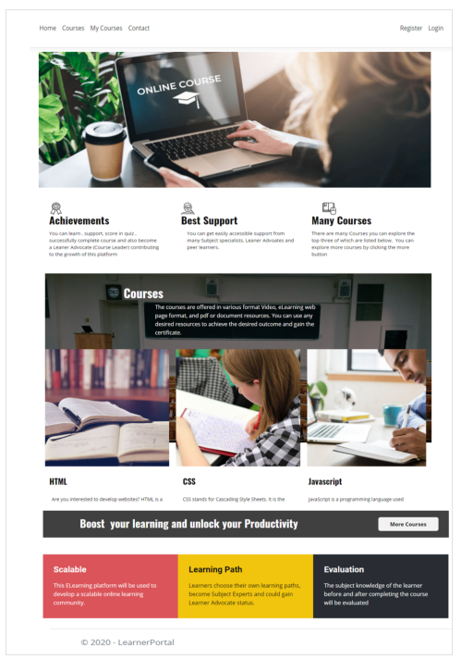
Screen short of the Application design

Slide 10
Plans for Testing
Cardiff Met students of Dr. Fiona Caroll
ERASMUS Sport Employability Project employability tool kit hosting
International testing with students of Dr. Radhikaselvamani Velammal College

Slide 11
Demo

