Slide 1
Exploring the Role of Gender in Promoting Work from Anywhere in the New Normal
Gautam Agrawal, Doctoral Scholar
Rubal Rathi, Doctoral Scholar
BML Munjal University
Gurugram, India

Slide 2
LET’S START WITH FACTS…
76% vs 54%
70% vs 44%
1.5x

Slide 3
Evolution of remote working
From Work-from-home (WFH) to Work from Anywhere (WFA)
How are they different?

Slide 4
What does literature tell us?
Acceptance of adaptive workspaces
Many nomenclatures over time
Focus of studies on
- Better work-life balance
- Performance
- Gender-equality

Slide 5
Cons
Pros
Work from Anywhere- what works, what doesn’t…
Increased coordination costs
Limit tacit coordination
Increased knowledge sharing costs
Professional isolation
Geographic flexibility
Psychological advantages
Financial benefits
Increased productivity

Slide 6
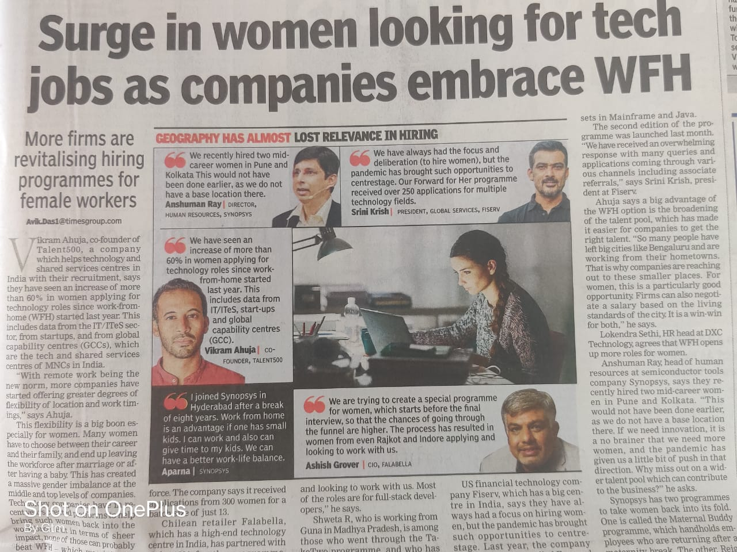
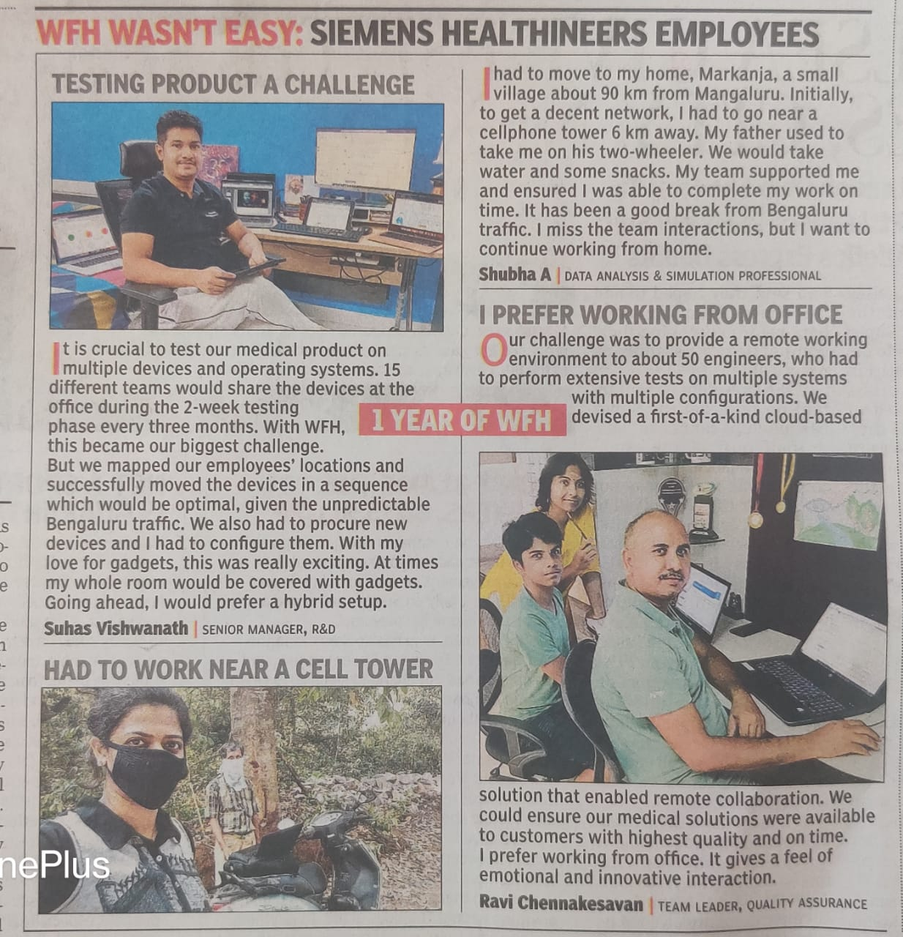
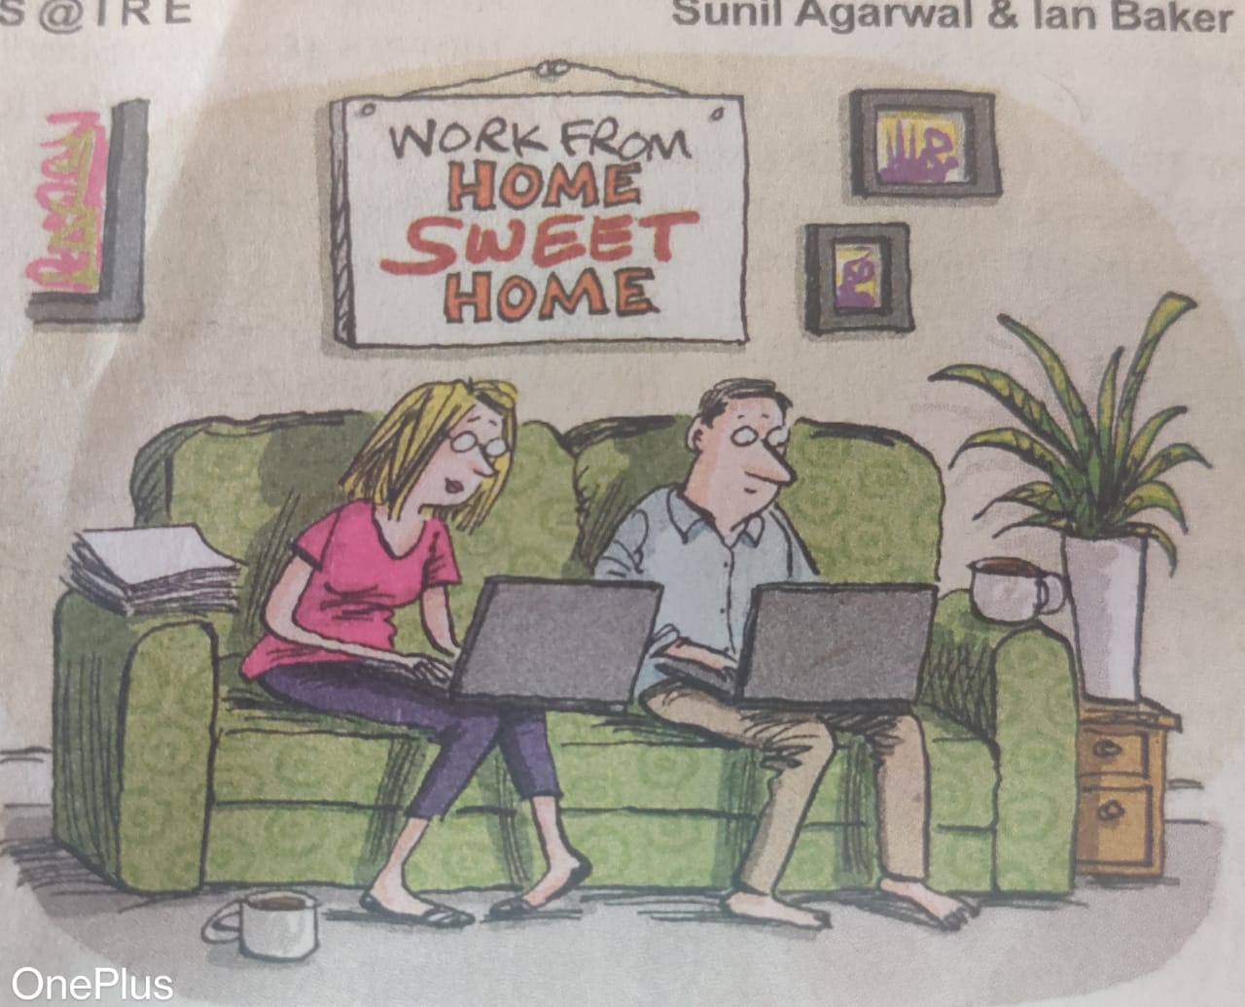
What the world is talking about…

Slide 7
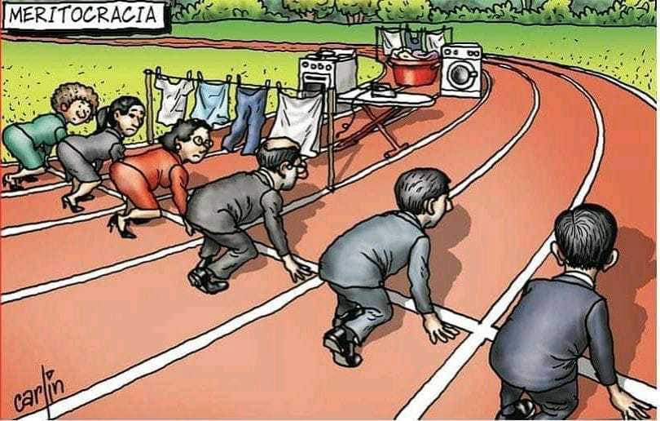
Role of Gender
Industry based
01
Gender Role Theory (Gutek et al 1991)
02
Adoption of technology- UTAD
03

Slide 8
Research Proposition
Women will prefer the WFA alternative against WFH
Gender Role Theory
Ceteris paribus, men will not accord preference to WFH or WFA

Slide 9
METHODOLOGY
Mixed methods
- Qualitative (Interviews)
- Framework testing with broad respondent group
Respondent Profile
- Equal mix of genders
Industries
- Diverse sectors

Slide 10
Preliminary Findings…
Home cannot replace workplace. For women, it is not even close
Dissatisfaction among women
Per hour productivity might be less but overall increase
Close proximity Radius of 4-5 km
Sector agnostic
WFH is a distraction even for men
Difficult for HR to bring all on same platform
Notes:
Issues in each sector are still persistent

Slide 11
Implications we foresee…
Missing coffee table chats
Re-work management principals
HR-OB theories: relook
Employee
Org
WFA
Breakdown of geographical boundaries- no limitation
Long term imp for company- Cultural hiring
Cost of coordination
Breakdown in professional relationships
Misrepresentation
Redefines professional relationships
Evovled couple relationships
Society
Notes:
Society- manyfold, breakdown in prof relationships- mediated by digital mediums/channels, chances of misrepresentation. Prof rltnshps need to be redefined. Better family/couple relationships
Company- cost of coordination
Employees- Missing coffee table chats, Principals of mgmt. need to be re-worked. Grapevine, scalar chain etc.
HR OB theories- relooked

Slide 12
Thank you
rubal.rathi.19pd@bmu.edu.in

