Slide 1
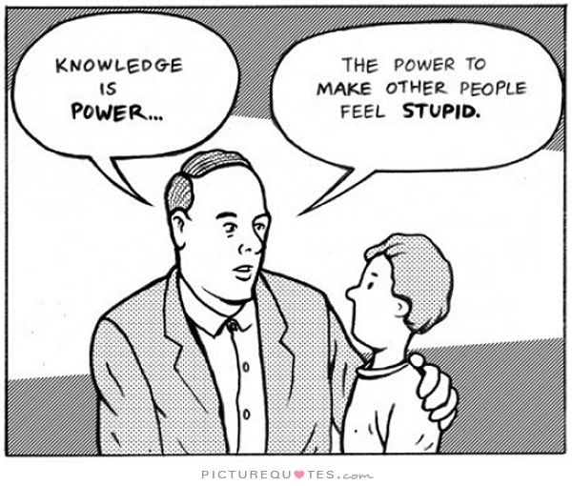
Exploring the impact of power dynamics on supply chain relationship management. The legacy of Mary Parker Follet.
Dr Paul Davies and Dr Rachel Mason-Jones

Slide 2
Aims of the Session
Explore aspects of Power dynamics that inform supply chain relationships
Introduce the work of Mary Parker Follett and how this can influence the understanding of Power

Slide 3
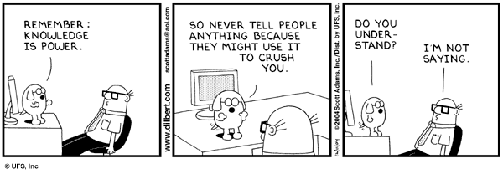
Context
The ability to influence the actions of others is a central aspect of many types of supply chain relationship
Hence, there needs to be a means by which this influence is enacted
Indeed, the dynamic between individuals and organisations (actors) inevitably shapes the way activities develop
Therefore, it is helpful to consider the way that power exists within relationships – often referred to as X&Y
“Skill to do comes of doing; knowledge comes by eyes always open, and working hands; and there is no knowledge that is not power”
(Ralph Waldo Emerson, 1870)
A link between Knowledge and Power has existed in literature and philosophy for centuries

Slide 4
Power Positions
During this session we will discuss three types of Power dynamic
Power–Over;
X has power to Y’s disadvantage
Power–To;
X has power over Y but it can be to Y’s benefit
Power-With;
X & Y both have the power to influence the relationship
Company Y (Supplier)
Company X (Customer)

Slide 5
Economic View of Power
At the heart of economic thinking around the concept of power is the principle of a transaction.
It is unsurprising then that power is considered an activity that one side of a transaction has in greater quantity than the other.
Central to this is the notion of the relationship between X & Y.
A two dimensional view where there is a clear relationship between two actors
The focus of attention is who has the power and how it can be used to get what is required
This is commonly referred to as ‘Episodic’
i.e. the episode is a distinct event
This is a ’Power-Over’ position and is incredibly influential in the way thinking about power within supply chains has evolved

Slide 6
Dimensional Views
The Transactional ‘Two Dimensional’ views provided a clear framework until the 1970s.
The work of Steven Lukes (1975) added a greater depth to the discussion moving away from a removed analysis of how X&Y interact
A ‘Third Dimension’ added to the debate by considering that X can affect what Y identifies is in their best interest without doing anything specific.
A more subtle idea of power.
This relatively simple development adds a depth to considerations of power that arguably were lacking to this point.
It also introduces the need to take a more rounded view of the relationship at the heart of the power concept i.e. X & Y.
Essentially we need to consider the context and surrounding factors that influence the example

Slide 7
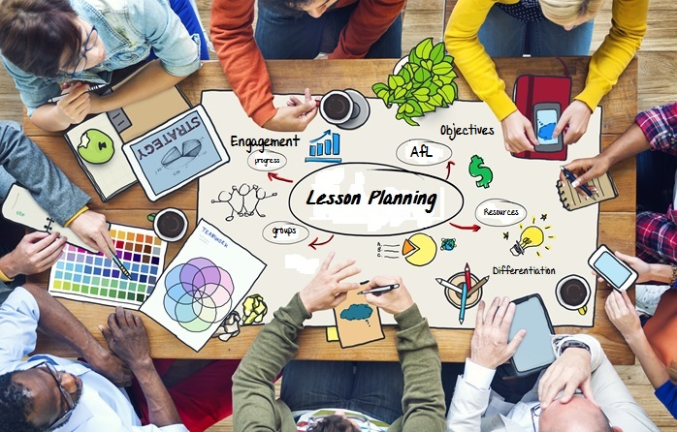
Collaborative Power
A different view of power is offered by a more collaborative motivation
Here the nature of the relationship changes from ‘power over’ to ‘power with’
Though a more ‘modern’ perspective e.g. Social Capital, Communities of Practice, the origins can be identified in earlier works
An interesting contributor is Mary Parker Follett, writing in the early part of the 20th Century
Her main contribution is the sense of integrating motivation in order to enable people to work together

Slide 8
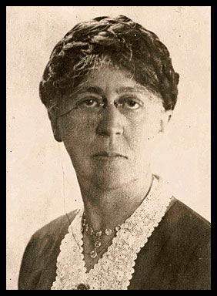
Mary Parker Follett (1868-1933)
”The prophet of modern management” (Pauline Graham, 1995)
Follett was an influential writer in the early 1900s speaking regularly at institutions such as London School of Economics
Dispute resolution in New England helped to shape her ideas
Her work covered ideas of Government, Society and Management
Her core idea is The Circular Response
Central to this idea is the way in which interaction can be considered as episodes within an ongoing relationship, each informing and shaping the context within which future interaction will take place

Slide 9
Integrating Motivation
There are reasons why we perform any act
E.g. we eat because we are hungry, need comfort, etc.
Thus, if the motivation for actions are more clearly understood then we may be able to understand and enable more thoughtful actions
Power can typically be considered as conflict. Here there are two common outcomes:
The dominant side wins
There is compromise from both sides, with neither feeling happy
Follett advocated the sense in exploring the possibility of a third:
Aligning motivation to achieve both sides desires. A ‘power-with’ approach to a relationship
“Integration means three things: you and I both get what we want, the whole situation moves forward, and the process often has community value. “

Slide 10
Elements of Follett’s Integrative Method
At the heart of integrative potential is a process that enables a more positive dynamic
Sharing of perspectives, experience, knowledge, values…
Disintegration of firmly held positions to identify underlying motivations e.g. symbols.
Revaluation of the comparison with one another to identify common ground and alternative understandings.
Synthesis to create an integrative outcome—agreement, idea, purpose, etc.
However, being able to achieve these is not an easy option and it may be more applicable in more localised environments
Adapted from Follett

Slide 11
Concluding thoughts
Relationships are informed by Power Dynamics
‘Power-over’ & ‘Power-with’ need to be understood
Our Motivation is a major driver of how we will potentially interact with others
This shapes the way that Power is likely to be experienced

