Slide 1
Artificial Intelligence (AI) and Machine Learning (ML) within the context of Cyber Security used in the
UK SME sector
Authors:
Nisha Rawindaran
Prof. Edmond Prakash
Dr . Ambikesh Jayal
Presenter:
PhD Student Nisha Rawindaran

Slide 2

Cardiff School of Technologies
AMI CONFERENCE MAY 2021
This Photo by Unknown Author is licensed under CC BY-NC
Concepts
Small Medium Enterprise ( SME)
- The Way Forward
Study One:
Open Source vs Commercial Network Intrusion & Detection Systems
  Study Two:
  Awareness of Artificial Intelligence and Machine Learning

Slide 3
Cardiff School of Technologies
AMI CONFERENCE MAY 2021
Prof Stephen Hawking, one of Britain's pre-eminent scientists, has said that efforts to create thinking machines pose a threat to our very existence.
He told the BBC:
"The development of full artificial intelligence could spell the end of the human race."
Stephen Hawking warns artificial intelligence could end mankind - BBC News

Slide 4
Cardiff School of Technologies
AMI CONFERENCE MAY 2021
Artificial Intelligence
Machine Learning
Cyber Security
Cyber Security Threats

Slide 5

Cardiff School of Technologies
AMI CONFERENCE MAY 2021
What is Artificial Intelligence (AI)?
This Photo by Unknown Author is licensed under CC BY-NC

Slide 6
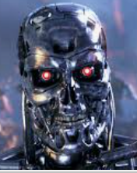

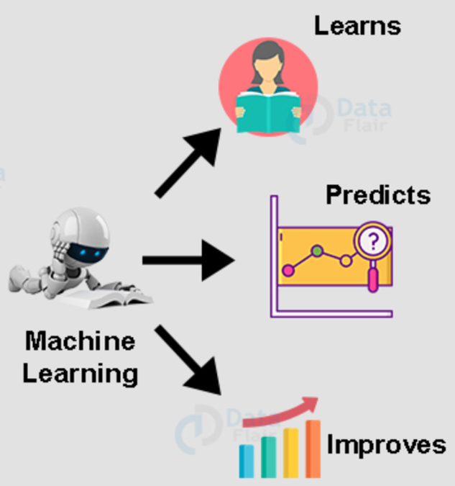
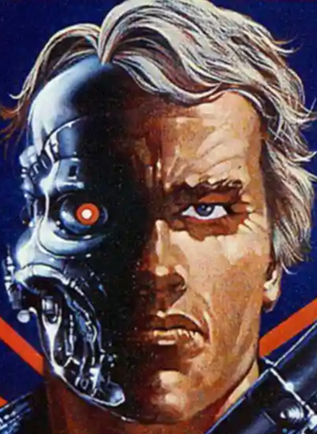



Cardiff School of Technologies
AMI CONFERENCE MAY 2021
What is Machine Leaning(ML)?
Machine of the Future
This Photo by Unknown Author is licensed under CC BY-NC

Slide 7
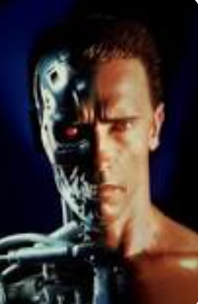
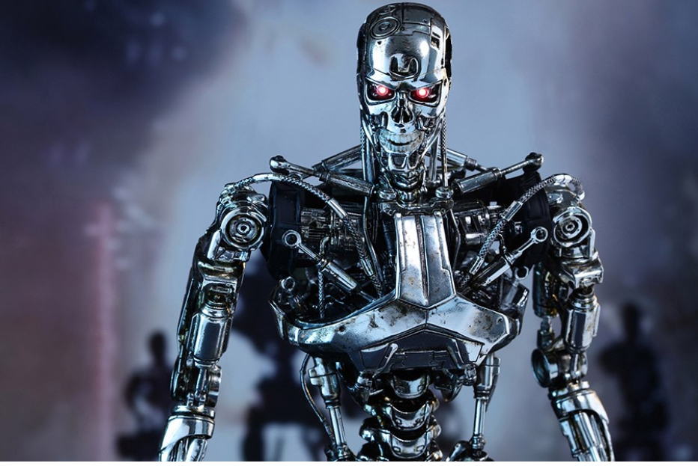

Cardiff School of Technologies
AMI CONFERENCE MAY 2021
Machine Learning a subset of AI
Make and Model of AI: T-800 Model 101 Cyberdyne Systems Model - a highly-advanced robot with living tissue over a metal endoskeleton
Mission: Sent back to kill Sarah Connor.
Reasoning: Machine does not know which Sarah Connor to target.
Data Given: Sarah Connor’s name and the city she lives in.
Source of Data: The phone book (remember those?)
Lessons Learnt: Old Terminator lacks basic, foundational training data . T-3000 (Terminator Genisys) – The new Terminator is able to take new information used to train using Machine Learning.
Machine Learning Model: Feed the proper training data by learning and adjusting through its first failed and corrected attempts.
T-800 was then sent back to PROTECT Sarah Connor!!
This Photo by Unknown Author is licensed under CC BY-NC

Slide 8
Cardiff School of Technologies
AMI CONFERENCE MAY 2021
What is Cyber Security?
Cyber security refers to “a measure for protecting computer systems, networks, and information from disruption or unauthorized access, use, disclosure, modification or destruction” (Gallaher, Link & Rowe, 2008)
What is Cyber Security Threats?
Cyber security threats is defined as “asymmetric, surreptitious and constantly evolving – a single individual or a small group anywhere in the world can inexpensively and secretly attempt to penetrate systems containing vital information or mount damaging attached on critical infrastructure”
National Science and Technology Council (2006, p. ix).

Slide 9
Cardiff School of Technologies
AMI CONFERENCE MAY 2021
Paper One:
Open Source vs Commercial Network Intrusion & Detection Systems

Slide 10
Cardiff School of Technologies
AMI CONFERENCE MAY 2021
Paper One
Title :
Intrusion, detection and prevention model ; Commercial Vs Open-Source
Aims :
To identify ways to detect and protect any intrusions coming into the network
To protect the data with the use and understanding of the General Data Protection Act (GDPR )
Comparison using Open-Source code, such as SNORT and pfSense, and Commercial Network Intrusion Detection (NIDs) such as Cisco and their impact on threats and how they attack
Methodology :
Observation, Evaluation and Experimentation methods applied with which certain identified variables occur and whether this occurrence is in relation to associated external variables using various AI and ML approaches such as Signature and Anomaly based models to detect unknown attacks

Slide 11
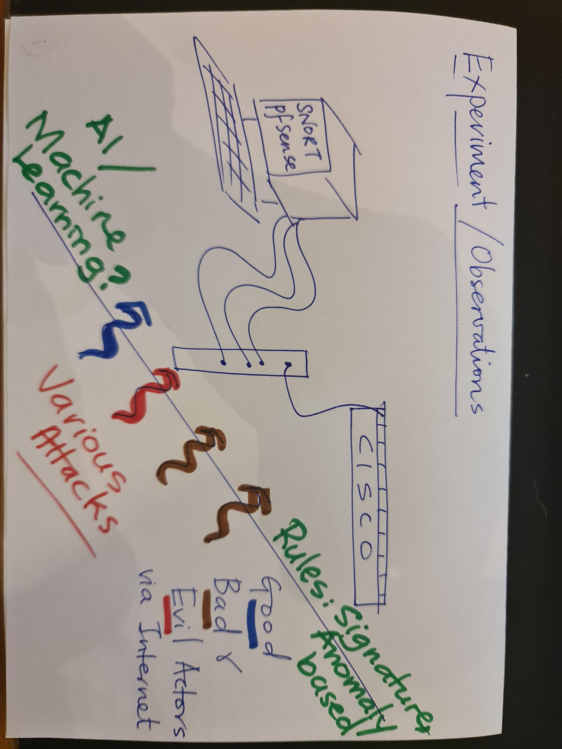
Cardiff School of Technologies
AMI CONFERENCE MAY 2021
Paper One- Visual
Figure 1: Visual representation of experiment and the observations

Slide 12



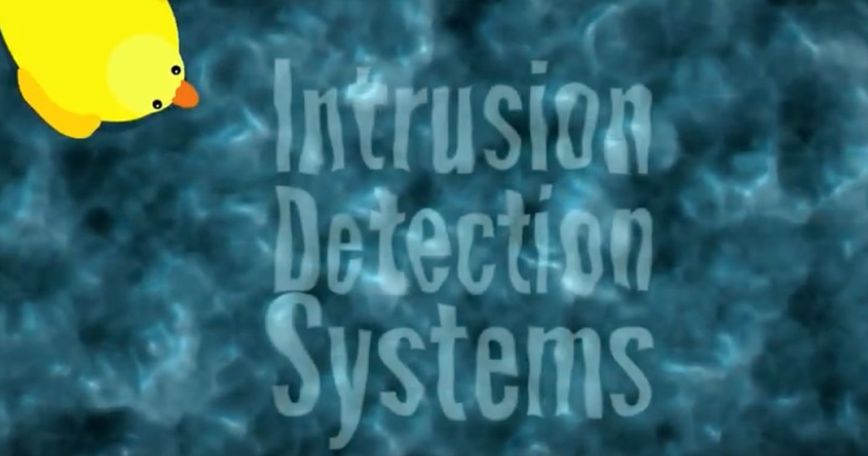
Cardiff School of Technologies
AMI CONFERENCE MAY 2021
Paper One : Findings
SNORT and PfSense :
Very Low Cost and Free on Open-Source
CISCO ASA 5516-X Fire Power:
Expensive
SNORT: Rules can be changed and integrated very easily;
Rules are simple to write; Rule based Content Pattern
Matching;
Rules cannot be changed, SNORT and pfSense
Rules are embedded into Cisco Firepower
Knowledge of engineering linked to Cisco main database for new code generation and platform and rules
pfSense: Rules cannot be changed
IT community feeds into the rules and able to bounce ideas
SNORT and PfSense:
Signature , Anomaly and Machine Learning
Signature based models could only detect known attacks
Anomaly-based systems were able to detect unknown attacks
Anomaly required computing power and was expensive!
Cisco:
Signature and Anomaly
Machine Learning already embedded
(subscription on device required!)

Slide 13
Cardiff School of Technologies
AMI CONFERENCE MAY 2021
Paper Two:
Awareness of Machine Learning in Cyber Security Software Packages

Slide 14
Cardiff School of Technologies
AMI CONFERENCE MAY 2021
Paper Two
Title :
Awareness of Machine Learning techniques used by (SME) and for their cyber security.
Aims :
The paper will share the success stories of Machine Learning and its usage in cyber security.
To fulfill the awareness gap at which Machine Learning techniques are being used by UK SMEs.
Methodology :
Structured survey questions on a selected small sample number of 30 respondents and directed to the SMEs management, technical and non-technical professionals.

Slide 15
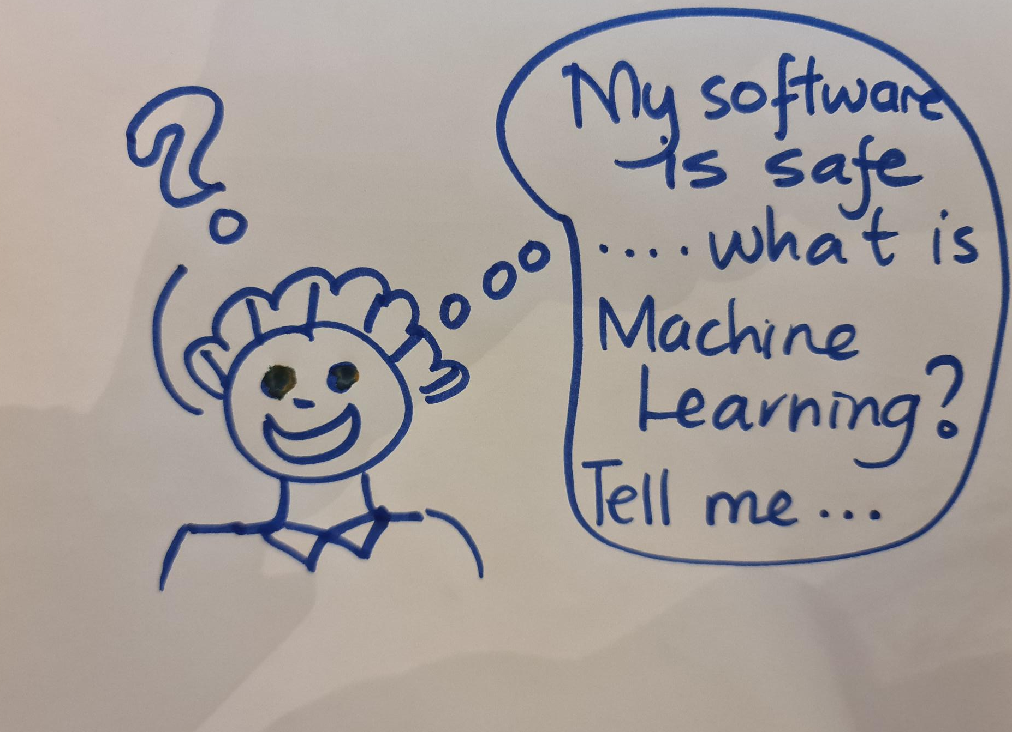
Cardiff School of Technologies
AMI CONFERENCE MAY 2021
Paper Two

Slide 16
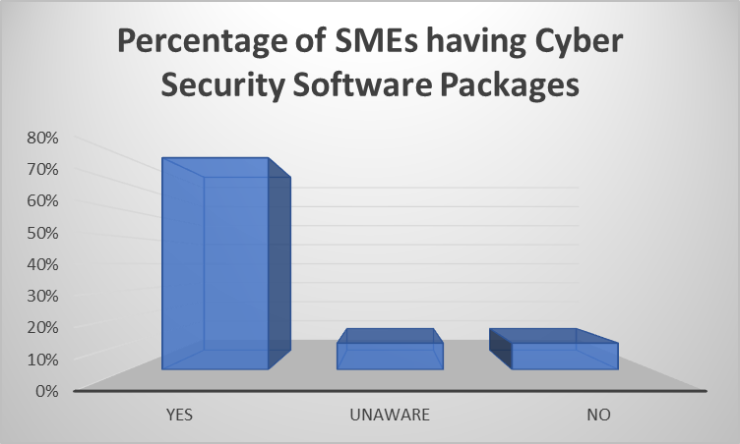
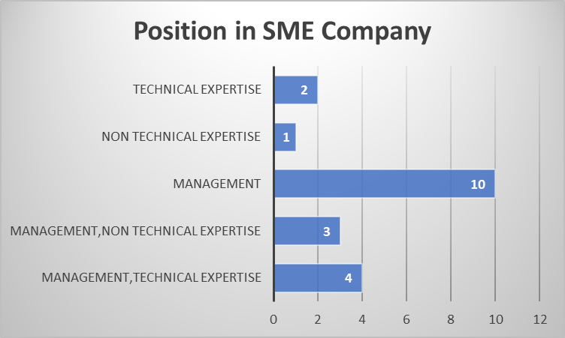
Cardiff School of Technologies
AMI CONFERENCE MAY 2021
Paper Two - Visual
Four 4 elements:
Details of participant and experience
Knowledge of Cyber Security and its packages
Knowledge of the Machine Algorithms used in the packages
Knowledge of the Price indicators of those packages
(not discussed here)
Figure 2: Percentage of SMEs having Cyber Security Software Packages
Figure 3: Position in SME Company

Slide 17
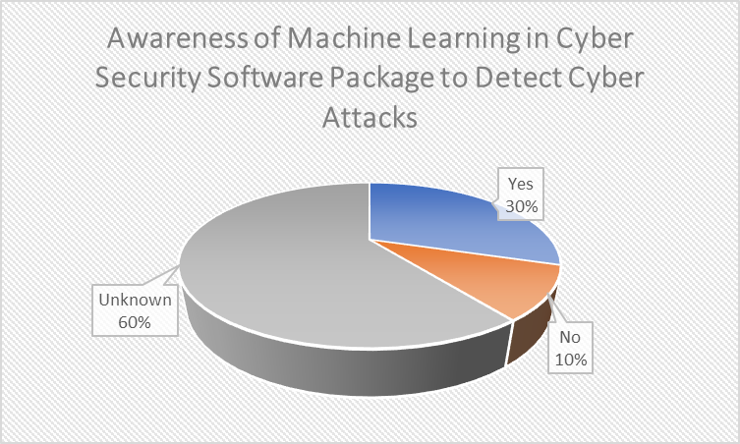
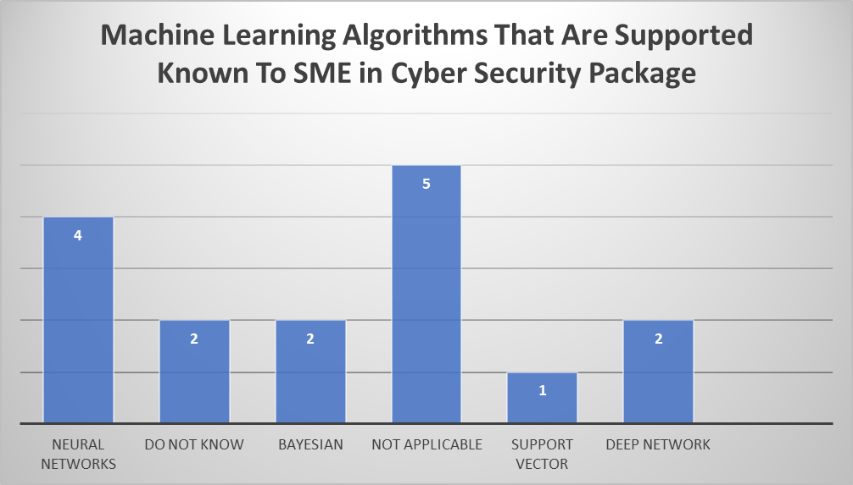
Cardiff School of Technologies
AMI CONFERENCE MAY 2021
Paper Two: Findings
Figure 4: Awareness of Machine Learning in Cyber Security Software Package to Detect Cyber Attacks
Figure 5: Machine Learning Algorithms That Are Supported Known To SME in Cyber Security Package

Slide 18
Cardiff School of Technologies
AMI CONFERENCE MAY 2021
Paper Two: Analysis
Machine Leaning awareness is still on a learning curve and yet to be defined.
Strong and weak perceptions and awareness of Machine Learning in UK SME business minds.
Business and organisations need help of government policies and process.
Train technical staff to better understanding the importance of machine learning in cyber security software packages.
Funding gaps that could be fulfilled by the government to support SMEs in the form of grants, subsidies, and similar financial assistance through various public sector policies.

Slide 19
Cardiff School of Technologies
AMI CONFERENCE MAY 2021
Both papers…
…recognised an important gap of knowledge to future proof devices.
…showed strength and weakness of perception and awareness of Machine Learning in UK SME business minds.
…highlighted funding gaps that could be fulfilled by government to support SMEs in the form of grants, subsidies, and similar financial assistance through policies.
…recognised importance of management and staff to be aware and undergo training to better understand Machine Learning and AI in Cyber security.

Slide 20




Cardiff School of Technologies
AMI CONFERENCE MAY 2021
The Final message…
SMEs to raise their game in the awareness of cyber-security, Machine Learning and AI as the way forward in growing their business in a safe and secure way in protecting their data
Understanding Bad AI/ML vs Good AI/ML and making an informed choice

Slide 21



Cardiff School of Technologies
AMI CONFERENCE MAY 2021

Slide 22
Cardiff School of Technologies
AMI CONFERENCE MAY 2021
Reference
[1] Artificial Intelligence Films in Pictures (1989) https://www.theguardian.com/culture/gallery/2015/jan/08/the-top-20-artificial-intelligence-films-in-pictures
(Accessed: 13 May 2021)
[2] What the terminator teaches us above AI and the need for better data (2021) https://aithority.com/guest-authors/what-the-terminator-teaches-us-about-ai-and-the-need-for-better-data/ (Accessed: 13 May 2021)
[3] Machine Learning Tutorial https://data-flair.training/blogs/machine-learning-tutorial/(Accessed: 13 May 2021)
[4] Stork, D.G. ed., 1997. HAL's Legacy: 2001's Computer as Dream and Reality. Mit Press.
[5] Crowdbotics (2020) What AI and ML Look Like in Practice. https://medium.com/crowdbotics/demystifying-the-buzzwords-what-ai-and-ml-look-like-in-practice-d24a00d524f3 (Accessed: 3 March 2021)
[6]Bringing Ingenuity to Life; Man vs. Machine: From RoboCop to the future of AI in European financial services (https://www.paconsulting.com/insights/man-vs-machine-from-robocop-to-the-future-of-ai-in-european-financial-services/ ( no date ) (Accessed: 3 March 2021)
[7]What Is Machine Learning: Definition, Types, Applications And Examples https://www.potentiaco.com/what-is-machine-learning-definition-types-applications-and-examples/ (Accessed: 3 March 2021)
[8] Buczak, A.L. and Guven, E., 2015. A survey of data mining and machine learning methods for cyber security intrusion detection. IEEE Communications surveys & tutorials, 18(2), pp.1153-1176.
[9] J. B. Fraley and J. Cannady, "The promise of machine learning in cybersecurity," Southeast Con 2017, Concord, NC, USA, 2017, pp. 1-6, doi: 10.1109/SECON.2017.7925283.
[10] LAZIĆ, L., 2019. BENEFIT FROM AI IN CYBERSECURITY. In The 11th International Conference on Business Information Security (BISEC-2019), 18th October 2019, Belgrade, Serbia.
[11]Denning ED. An intrusion-detection model. IEEE Transactions on Software Engineering 1987;13(2):222–32. Cisco (2020) https://www.cisco.com/c/en/us/products/collateral/security/asa-5500-series-next-generationfirewalls/datasheet-c78-733916.html (Accessed: January 2020)
[12] Roesch, M., 1999, November. Snort: Lightweight intrusion detection for networks. In Lisa (Vol. 99, No. 1, pp. 229-238).
[13] Patel, K.C. and Sharma, P., 2017. A Review paper on pfSense–an Open source firewall introducing with different capabilities customization. Vol-3 Issue-2.
[14] Iman, R.N., Asmiyanto, T. and Inamullah, M.H., 2020. Users’ Awareness of Personal Information on Social Media: Case on Undergraduate Students of Universitas Indonesia.
[15] Hewage, C., Jayal, A., Jenkins, G. and Brown, R.J., 2018. A Learned Polyalphabetic Decryption Cipher.

Slide 23


