Slide 1
AMI 2021: Managing the Next Normal Track 01: Strategy and Management
What happens when the game changes? Presenting a model for Transformative Change.
Dr Maria Ash

Slide 2
The game has changed …
… “bosses should prepare themselves, and their companies, for a hybrid future with a mix of remote working, smaller headquarters and co-working hubs in satellite locations. They will have to adapt their management styles and pay closer attention to morale and well-being” (Vijay Vaitheeswaran: US business editor, The Economist , Nov 16th 2020).
Organisations must learn to respond and adapt to the next normal through enacting transformational change.
Transformation signifies a radical step change not only to institutional structures and systems but also the organisational culture, values, attitudes and beliefs (Chapman 2002).
BUT … how to do this?
…”the success of change initiatives in contemporary organisations remains poor” (O’Connor et al 2017: 629)

Slide 3
My research as it evolved …
Initial research question:
Why is there a gap between rhetoric and reality when it comes to GE policy in UK universities?
My study:
Thematic analysis based upon ethnographic case study - 44 multi-level participant interviews within 5 schools across 3 UK universities, supported by participant observation and documentary analysis.
But research aim and objectives evolved through fieldwork analysis of university change processes – iterative process!
So … research question focus changed over time:
Why is it difficult for organisations to enact real change?
PhD Thesis:
Possibilities for Transformation? An Exploration
of Gender Equality Policy
in UK
Universities
from the Perspective of Women Academics

Slide 4
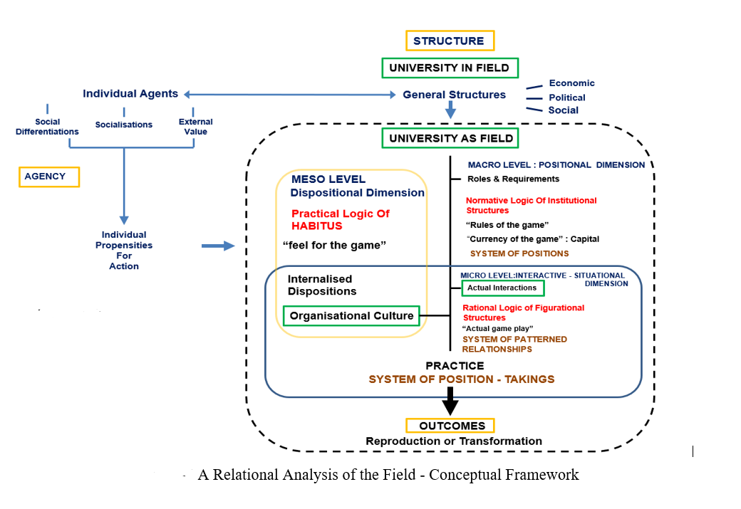
Theoretical framework
Source:
(Ash 2020:112)

Slide 5
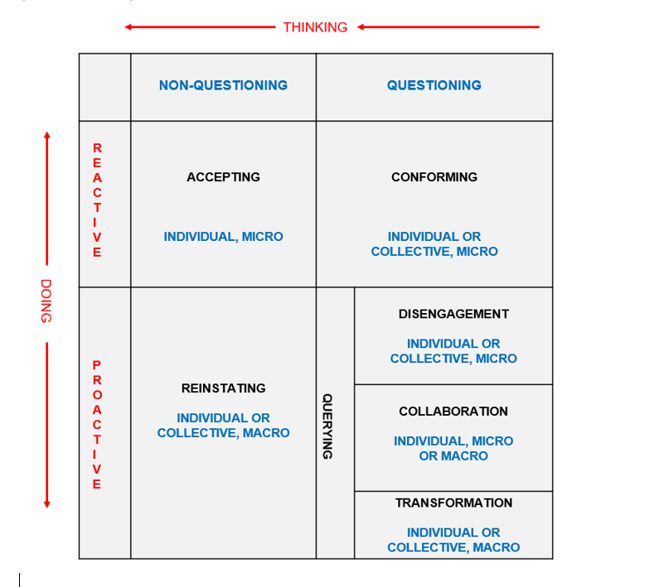
Barriers to Transformative change?
A Typology of Six Responses in the Field
Source: (Ash 2020: 289)

Slide 6
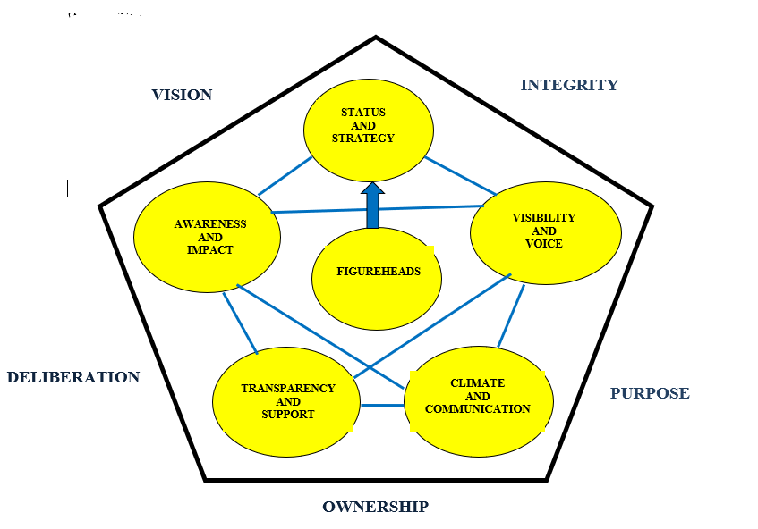
A model for transformative change
Source:
(Ash 2020:303)

Slide 7
So what? Implications of my study as we shift into the next normal ….
Model offers timely insights into change management processes from empirical and theoretical perspective.
Descriptive utility – identifies both the enablers and intended goals of change
Prescriptive utility – presents guidelines on enacting transformational change in organisations
Practical utility – can be adopted as a ‘toolkit’ for guiding and facilitating change management processes
Theoretical framework devised incorporating a fully ‘three dimensional’ relational analysis utilising Bourdieu and Mouzelis.
Theory grounded in an empirical analysis of fieldwork data from ethnographic case study of three organisations.
Research aims to ‘close the gap’ between the theory and practice of change management processes.

Slide 8
Thank you for listening!

