Slide 1
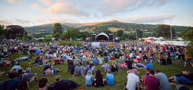
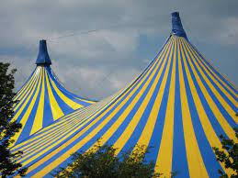
Exploring issues of affordability for participation in UK music festivals
Advances in Management Conference
Cardiff Metropolitan University
20th - 21st May 2021
Dr. Karen Davies

Slide 2
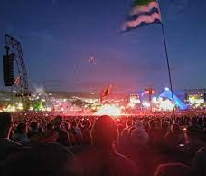
What will I Cover?
Aims and research questions
Why is affordability to festivals important?
Methods used to investigate the issue
Key findings
What next?..
Phase 2
Phase 3

Slide 3
Initial aims of the research
To investigate the issue of access to music festivals by those living in poverty by exploring the costs associated with attendance to UK music festivals and investigating what festivals are doing to counteract this issue.

Slide 4
Research questions
What are the associated costs of attending music festivals in the UK?
Including ticket price, food and drink, added extras
What outreach work do UK music festivals undertake to deal with the issue of poverty?
For example partnerships with charities, community work etc.
What are festivals doing to make their festivals more accessible for people living in poverty?
Do music festivals in the UK implement any schemes to make their festivals more accessible for people living in poverty?

Slide 5
Methods
Website analysis
Stratified sample of 30 paying music festivals:
10 x small (under 5,000 capacity)
10 x medium (5,000 – 25,000 capacity)
10 x large (over 25,000 capacity)
Selected via the website “efestivals.co.uk”
Analysis looked at 5 different areas:
Ticket prices per person
Added extra costs
Information on payment instalment plans
Information on ‘outreach activities’
Information related to accessibility for people living in poverty or for people with disabilities
Secondary research was conducted on reports created by AIF and Festival Insights to explore additional costs associated with attending music festivals, most notably food and drink

Slide 6
Key Findings:
It is important to consider the issue of affordability to music festivals for those living in poverty because these events can bring so much to people’s lives but only if they can afford to attend;
Festival costs and therefore ticket prices have risen exponentially in the last 10 years, leading to exclusion of some people to attendance;
Pre-pandemic 25% of the UK music festival industry was owned by just 2 companies giving them the power to book big named acts and develop economies of scale;
Independent festivals, which are ones that often have more ethical approach and practices (such as outreach work) have suffered most during the pandemic;
Results indicate that costs for attendance plus additional costs make it very difficult for people that live in poverty to attend music festivals;
Although many festival organisations donate to charities and conduct outreach work, only 1 of the festivals analysed has a scheme that considers affordability for marginalised groups, beyond spreading payments via instalments;
Many festivals work with “Attitude is Everything” to consider accessibility needs for people with disabilities, but they fail to recognise that many of these people live in poverty and so barriers to attendance can go beyond their disabilities;
More work is needed with festival organisers, charities and festival associations to explore this issue further and to develop schemes to promote affordability .

Slide 7
Journal submissions
Originally submitted to a Special Issue of Event Management Journal on “Events and Wellbeing”;
Comments included the need for a more rigorous website analysis;
Submitting new version to International Journal of Festival and Events Management this week

Slide 8
Phase 2
Six interviews conducted:
Glastonbury Festival (large)
2000 Trees (medium)
Association of Independent Festivals
Family Holiday Association
Boomtown Fair (large)
Between the Trees (small)
Currently being transcribed using money from “Get Started Funding”
Next steps – analyse using thematic analysis

Slide 9
Phase 3
ACTION RESEARCH
A series of collaborative workshops with AIF, FHA and festivals organisers using the “Ketso method”
Aim – to work with festivals to educate on the issue of poverty and discuss potential solutions to the issue of accessibility to festivals for people that live in poverty
Outcome – the development of initiatives that could be piloted at willing festivals in the 2022 season

Slide 10
Questions
Which Journal should I send the papers to next?
Are phase 2 and phase 3 separate papers or the same one?
Is this the type of topic that could be placed in a 3* or 4* journal?

