Slide 1
Becoming an excellent academic journal article reviewer
Professor Paul Jones
Swansea University

Slide 2
Presenter
Professor Paul Jones
Editor in Chief of the International Journal of Entrepreneurial Behaviour and Research .
Associate Editor of the International Journal of Management Education.
Book Series Editor of Contemporary Issues of Entrepreneurship Research.

Slide 3
Purpose of the Talk
Need to promote the correct practices and values for journal reviewing.
Discuss the importance of reviewing.
Identify best and worst practice for journal reviewing.
Discuss effective engagement with journal reviewing.

Slide 4
The Problem!
Our careers are defined by rejection and how we deal with it.
The academic reviewing process
The Editor
The journal
Reviewers: not enough, quality of reviews

Slide 5
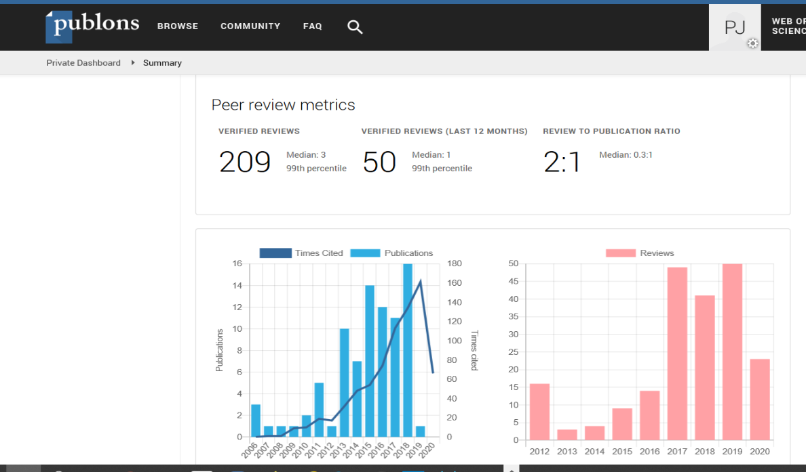
Why I should Review?
Its my contribution to my academic community.
Build your profile (CV) and career. Publons.com.
Build your networks.
Build your knowledge, writing expertise and competency.
Possible career enhancements e.g. Best Reviewer Awards, Places on Journal Editorial Boards, Journal Editorship Roles.

Slide 6
Experience of being Reviewed
Positive | Negative
Supportive | Negative
Encouraging | Dismissive
Developing | Rude
Lots of feedback | Inaccurate
Engagement | No feedback
Developmental | Brief
 | Impossible Cite me now!

Slide 7
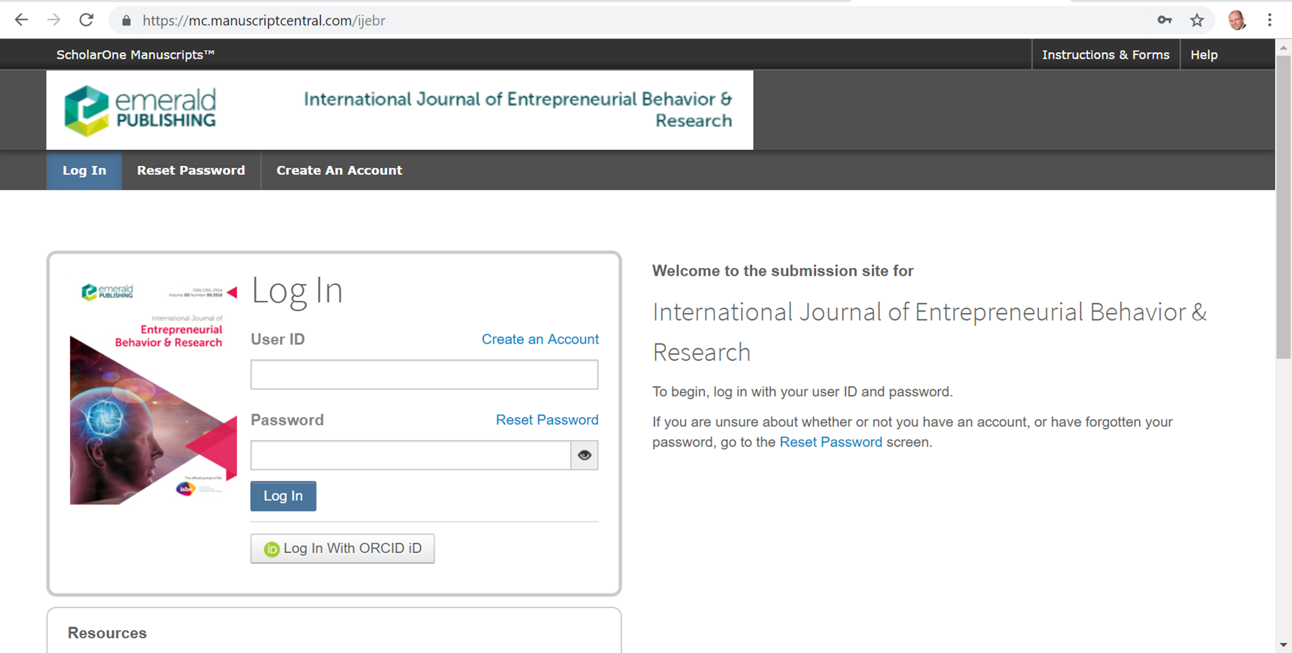
How do I become a Reviewer?
Contact the Editor and express your interest.
Register for an account identify your areas of interest.
Build your Academic Profile visibility (Google Scholar, Researchgate, Academic.edu)

Slide 8
The Role of the Reviewer
To provide an overall critical judgement regarding the value of a paper. For example accept, minor amendments, major amendments, reject.
To assess the theoretical contribution achieved.
To identify the strengths of the paper.
To identify the weaknesses of the paper and required improvements.
To verify the methodology used.
To ensure compliance with the journal standards in terms of academic quality, structure and formatting requirements.
To offer recommendations for improvements.

Slide 9
About IJEBR
25th Volume in 2019.
Emerald journal, ABS2. Aiming to become ABS3 for 2021/22
Granted full impact factor with Clarivate Analytics in 2017 impact factor currently 2.4
Publishing 8 issues from 2020.
Published 89 papers in 2020 grown from 30 in 2014.
Rejection rate is approximately 88%.
430 submission in 2016, 880 in 2019.

Slide 10
Focus of International Journal of Entrepreneurial Behaviour and Research
IJEBR focuses on research related to the human and social dynamics of entrepreneurship, and entrepreneurial management in small and growing organizations. The journal has an international perspective on entrepreneurship. IJEBR encourages submissions which advances human and behavioural dimensions of entrepreneurship and smaller organizations. Topics include:
Nascent entrepreneurship and new venture creation.
Management development and learning in smaller businesses.
Enterprise and entrepreneurship education, learning and careers.
Entrepreneurial psychology and cognition.
Management and transition in smaller, growing and family-owned enterprises.
Corporate entrepreneurship and venturing.
Entrepreneurial teams, management and organizations.
Social, sustainable and informal entrepreneurship.
National and international policy, historical and cultural studies in entrepreneurship.
Gender, minority and ethnic entrepreneurship.
Innovative research methods and theoretical development in entrepreneurship.
Resourcing and managing innovation in entrepreneurial ventures.

Slide 11
The IJEBR Journal review process
A paper is submitted
Assessed by Editor and Guest Review Editor
90% rejection rate
Quantitative
Co-Editor
Qualitative
Co-Editor
Possibly Reject
Send to 2/3 Reviewers
Decision is made by Co-Editor on the reviewers returned
Decision Reached to accept or revise
Notes:
Initial rejection reasons: paper does not meet submission requirements, is in the wrong format, is not good enough, decision is made in about 15 mins per paper.

Slide 12
A Taxonomy of Journal Reviewer Types
The Expert Reviewer: has a detailed subject knowledge of the theory in this area. Has published widely and is highly cited. Is recognised as an international world leading elite expert in this area. Availability is limited and typically works only with high ranking journals only.
The Associated Reviewer: can be a subject expert or competent reviewer. Is associated with a learned society and journal (editorial board member) and is asked to regularly review for a specific journal often in a range of areas.
The Competent Reviewer: has published in this area and has general knowledge in the field. Is regarded as a competent and reliable reviewer and will regularly review for a range of journals.
The Nascent Reviewer: an early career academic who has limited reviewing experience and is seeking to develop their reviewing expertise, networks and experience.
The Disconnected Reviewer: Regularly refuses to review and when they do connect they provide a limited or poor quality review which is typically discounted.

Slide 13
Reviewer Development
Nascent
Competent
Expert
Associated

Slide 14
Good Practice for Journal Reviewing
Consider the Contribution Achieved
Does the paper have sufficient quality in terms of the scope of the research undertaken and the level of the contribution achieved for the target journal.
Does it effectively connect to the relevant literature. Is it current?
Does the paper have the appropriate theoretical connection in underpinning theory.
Does the paper offer a critical literature review.
Does the paper extend the existing literature.
Does the paper offer an appropriate conceptual (qualitative) or theoretical framework (quantitative)

Slide 15
Good Practice for Journal Reviewing
Structural Issues
Does the paper offer a clear focus in terms of its aim and objectives
Is the Methodology effectively and appropriately designed?
Does it provide the relevant connection to the methodology literature (for example case study method Yin, Eisenhardt).
Does it offer any previous precedent for the approach undertaken.
Is methodology design, data collection and data analysis clearly explained.
Is the methodology appropriate for the target journal.
Are the results accurately presented.
Does the Discussion connect effectively with the key literature and research questions/hypothesis.
Do the conclusions confirm the contribution achieved, implications of the work for theory, policy and practice, study limitations and further research requirements.

Slide 16
Good Practice for Journal Reviewing
Best Practice as a Reviewer
Review with good will: have no prejudices.
Be reasonable.
Read with care and attention.
Know the submission journal, its language and format.
Be constructive and positive.
Know your own limits as a Reviewer and be honest.
Be diligent check the claims been made.
Check the linear development of the paper from abstract to conclusions.

Slide 17
Good Practice for Journal Reviewing
Some good Practice
Avoid showing off! It not about citing your work!
The review should be professional and adopt a measured tone
Read more than once. Check what you have written.
Put yourself in the authors place when you consider what you have written.
Check references and suggest additional references.
Include both strengths and weaknesses.
Say no if you cannot do it.
Try and complete by the deadline.

Slide 18
Useful reference
Frank Bannister ^{and} Marijn Janssen (2019) The art of scholarly reviewing: Principles and practices, Government Information Quarterly https://www.sciencedirect.com/science/article/pii/S0740624X18305483

Slide 19
Questions and thoughts?

