Slide 1
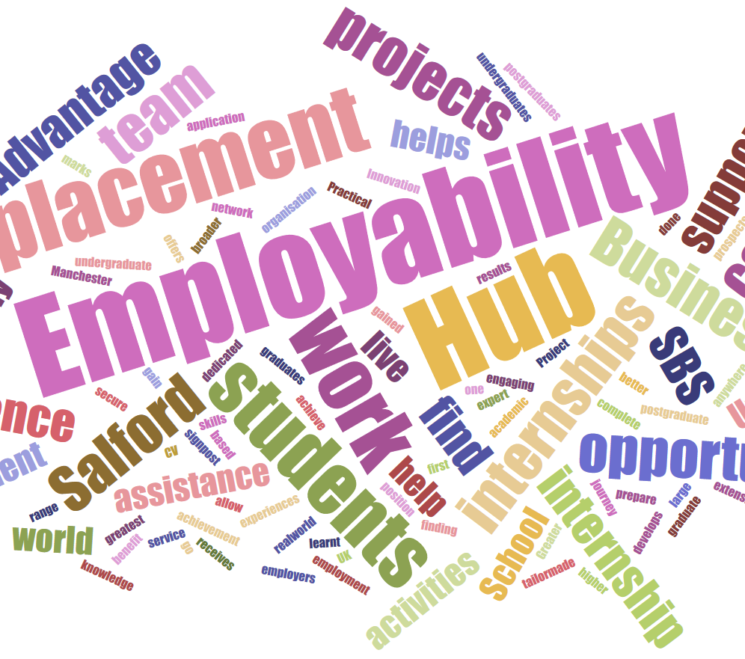

The Higher Education Journey into the Graduate Market and Beyond
F Neeson B Eng (Hons) PGCE, MBA, FHEA, PGCSAR
Notes:
Good Afternoon, hope everyone is staying safe and well. My presentation today supports my paper on the higher education journey into the Graduate Market and beyond.

Slide 2

Background
Efficiency of Work Placements currently
Consideration of ‘fit for purpose’
Existing format
Does this work?
Notes:
The reason for my paper is to consider from my position as module leader in a work experience role whether the delivery is currently effective and gives the correct support in a somewhat saturated graduate market.

Slide 3

Research Approach
Stage 1: Secondary research with regards students, staff and stakeholders.
How do we capture the current data?
How do we identify the skills gaps?
How do we encourage social mobility?
Notes:
Currently CMU experiences a relatively low level of graduate employment, with just below 60% of CMU graduates staying in Wales to start their careers. ‘The graduate outcomes survey is the biggest annual social survey in the UK and captures the perspectives and current status of graduates’ HESA online (2020). To capture this data sufficiently it is not just the responsibility of the student but the support and guidance of the staff to develop connections to encourage and promote the survey and also ensure that contact is maintained within the 15 months after graduating up to the date of the survey. The skills gaps need to be identified by identifying employer expectations and also further investigation into student mobility. Majority of students remaining in Wales following graduation were predominantly employed by health industry, education and retail sector. It was noted that the biggest skill gap was Welsh Language skills.

Slide 4
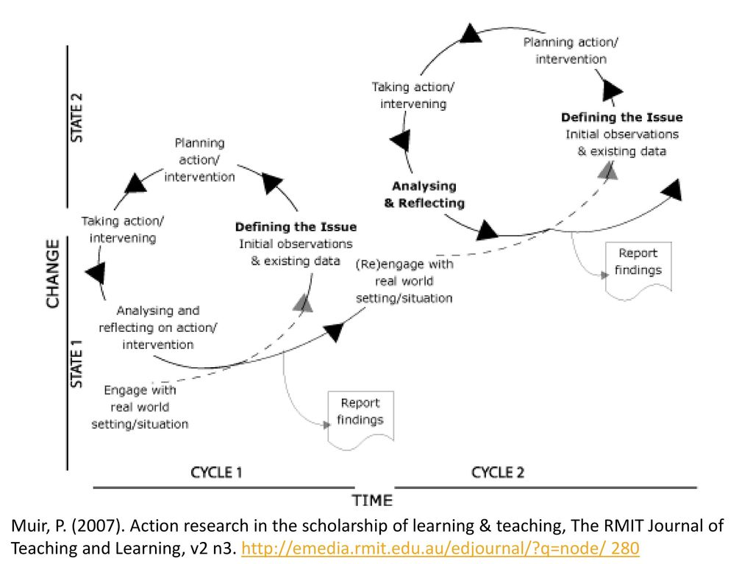
Action Research
There are four main areas to consider:
Secondary Research considering students, staff and stakeholders
Secondary Research based on expectations of employers
Secondary literature based on Higher Education Departments.
Secondary Research considering best practice and case studies
Notes:
Action research will be considered the main research Once Muir’s (2007) cycle of events has been considered it is anticipated that the results will show changes in practice, identify information on possible collaborations and as it is in a cyclical formation it is anticipated that it will enable constant reflection and improvement.

Slide 5

Research Approach
Approach:
What we have
What Employers want
What needs to be done to bridge the gap
Notes:
Things to consider: Jennifer Bradford of Liverpool John Moores University based her research and investigation on the Leitch Report (2006) which highlights the responsibility of HE to develop and provide the skills for a ‘rapidly evolving global economy’ (Bradford (2013). It was interesting to see that Bradford also noticed the reluctance of some students to engage, confirmed by Yorke (2006) that providing these opportunities does not always ensure that curriculum enhancement and development will result in employability. The outcome of this research suggested a broader awareness raising by HEI’s was required (Barrie 2007, O’Regan 2009) identifying a closer fit between academia and employment was needed.
This could link to the study by Thayler and Sunstein 2008 which considered Behaviour Change Theory of students and undergraduates. Any adjustment to the curriculum using this theory would involve ‘subtle adjustments in communication to make significant changes in individual and/or group behaviour’ (Service, Hallsworth, Halpern et al., 2014 p.1).
In order to provide a robust model of employability and the development of skills it is necessary for all stakeholders to support this and contribute to this goal. Research at Kings College London found some interesting mindsets behind the views of staff. Some felt it was not their job to incorporate employability into their delivery – these were posed with the question ‘but what is the employability value of what you teach?’ This suggests a silo existence in academia in some areas which needs to be reviewed. This is undoubtedly not isolated to Kings College.

Slide 6
Artess, Hooley & Mellors-Bourne (2016) & HEA (2015)
Opportunity should be there for all students to gain experience
All stakeholders should be united in delivery and importance of this experience
Employers and students need to be engaged and supported by an embedded model
Notes:
AGCAS/HESCU (2019) conference highlighted a number of areas when considering embedding employability in the curriculum to prepare students and to bridge the gaps between academia and to aim to satisfy expectations of employers. The points considered in the slides below identify in further detail what is required, these include Inclusivity, Collaboration, Engagement, Understanding and Strategic support.

Slide 7
Artess, Hooley & Mellors-Bourne (2016) & HEA (2015)
This suggests there is a holistic approach looking at current needs and requirements.
Being mindful of the changing face of the market place.
Education should be academically and expert led
Encouraging links with Educators, Employers and also Careers professionals
Notes:
LHS and then List: Holistic, Current, Impact, Expert Led and Complementary

Slide 8

Ball (2019) focusses on skills shortages in UK
Graduates lacking the relevant skills
Subject related skill gap rather than transferable skill gap
Move from soft and transferable skills to vital skills
Notes:
These are employment opportunities where the applicants are lacking the relevant skills, qualifications or experience.
This is interesting as Ball’s (2019) research suggests the biggest gap seems to be in subject related skills rather than transferable skill which are the focus of other research.
It is interesting to see a realignment and possible change from soft skills with the focus becoming more on vital skills. Law graduates for example on average show a percentage of just over 30% of graduates working in the legal sector, this highlights further the need for vital skills to be developed within HE. The reason behind this could be due to students’ reluctance regarding mobility and therefore suggests that employees may need to deliver more localised recruitment strategies.

Slide 9

Employability solutions
Clark (2019) from Newcastle University Business School (NUBS) has been conducting research on how employer collaboration may improve graduate employability based on the EDGE model.
Notes:
Content on slide

Slide 10
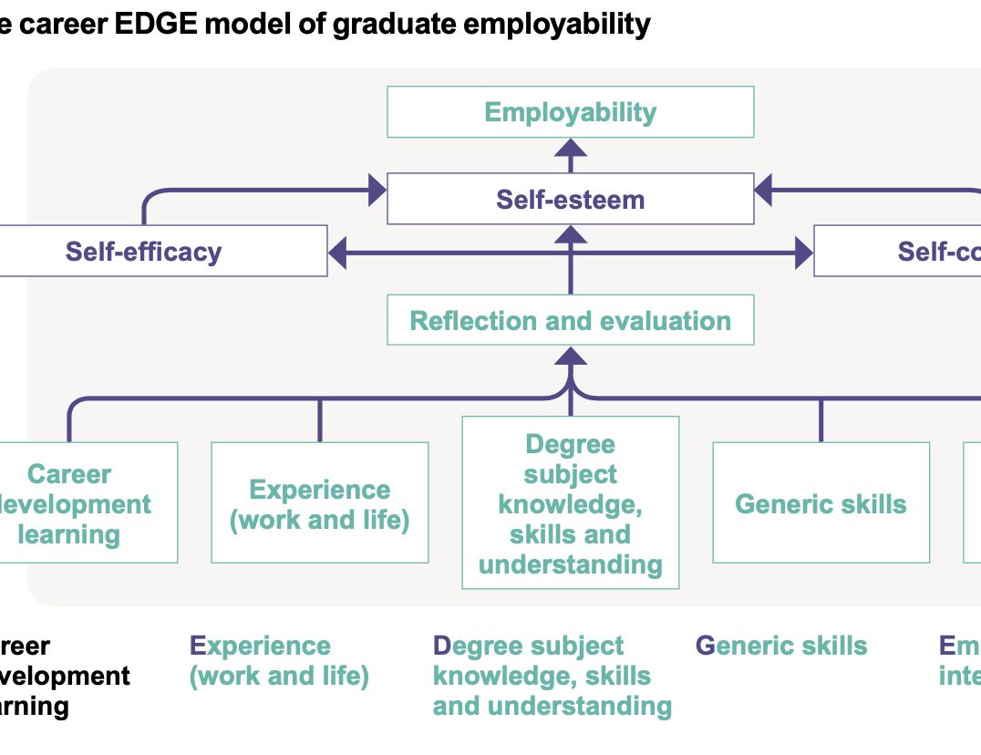
The career EDGE model of graduate employability
Dacre, Pool and Sewell, 2007
The EDGE model looks at career development learning through the various stages to employability.
When considering an academic qualification there is not only degree specific but also the need for career development and also experience both in the form of life experience and work experience.
Notes:
The EDGE model looks at career development learning through the various stages to employability.
When considering an academic qualification it is not only degree specific but also the need for career development and also experience both in the form of life experience and work experience. This along with generic skills and emotional skills will enable the student to be able to reflect and evaluate. Once this evaluation and reflection has been undertaken self-esteem self-confidence and self-efficacy will then bridge the final gap in preparation for employability.

Slide 11

Peck (2016) links between work placements and social mobility
This Photo by Unknown Author is licensed under CC BY-SA
Research on Sandwich Placements
Notes:
Peck (2016) considers there is a definite link between work placements and social mobility, Peck researched sandwich placements to identify whether this could unlock social mobility and the result showed this could certainly help. Pecks research considers social mobility initially within the Russell group, his findings were confirmed by the Institute for Fiscal Studies confirms and supports Peck’s findings that the higher salaries and greater mobility are obtained by students graduating from a Russell group University. How will this be affected by the government challenge to increase disadvantaged young people entering higher education in 2020. To consider this further, Peck carried out a study at Nottingham Trent connected to sandwich placements. His findings were that widening participation students in this university who opted for a sandwich placement within their studies not only unlocked social mobility but raised their chances of achieving a professional level outcome in the region of 32% higher than Russell group students who did not complete a sandwich placement. Though in the last 10 years sandwich courses have increased to nearly 60% many disciplines and sectors within higher education often find it difficult due to the nature of the degree to undertake a year in industry.

Slide 12

Research Approach
Section 3:
Research is also required to investigate further HE models and whether there is a need to develop these further.
This Photo by Unknown Author is licensed under CC BY-SA-NC
Notes:
Secondary research will be carried out through research of relevant existing literature and through Higher Education Funding Council for Wales (HEFCW), Higher Education Wales (HEW), Higher Education Achievement Report (HEAR), Destination of Leavers from Higher Education (DHLE now known as Graduate Outcomes) documentation and also academic journals and grey and white papers.

Slide 13
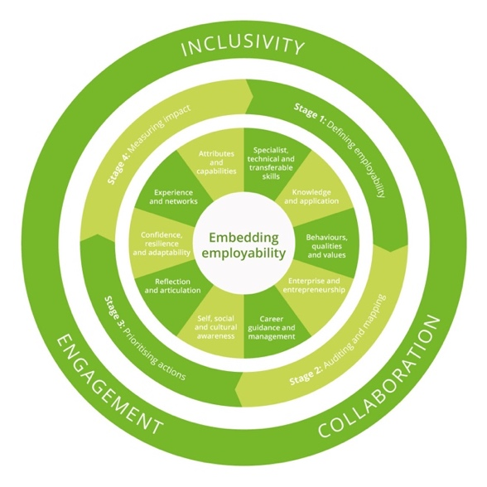
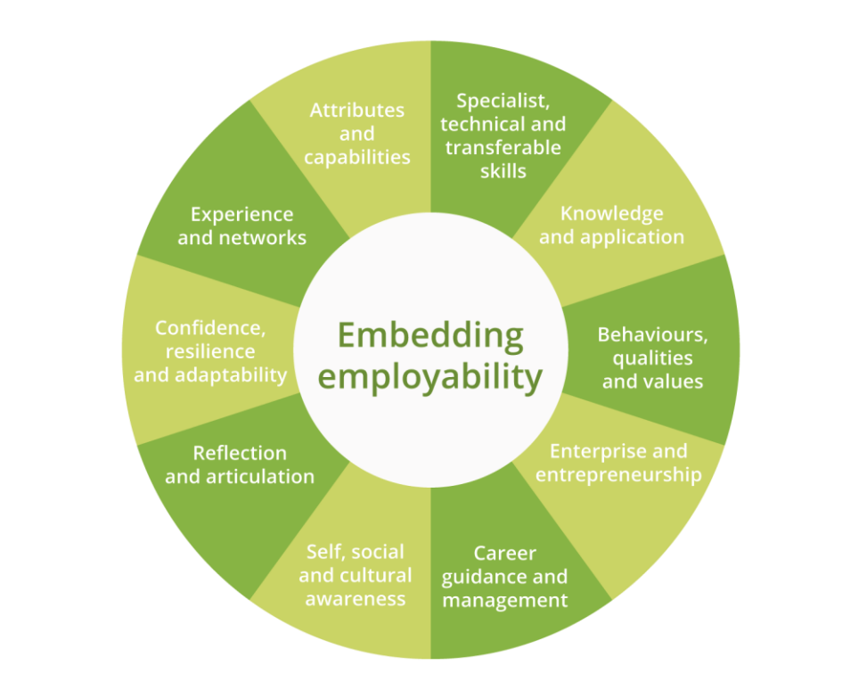
In the initial stages of research consideration was made into the HEA Embedding Employability wheel (HEA 2015). (Since 2019 the HEA has been re-branded as Advance HE)
The initial smaller wheel was the starting point of embedding employability.
The full wheel shows how this develops a consistent and flexible approach to embedding employability.
It provides one consistent university approach which is owned designed and formed by program areas.
Enables all staff to be reached and to be included in this embedding process and also proposes to have a good positive impact on all students.
Notes:
This involves bringing staff students and employees together and enables these three vital contributors to define critical elements which are important for graduates. The desired outcome will provide a benchmark for current and future practice and identify areas for development. The aim of this wheel of embedding employability it’s not just to look at isolated departments or courses or programs of study but to look at the institution as a whole.

Slide 14
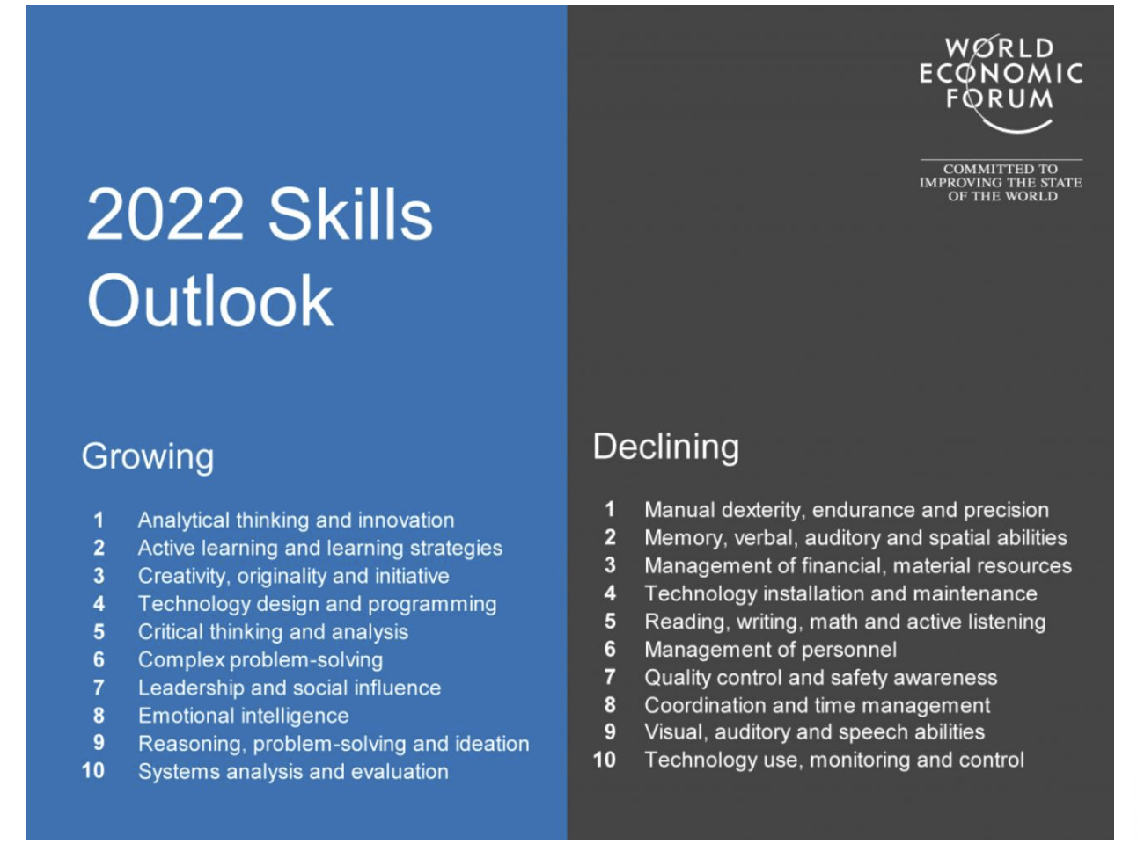
Section 4: Consideration and research into related Higher Education case studies.
Students should be encouraged to consider the 10 emerging skills and see how their individual situation will map onto some of those skills to enhance their opportunities in the future.
Notes:
The intention of this research is to undertake a critical assessment of case studies within FE and HE to identify best practice in employability strategies. Consideration needs to be focussed on the emerging and growing skills for 2020 onwards.

Slide 15
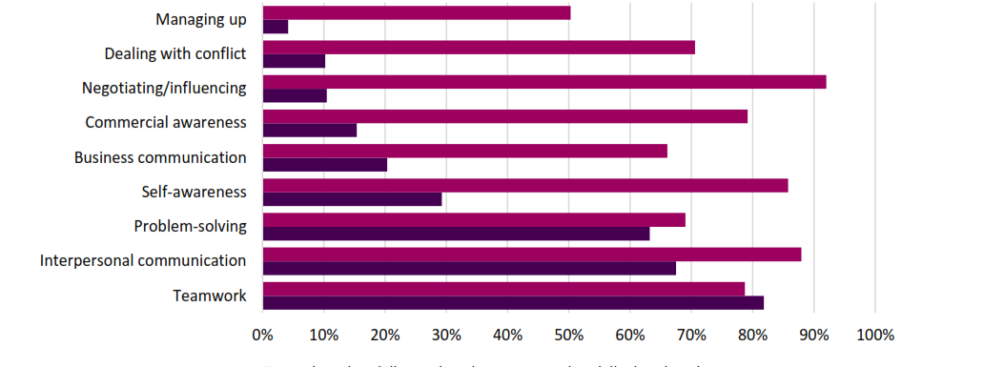
Employers perceptions on Graduate Skills GradConsult (2020)
This graph shows the gap between what graduates have prior to employment compared to the employment skills required.
Notes:
List LHS of graph

Slide 16

Conclusion
Early stages of CSM research but what has the research shown to date?
Responsibility of students, staff and employers to prepare students for employment
Socio mobility
Types of skills – transferable to vital – in Wales welsh language.
Growing Skills and Declining skills
Subject relevance in relation to career / employment.

Slide 17

Recommendations to date
Fit of placements across disciplines and schools – look at Toolkits
How to encourage collaboration of all parties
Skills gaps – transferable vs vital
Social Mobility with Sandwich programmes.
Employer led projects to enhance experience
Notes:
Create toolkits to identify best practice for individuals and recognise potential patterns within cohorts.
Work with Careers to develop frameworks to make it easy for academic departments to engage with employers more effectively
Embed employer-led project modules, this has been proved to be successful by a number of universities across the UK. Hulseimer (2019) a Senior Lecturer at the University of Sunderland structures the BA (Hons) Drama and Film Production programmes as a collaboration with Northumbria Police Force. There is a great deal of focus on EDGE and USEM models of employability (Yorke & Knight, 2002) and this is based by acting on Harvey (2005) who recommends that if there is not enough knowledge of the workplace then it is a difficult transition to the world of work after graduation. In the University of Sunderland, students develop transferable skills in a real-life situation. This is supported further by meetings at regular intervals throughout the programmes when the Police force attend University for updates and feedback sessions - Their work has been recognised with being nominated as winners of the Collaborative Award for Teaching Excellence (CATE) 2019.
Real life projects enable large numbers of students to gain commercial experience and encourage a move away from elaborating their part time jobs to reflect on.
Employer engagement and industry related assessment should become a compulsory part of module design.
It could be recommended to create assessments that are linked with the real world and support graduate recruitment processes

Slide 18

Thank you for listening.
Any questions?

