Slide 1

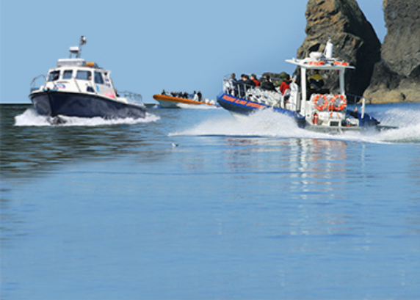
United We Stand- An Approach to Consolidating Marine Wildlife Tourism Codes of Conduct in West Wales
Dr Jeanette Reis
Advances in Management and Innovation Conference 2020
13th May 2020, Cardiff Metropolitan University
St Davids marine wildlife tour operators

Slide 2
Aim
The aim of this paper is to explore how to consolidate marine wildlife tourism codes of conduct. This is particularly focussed on codes used by commercial boat operators seeking Minke, Orca and Fin whale species along the coast of West Wales.
A study by the author which was undertaken in 2019 (Reis and McLoughlin, 2019) identified 22 relevant marine codes of conduct, with 37 different recommendations which related to the migratory routes of the species concerned.
This vast range is confusing for boat operators and ineffective for marine wildlife tourism management.

Slide 3
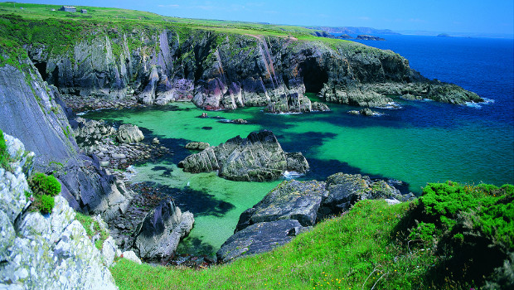
Context
The most recent global marine wildlife industry figures cite that the sector attracts 13 million tourists, supports 3300 operators, generates $2 billion per annum and supports 13,000 jobs (MMC, 2019). Furthermore, Cisneros-Montemayor (2010) suggests that an additional $413 million per annum and a total of 19,000 jobs could be generated by expansion into emerging tourism regions.
Global trends are reflected at local level, as is seen in West Wales. According to Visit Britain (Visit Britain, 2019), 9.02 million people visited Wales in 2018, and 3.7 million of these visited the coast. Approximately £719 million was spent at coastal destinations, with an average spend of £180 per trip.
In St David’s, West Wales, 5 marine wildlife boat operators (Tripadvisor.co.uk, 2019), offer trips. A typical 2.5-hour trip around Ramsey Island would cost around £60 ($78) for an adult and £30 ($39) for a child (Ramseyisland.co.uk, 2019).
West Wales coast on a sunny day

Slide 4
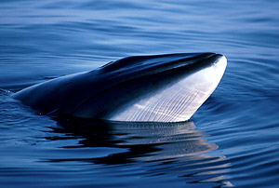
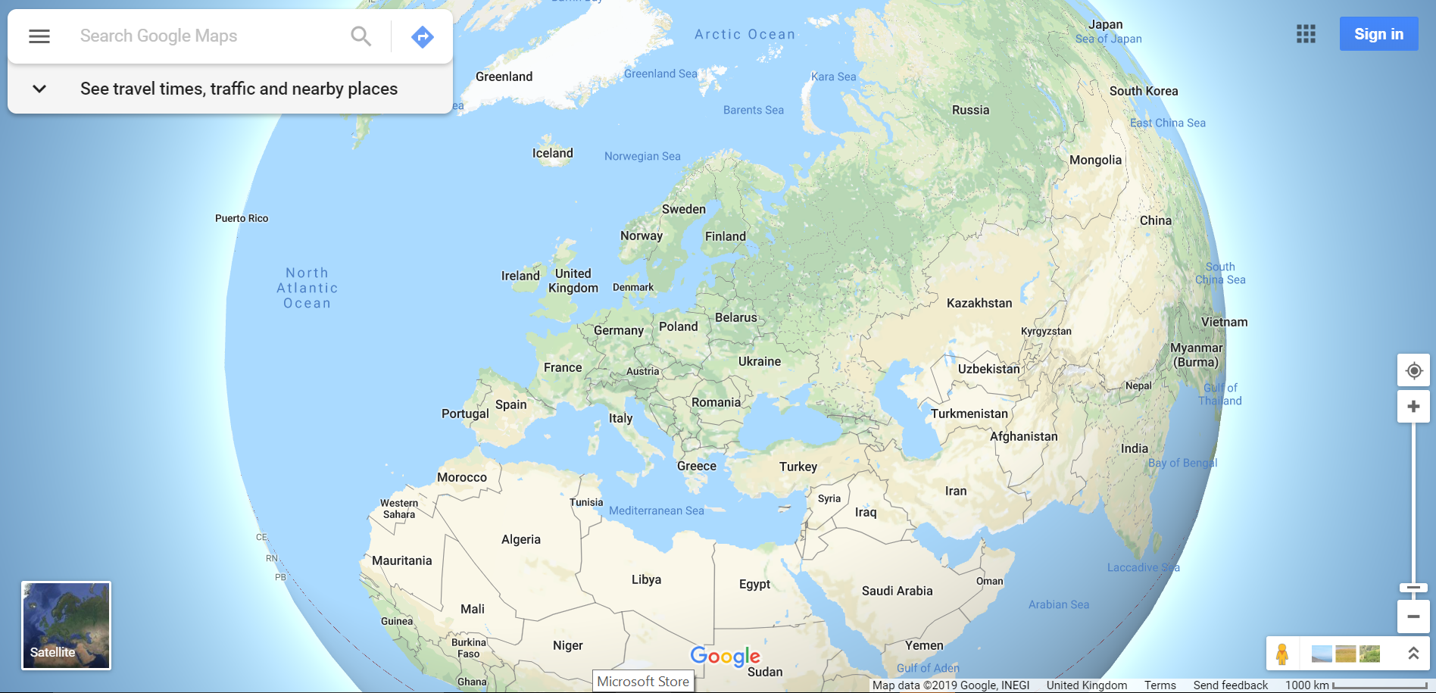
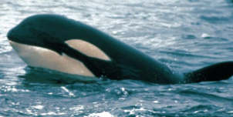
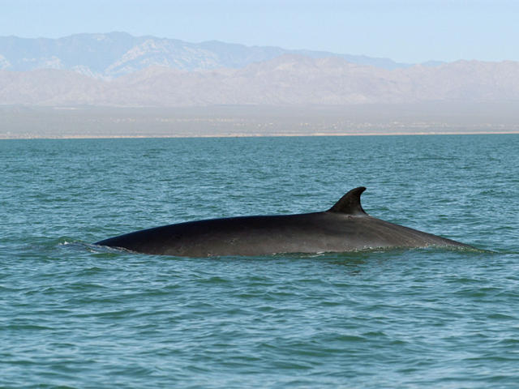
UK Minke, Orca and Fin Whale Migration
 | Minke | Orca | Fin
Iceland |  | √
Norway | √ | √
Denmark | √ | √
Netherlands | √
Scotland | √ | √ | √
England | √ | √ | √
Ireland | √ | √ | √
Wales | √ | √ | √
Belgium | √
France | √ |  | √
Spain | √ |  | √
Portugal | √
Minke (Balaenoptera acutorostrata) 18,958
Orca (Orcinus Orca): 15,014
Source: Google Maps, 2020
Fin (Balaenoptera Physalus) 13,966

Slide 5
Positive and Negative Impacts
While marine wildlife tourism is undoubtedly positive for the economy, there are recognised negative impacts on wildlife behaviour, particularly feeding and resting activities (Marino, 2012). Injuries and mortality caused by vessel collisions have also been recorded (New, 2015).
Although marine wildlife national and international legislation exists, to manage these risks, it is very generalised and does not respond to local issues. Consequently self-regulation via codes of conduct have emerged. (Gjerdalen and Williams, 2000; Inman et al, 2016; Parsons, 2012). These operate at global, regional, national and local level (WCA, 2019).

Slide 6
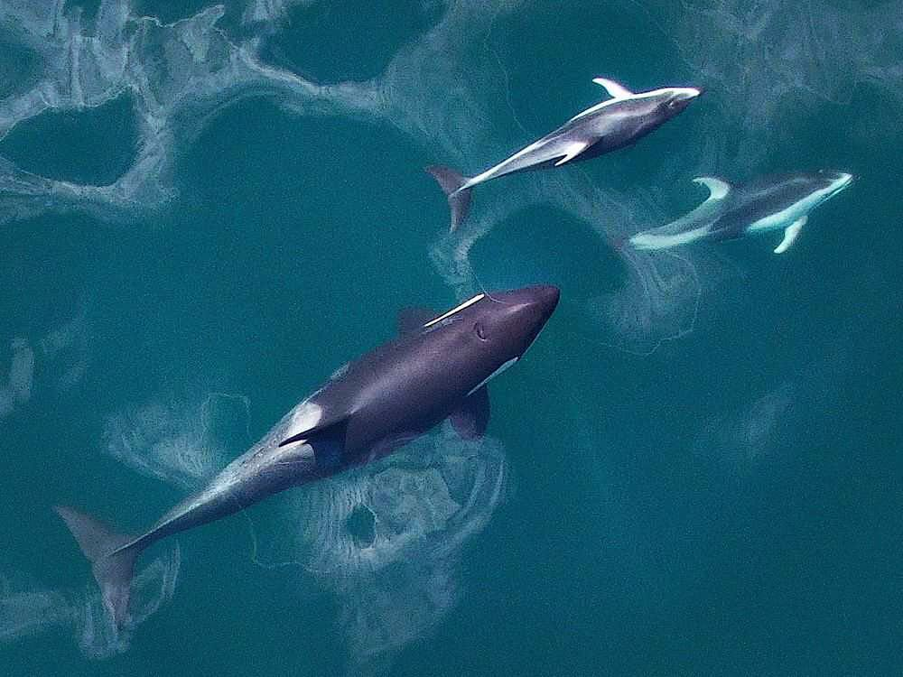
Research Approach
The preceding study (Reis and McLoughlin, 2019) used survey data (Hammond et al., 2002; Hammond et al., 2007; Hammond et al., 2013; JNCC, 2013) to identify relevant migratory routes of the three whale populations being considered.
Desk based research was then undertaken to identify local, national and regional codes of conduct for those areas identified.
The search terms “marine code”, “marine code of conduct”, “whale-watch code of conduct”, “whale watch code”, “whale watch guidelines”, “marine wildlife guidelines” and “marine wildlife code” were used.
Finally, thematic analysis was used to categorise management measures cited in the literature and
Frequency of occurrence and best practice were identified.
Pacific white-sided dolphins hanging out with an Orca. Source: Raincoasteco

Slide 7
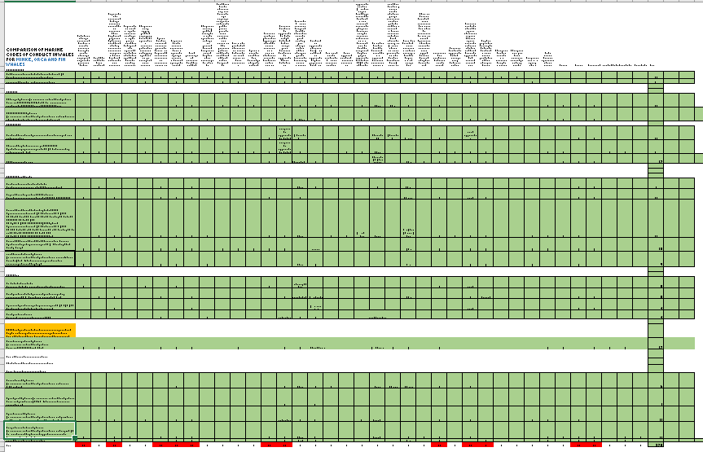
Discussion and Results
Twenty two codes of conduct were identified, which included 37 management measures. Many of these contradicted one another in terms of recommendations for maximum numbers of boats, minimum distance, speed, direction of approach, stay time, advice on swimming with cetaceans, group division, feeding, chasing, direction of approach and avoiding juveniles (Reis and McLoughlin, 2019).
In order to consolidate the number of recommendations in any future overarching code of conduct, it was decided to only include those management measures which had been cited by 10 or more of the 22 codes of conduct. These were then ranked in order of frequency. This approach captures the main recommendations, helps to prioritise and minimises contradictions. Table 1 shows the results.
Best practice in the form of most stringent measures was extrapolated from the 22 codes of conduct for the following criteria: approach speed, maximum approach distance, maximum stay time and maximum number of boats. Table 2 shows results.

Slide 8
Table 1. Priority Code of Conduct Measures, Ranked by Frequency of Citation
Number of codes recommending the measure (n=22) | Recommendation
17 | No person or boat shall cause any cetacean to become separated from a group.
16 | No person shall use motorised swimming aids for cetacean watching.
15 | If a cetacean shows avoidance behaviour, it must not be pursued.
13 | Do not swim with cetaceans.
13 | Extra caution needs to be taken by the operator when calves are present.
13 | Cetaceans should always be approached from the side and slightly behind, with the boat moving in parallel.
12 | No deliberate chasing of cetaceans.
12 | No person shall make excessive loud, disturbing or continuous noise.
12 | Do not touch cetaceans.
11 | Operators should not enter restricted zones or areas protected from boats or swimmers as designated by local, national, or international law, conventions or agreements.
11 | Cetaceans always have right of way.
10 | If cetaceans bow-ride alongside the boat, the boat should remain at a constant speed with no sudden changes in direction.

Slide 9
Table 2. Best Practice
Measure | Limit
Approach speed | 300m, no wake speed
Maximum approach distance | 100m
Maximum stay time | 15 minutes
Maximum number of boats | 1

Slide 10
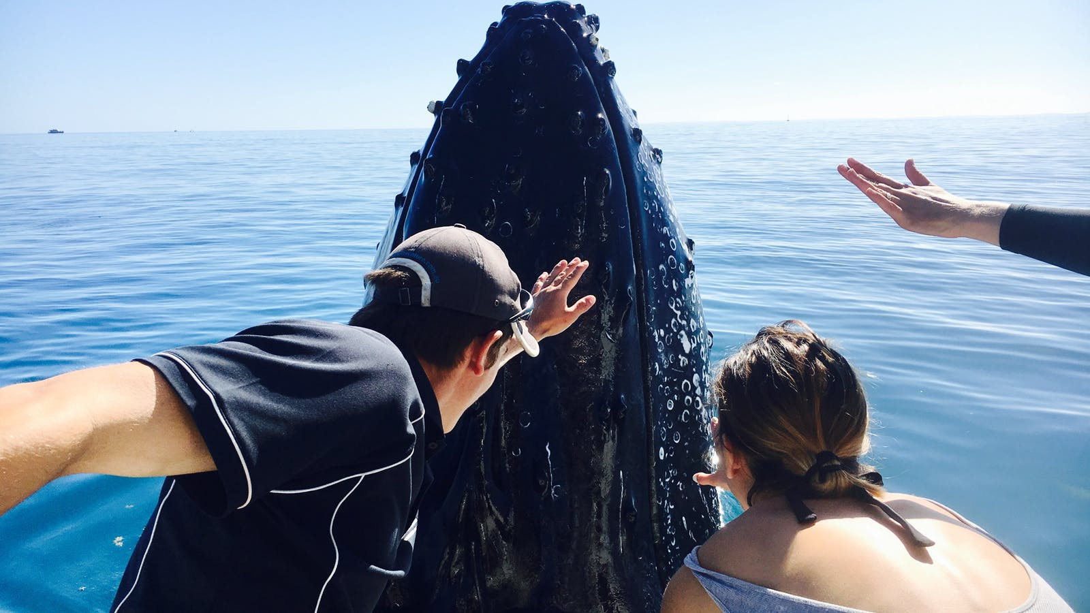
Synthesis- So What?
Using this approach, the number of recommended management measures has been reduced from 37 to 12 and clarity around best practice for approach speed, distance, stay time and maximum number of boats has been provided.
This is much more mangeable for boat operators and more likely to be adhered to.
“No Touching”
https://www.visitfrasercoast.com/Detail/ID/Remote-Fraser-Island-Experience-and-Whale-Watch-Encounter-Tasman-Venture

Slide 11
Limitations
As an early piece of research, it is recognised that there are a number of shortcomings.
Firstly, the research was fairly simplistic and relied on subjective interpretation of a relatively limited sample size.
Secondly, some of the sources of literature were dated and therefore might be redundant, and thirdly,
Reports were multi-lingual and so could have been mis-interpreted.
It is also possible that codes of conduct were missed if they were only available in hard copy.
Codes of Conduct have a vital role to play in reducing the negative impact of marine wildlife tourism and sustaining the industry for future generations.

Slide 12
What’s Next?
It is accepted that even if codes are streamlined, they still need to be supplemented by local education and training activities, not only for commercial boat operators, but also for recreational boat owners.
Furthermore, while codes of conduct are fundamentally voluntary in nature, their effectiveness relies on clear links to existing wildlife legislation and recognition and adoption by statutory agencies with a monitoring role.
Further research is required to explore factors (eg. level of knowledge, payment, accreditation schemes etc.) that might positively influence adoption of codes. Ideally this would be undertaken jointly with statutory agencies.

Slide 13
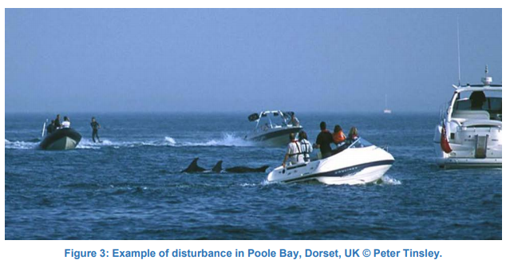
Thank you for your attention.
Any questions?
Dr Jeanette Reis, Cardiff Metropolitan University
JReis@cardiffmet.ac.uk

Slide 14
References
Cisneros-Montemayor, A., Sumaila, U., Kaschner, K. and Pauly, D. (2010) The Global Potential for Whale Watching. Marine Policy, 34(6), pp.1273-1278.
Gjerdalen, G. & Williams, P.W. (2000). An Evaluation of the Utility of a Whale Watching Code of Conduct. Tourism & Recreation Research. 25 (2), pp 27-36.
Hammond, P., Berggren, P., Benke, H., Borchers, D., Collet, A., Heide-Jorgensen, M. and Oien, N. (2002) Abundance of Harbour Porpoise and Other Cetacenas in the North Sea and Adjacent Waters. Journal of Applied Ecology, 39, pp361-376.
Hammond, P., Macleod, K., Berggren, P., Borchers, D., Burt, L., Cañadas, A., Desportes, G., Donovan, G., Gilles, A., Gillespie, D., Gordon, J., Hiby, L., Kuklik, I., Leaper, R., Lehnert, K., Leopold, M., Lovell, P., Øien, N., Paxton, C., Ridoux, V., Rogan, E., Samarra, F., Scheidat, M., Sequeira, M., Siebert, U., Skov, H., Swift, R., Tasker, M., Teilmann, J., Van Canneyt, O. and Vázquez, J. (2013). Cetacean Abundance and Distribution in European Atlantic Shelf Waters to Inform Conservation and Management. Biological Conservation, 164, pp.107-122.
JNCC (1) (2013) Third Report by the United Kingdom under Article 17 on the Implementation of the Directive from January 2007 to December 2012 Conservation Status Assessment for S2027 Minke Whale (Balaenoptera Acutorostrata). Joint Nature Conservancy Council.
JNCC(2) (2013) Third Report by the United Kingdom under Article 17 on the implementation of the Directive from January 2007 to December 2012 Conservation Status Assessment for S2027 Killer Whale (Orcinus Orca). Joint Nature Conservancy Council.
JNCC(3) (2013) Third Report by the United Kingdom under Article 17 on the Implementation of the Directive from January 2007 to December 2012 Conservation Status Assessment for S2621 Fin whale (Balaenoptera Physalus). Joint Nature Conservancy Council.
Hammond, P., Macleod, K., Gillespie, D., Swift, R., Winship, A., Burt, M. and Rogan E. (2007) Cetacean Offshore Distribution and Abundance in the European Atlantic (CODA). Published by the Sea Mammal Research Unit, University of St Andrews, Fife.
Inman, A., Brooker, E., Dolman, S., McCann, R. and Wilson, A. (2016) The Use of Marine Wildlife-Watching Codes and their Role in Managing Activities within Marine Protected Areas in Scotland. Ocean & Coastal Management, 132, pp1-11.
Marino, L., Gulland, F. and Parsons, E. (2012). Protecting Wild Dolphins and Whales: Current Crises, Strategies, and Future Projections. Journal of Marine Biology, 2012, pp.1-2.
MMC (2019) The Economics of Marine Mammals. Published by the Marine Mammal Commission.
Ramseyisland.co.uk (2019) Boat Trips. Available at: https://www.ramseyisland.co.uk/boat-trips/whale-dolphin-watch/ [Accessed 16 April 2019].
New, L., Hall, A., Harcourt, R., Kaufman, G., Parsons, E., Pearson, H., Cosentino, A. and Schick, R. (2015). The Modelling and Assessment of Whale-Watching Impacts. Ocean & Coastal Management, 115, pp.10-16.
Parsons, E. (2012). The Negative Impacts of Whale-Watching. Journal of Marine Biology, 2012, pp.1-9.
Reis, J. & McLoughlin, E. (2019) Which way now? Comparison of marine codes of conduct for sustainable marine wildlife tourism in West Wales. Journal on Tourism and Sustainability. Vol 3 (1). Pp. 49-61.
Tripadvisor.co.uk (2019) St Davids Activities. Available at: https://www.tripadvisor.co.uk/Attractions-g552051-Activities-c61-t188-st_Davids_St_Davids_Peninsula_Pembrokeshire_Wales.html [Accessed 16 April 2019].
Visit Britain (2019) The GB Tourist 2017 Annual Report. Published by Visit England, Visit Scotland and Visit Wales. Available at: https://gov.wales/sites/default/files/statistics-and-research/2019-03/the-great-britain-tourist-statistics-2017.pdf [Accessed16 April 2019].
WCA (2019) Global Best Practice Guidelines 2019. Published by the World Cetacean Alliance. Available at: http://worldcetaceanalliance.org/global-guidelines/ [Accessed 22 February 2019].

