Slide 1
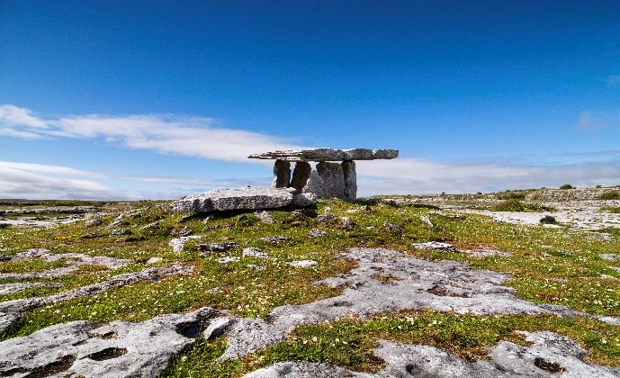
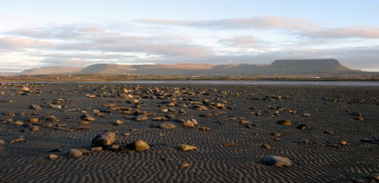
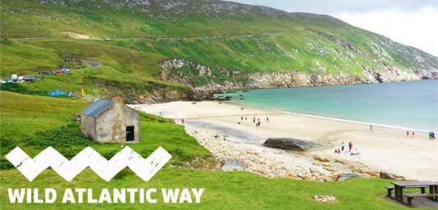
Social Impacts of Tourism in Clare, Donegal and Sligo
Dr Emmet McLoughlin, Dr James Hanrahan, Dr Ann Marie Duddy, Dr Seán Duffy and Dr Seán T Ruane
Introduction
Results and Analysis
Irelands popularity as a tourist destination could be attributed to its array of tourism products such as the 2,500 km Wild Atlantic Way (WAW) with the Cliffs of Mohar alone receiving 1,427,166 visitors in 2016. Issues such as community impacts, health and safety, gender equality, inclusion and accessibility and the protection of local heritage all highlight the need for data collection locally on the impact of Irelands flourishing tourism industry.
Sustainable tourism indicator data did vary along the WAW in issues pertaining to the category community and social impacts which included tourism penetration rate, number of secondary holiday homes and resident’s satisfaction with tourism.
Resident Satisfaction and Penetration Ratio of tourists to 100 residents
Results pertaining to gender equality did differ, with the percentage of women holding the position of general manager varying between the three counties.
Data gathered though the ETIS shows that the local tourism industry in each of the three counties does not tend to employ a considerably different proportion of women, when compared to men
Men and Women Employed in the Tourism Sector
Wild Atlantic Way Research Group
This research group formed with a principal focus on investigating and contributing to the sustainable development of tourism along the WAW and to better understand the key indicators for sustainable destination management.
European Tourism Indicator System (ETIS)
Analysis of these surveys revealed that the percentage of rooms in commercial accommodation accessible to people with disabilities across Counties Clare, Donegal and Sligo was found to differ considerably
Destinations have made significant efforts in making tourism accessible for visitors with a disability along the WAW.
The ETIS is a free indicator system developed by the European Commission (EC)
This particular indicator system contains thirteen social and cultural indicators to enable destinations to monitor their sustainability performance and progress over time
Inclusion/Accessibility
Source: EC (2016)
In Clare 62% of accommodation was accessible to people with disabilities. This value was somewhat lower in Sligo (53%) and lowest in Donegal (48%). .
This trend is reflected in accommodation participating in recognised accessibility schemes with 28% of accommodation participating in these schemes in Co. Clare, 25% in Donegal and 16% in Sligo.
Similar trends were evident among tourist attractions participating in recognised accessibility schemes with the highest number of attractions participating in these schemes in Co. Clare (50%) and a much lower level of participation in Donegal (23%) and Sligo (22%).
Three of the social and cultural indicators of the ETIS also complement the EEA TOUERM (Tourism and Environment Reporting Mechanism) which seeks to measure the environmental impacts and sustainability trends of tourism in Europe.
This comparative study contributes to new knowledge by presenting the results from the application of all thirteen social and cultural indicators of the ETIS across three different destinations along WAW.
Methodological Approach
The three destinations chosen for the pilot study were Counties Donegal. Clare and Sligo, all located along the WAW.
Surveys were carried out in several ‘honey pot’ destinations in each of the three counties.
Conclusion
It is clear that the development of tourism does affect local communities in varying degrees.
The evolving smart tourism landscape provides a perfect opportunity to drive sustainability in tourism through data collection.
This evidence based approach to tourism planning can facilitate Local Authorities in developing future tourism plans with a with a long-term vision with an emphasis on sustainability.
Preliminary research was desk-based and investigated the availability of information on the various indicators held by a variety of organisations
All visitor, resident and enterprise surveys were then undertaken using the survey templates provided in the ETIS toolkit.
Sample numbers for surveys were determined by the use of a standard formula, which used the number of the entire population and applying a confidence level of 95% and a standard margin of error of 8%.
All calculations were facilitated through the formulas provided by the ETIS
Dr Emmet McLoughlin,
Postdoctoral Researcher
Mobilities Research Unit, Institute of Technology, Sligo.
Office: D2018, Phone: (071) 915 5222 ext. 5805. Email: Emmet.mcloughlin@mail.itsligo.ie

