Slide 1
Enhancing Postgraduate Study: the use of Enhancement Weeks
Mark Sutcliffe Kallie Noble

Slide 2
The Lee Major Question.
If you could enhance your students, what enhancement would you give them? (Your enhancement can be knowledge, skill attribute or competence based….physical enhancements are not allowed!)
What benefits would this enhancement have for students?
What benefits would this enhancement have for you as a tutor?
Imagine, you have a week, free from the normal requirements of teaching and learning to add your enhancement. What would you do to achieve this?

Slide 3
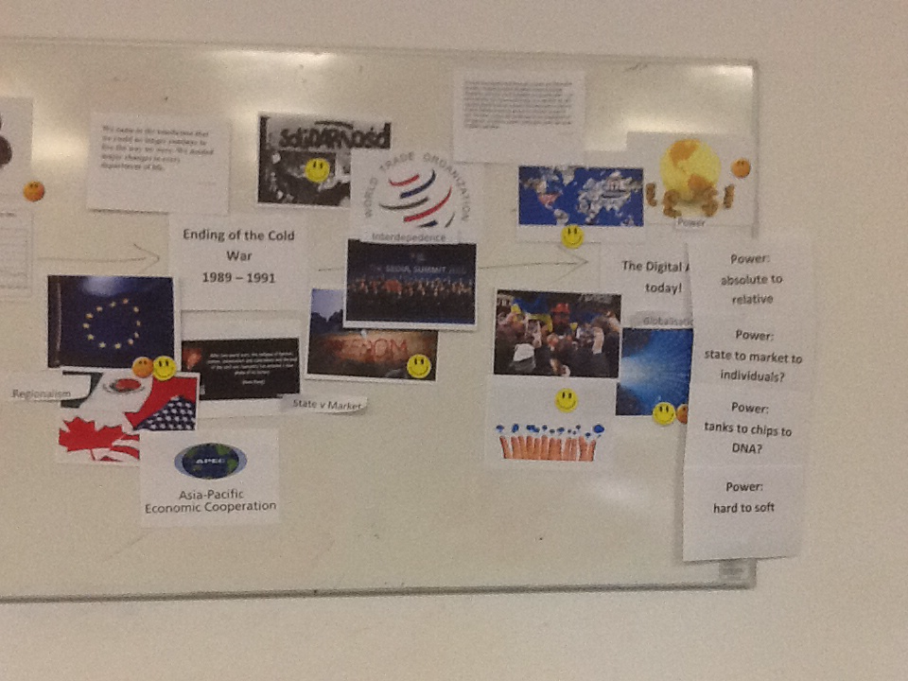
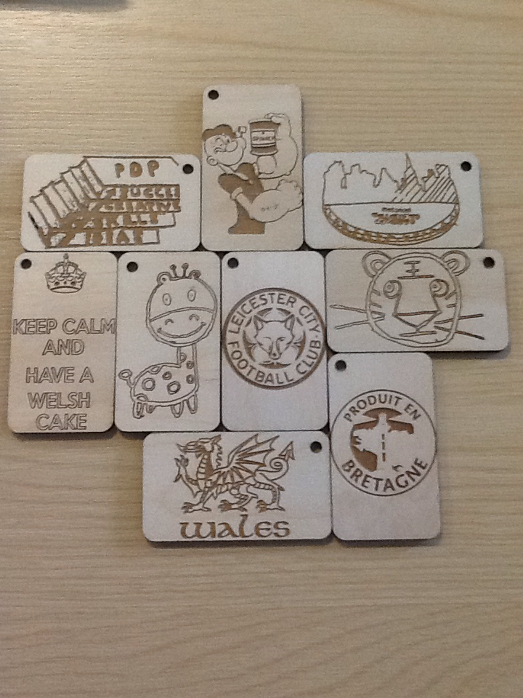
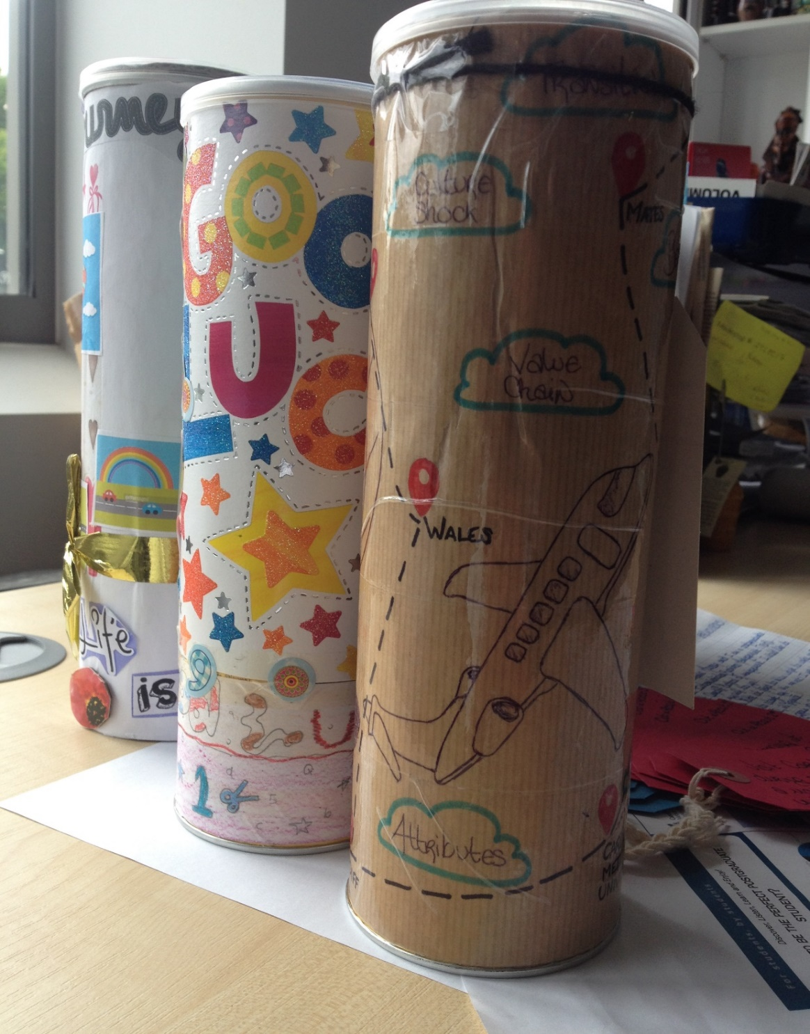
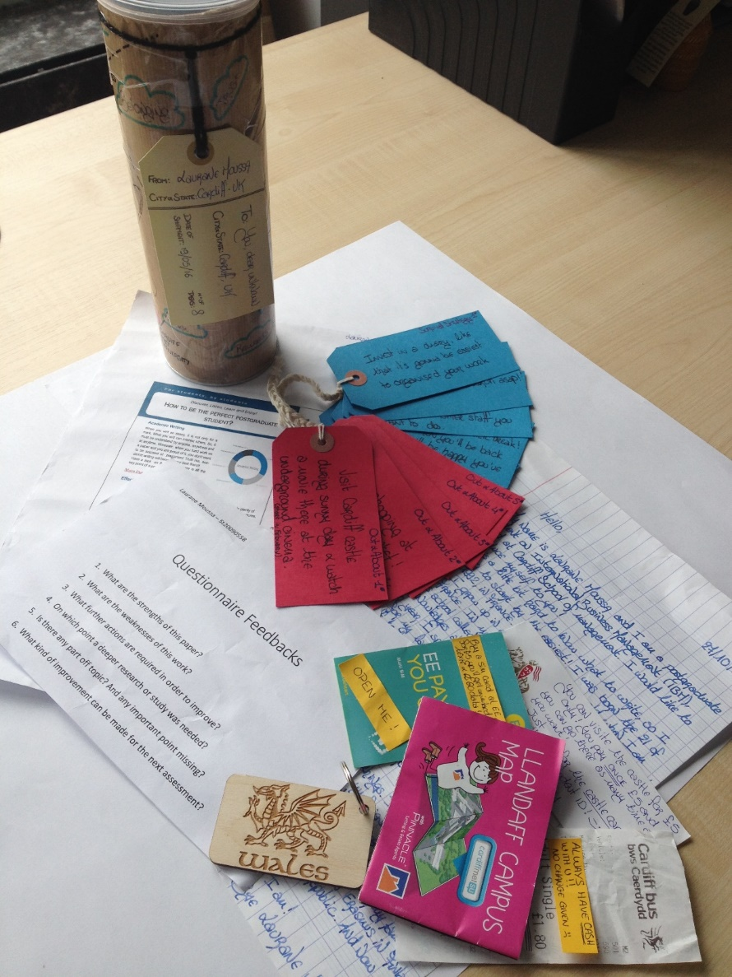
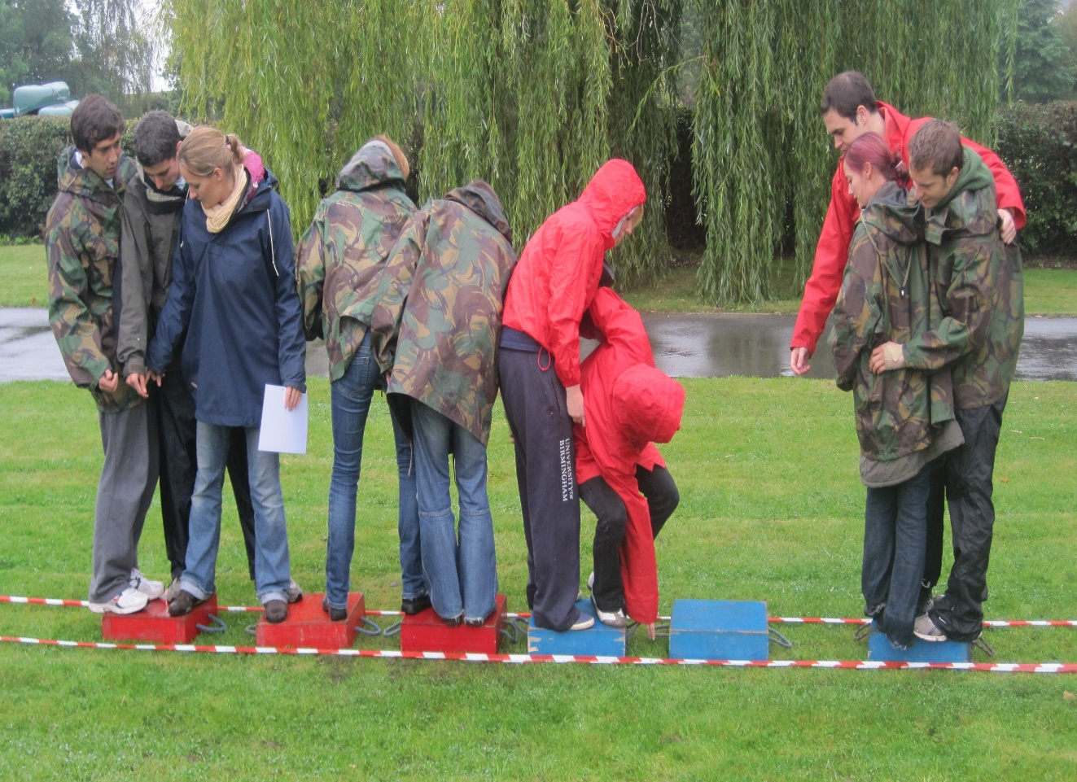
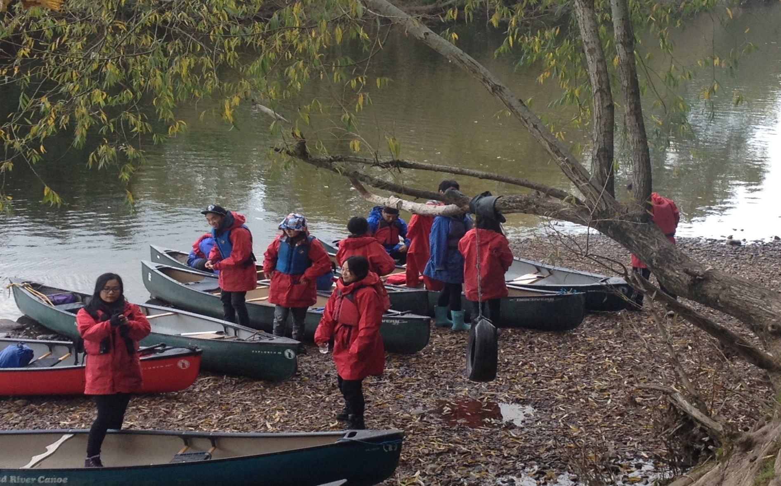
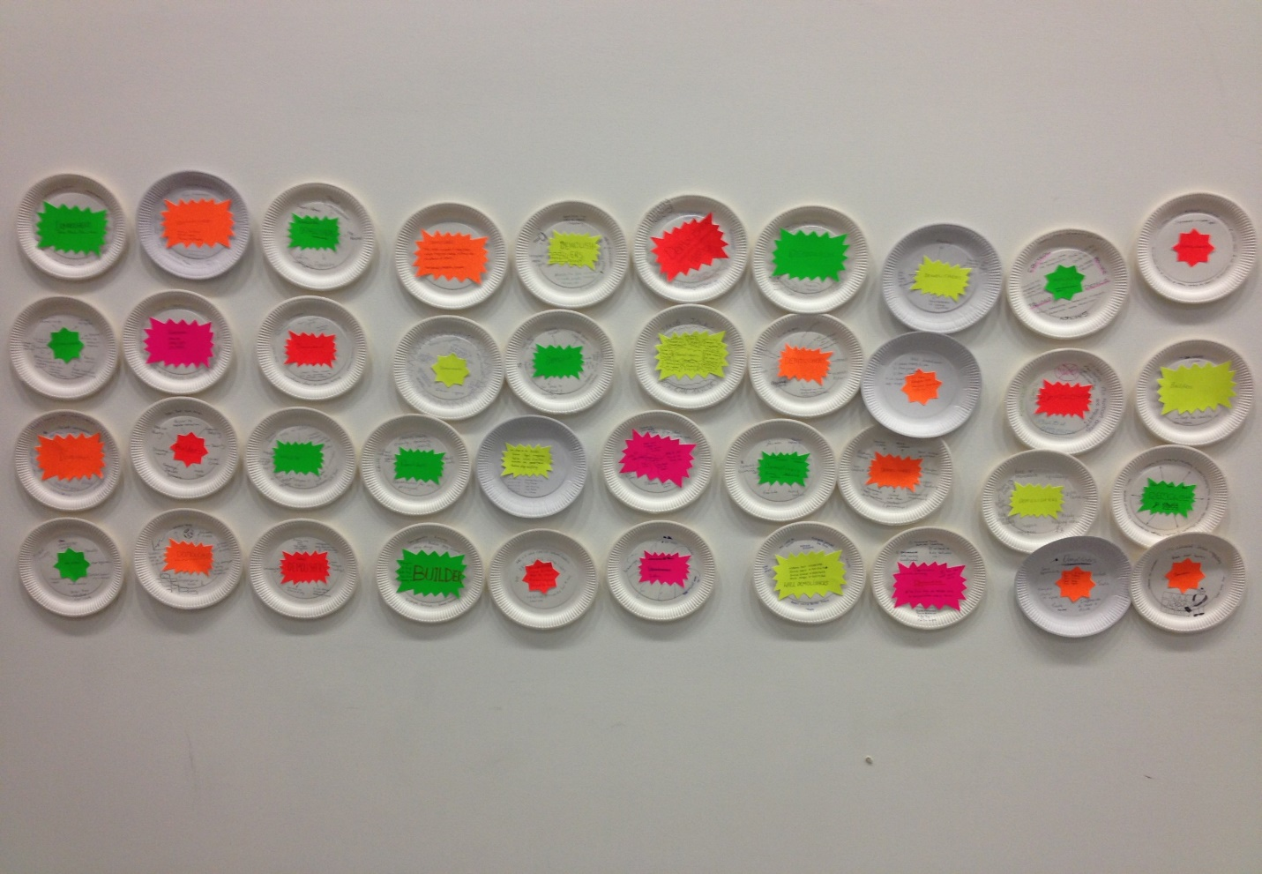
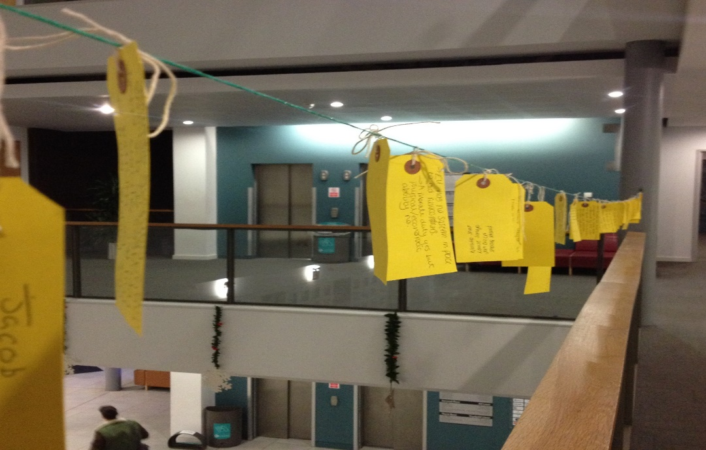
Montage of MSc IBM activities and stuff.

Slide 4
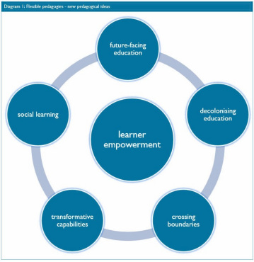
Programme designed around Ryan and Tilbury’s (2013) Flexible Pedagogy.
We asked ourselves ….”What enhancements did we need in order to deliver and make this programme more effective?”
Promotion of creative thinking and solutions (active and problem based learning strategy).
Decolonising education – promotion of effective team working in multi-cultural teams/trust enhancement (help with Transformations)
Learner empowerment – determination and shaping of content and approach, responsibility (help with Scrapbook)
Social learning – blended learning, digital enhancement (development of AR)
Transformative capabilities – putting learning into practice, creating competence at Level 7.
How best to do this? The Enhancement Week genesis.
So what did we do in the Enhancement Week in order to realise some/all of these requirements?

Slide 5
The Zine

Slide 6
Brand U
Current job market..
Notes:
Brand U

Slide 7
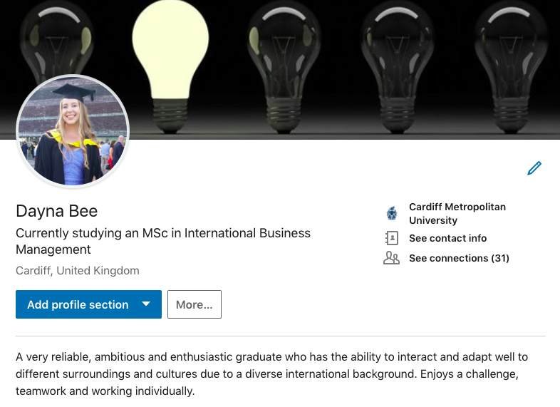
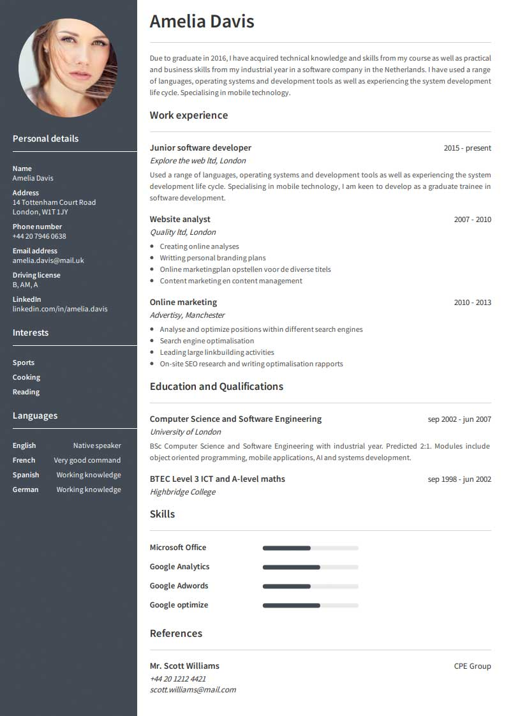
Living CV
Notes:
https://drive.google.com/file/d/1kK0cITa1xvFtbSvShuLADdGf9UMXGTnK/view

Slide 8
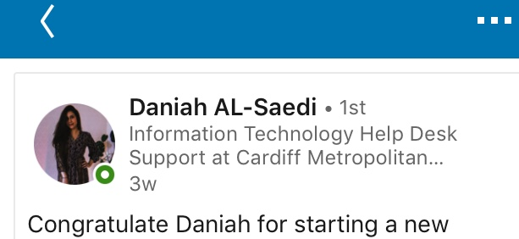

Slide 9
The Lee Major Question.
Imagine, you have a week, free from the normal requirements of teaching and learning to add your enhancement. What would you do to achieve this?
Are you inspired?

